Slide 1
Fall 2021 AP CS A
Lesson 9.5
Dr. O’Brien
Herbert H. Lehman High School
8 April 2022

Slide 2
Do now
$\text{factorial}(n)$ (also written $n!$)
The product of all numbers from $n$…to 1
Be sure to…
Review the vocab items to the left (you don’t need to copy these down)
Find the factorial $5!$.
Find the number of combinations of length 3 from a group of 4 items. Show all work
combination
A selection of items from a group of choices. The number of combinations of $r$ items from a group of $n$ choices is given by $\frac{n!}{r!(n-r)!}$
Notes:
5! = 5*4*3*2*1 = 120
num combinations:
4! / 3!(4-3)! = 4! / 3!*1! = 4! / 3! = 4*3*2*1 / 3*2*1 = 4

Slide 3
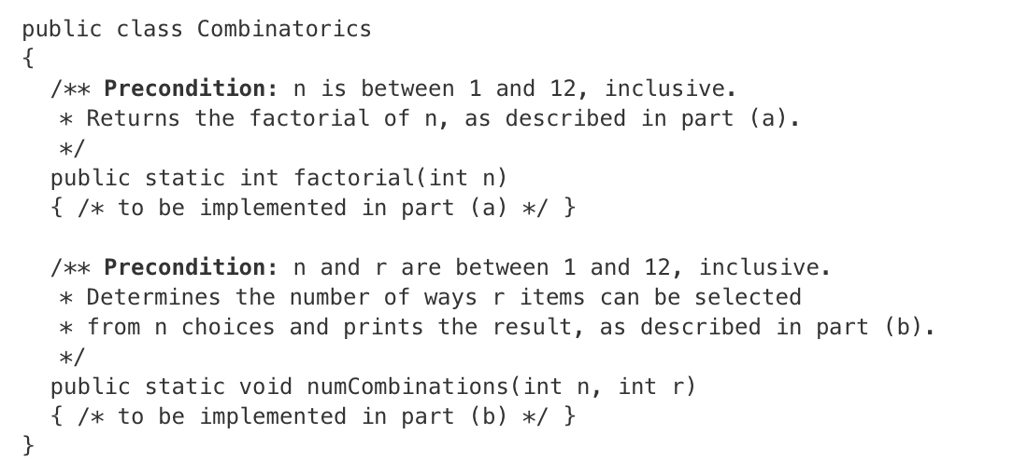
Warm up: writing to learn
Be sure to…
Review the unfinished class to the left
Answer the questions below:
What methods need to be completed?
What do you think these methods do?
What remaining questions do you have?

Slide 4
Today’s activity: MC practice quiz
Find a workstation at least two apart from the nearest student.
Login to AP Classroom. Work on AP Practice MC Quiz.
20 questions
spend the whole period working on it
If you finish early continue to work on FRQ Assignment

Slide 5
framing
what: use recursion to search through data
why: Recursion is a very powerful tool for making algorithms. We’ll see how it makes search easier.
where to: Using recursion in sorting algorithms

