Slide 1
Fall 2021 AP CS A
Lesson 11.2
Dr. O’Brien
Herbert H. Lehman High School
November 30, 2021
Notes:
VOCAB:
nested loop

Slide 2
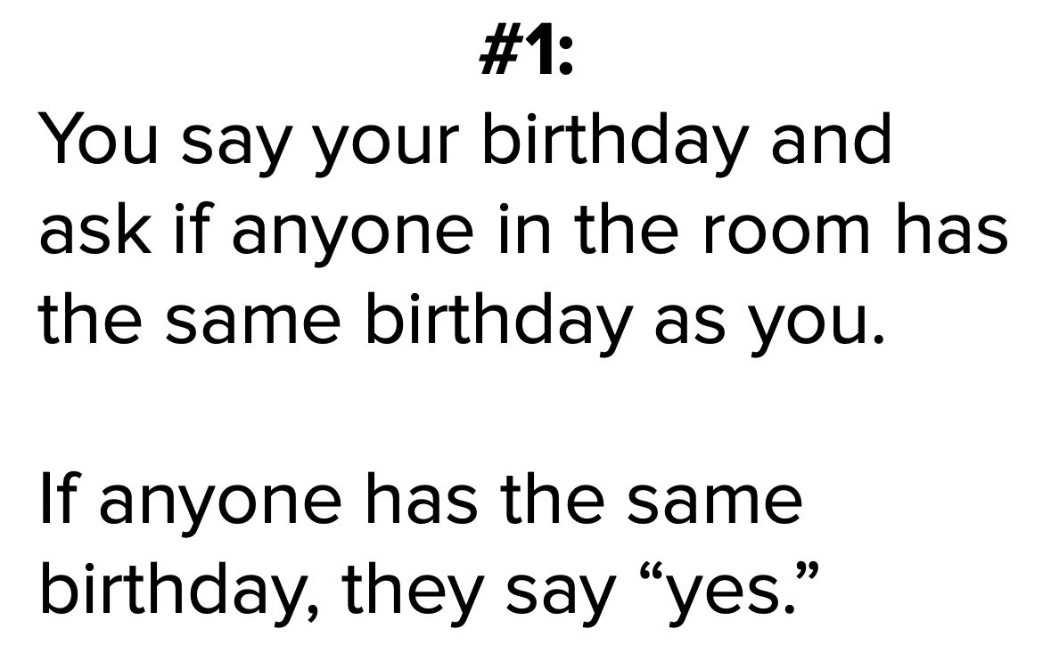
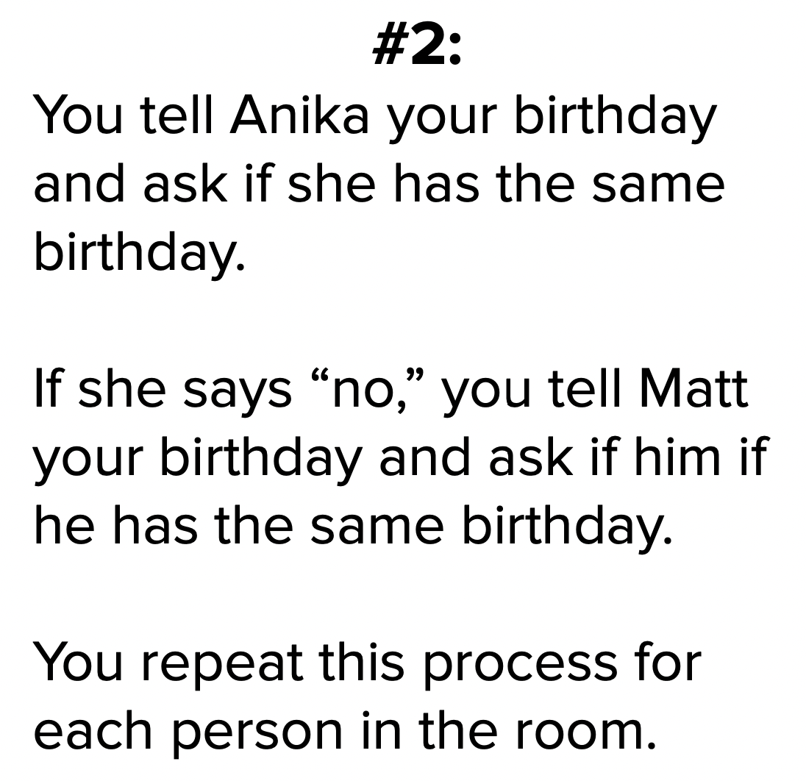

Do now
be sure to: Get out your binder. Copy goal and answer do now questions below. Show all work or write a complete sentence for each answer:
Below are two algorithms for finding someone with the same Birthday as you. Which one do you think is more efficient? Explain why.
Notes:
1 seems more efficient, since you’re only asking one question.
+How can we measure ‘efficiency’? which operation is faster? One will probably take less time
+What might be some problems with situation (1)? if a lot of people share the same birthday as you, it might get confusing.

Slide 3
framing
what: HDW use informal run-time comparison to analyze algorithmic efficiency?
why: Efficient algorithms save time and money ($).
where to: Test next week. Then writing classes.

Slide 4
Vocab
be sure to: Keep your notebook open. Copy each definition, in your Java Glossary.
Algorithm
A step-by-step procedure for solving a problem
Statement execution count
The number of times a statement is executed by a program.

Slide 5
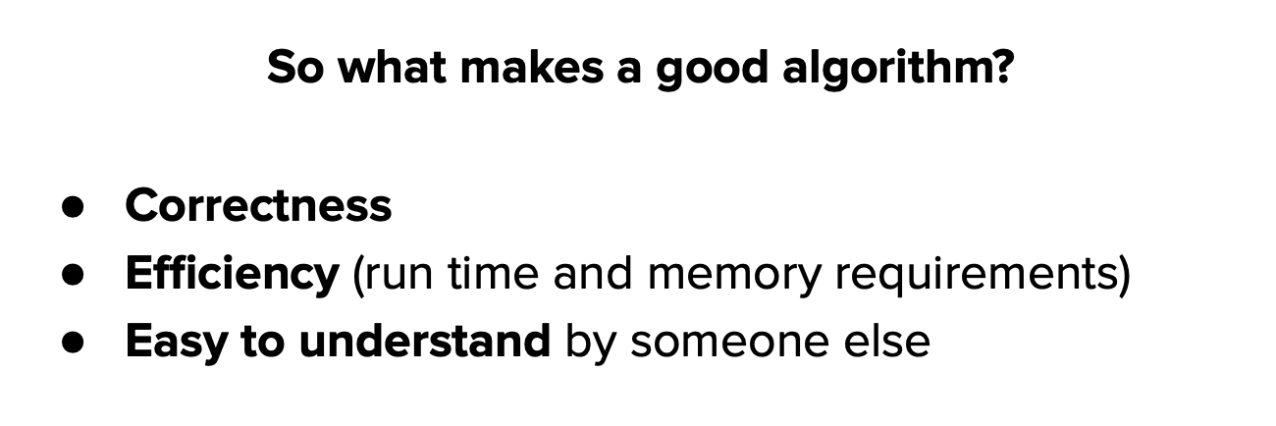
Mini-lesson
be sure to: Take notes and answer questions in your notebook.
Algorithm
A step-by-step procedure for solving a problem
Notes:
Copy in your notes!

Slide 6
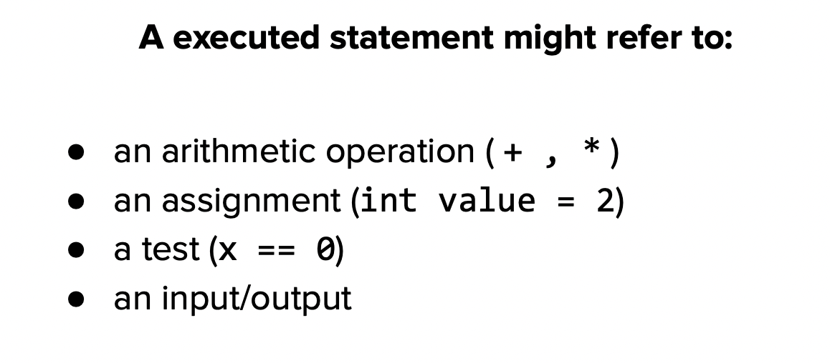
Mini-lesson
be sure to: Take notes and answer questions in your notebook.
Statement execution count
The number of times a statement is executed by a program.
Notes:
Make a table of numbers with five columns where the numbers in each row are a multiple of the top row.
Make a string and add 1 + 2. + 3 +4 +5. A loop could be useful with this.
Multiple each number by 2.
for each number i in 1-5:
for each number j in 1-5:
add i*j to column

Slide 7
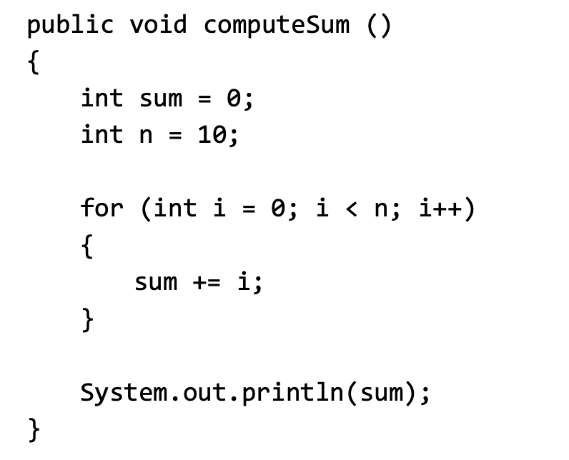
Mini-lesson
be sure to: Take notes and answer questions in your notebook.
measure the execution count for this program
Statement execution count
The number of times a statement is executed by a program.
Notes:
+How do we measure the execution count for this statement?
execution count: 1 + 1 + n + 1 = 3 + n; = 13

Slide 8
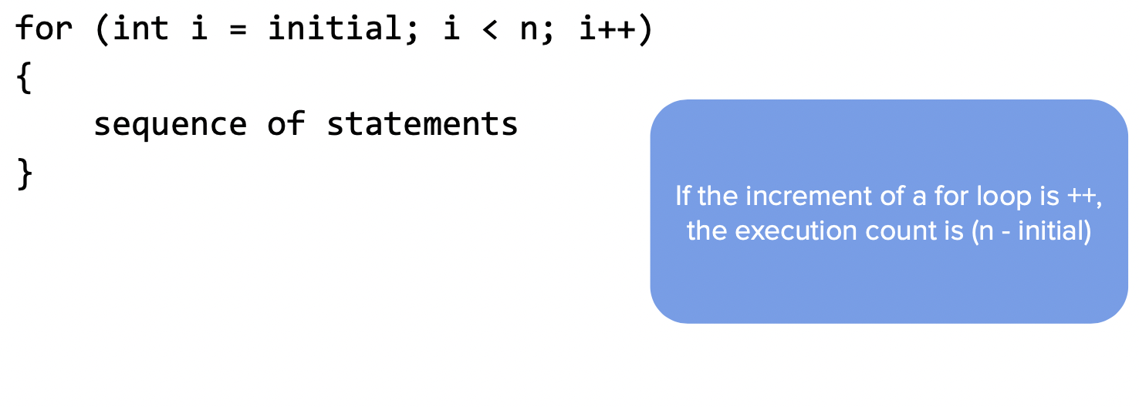
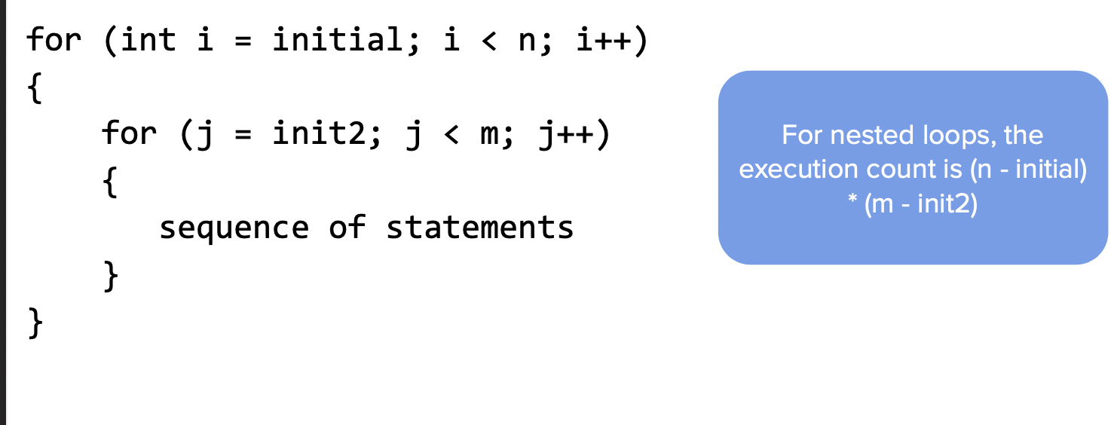
Mini-lesson
be sure to: Take notes and answer questions in your notebook.
Notes:
copy notes in bubble

Slide 9
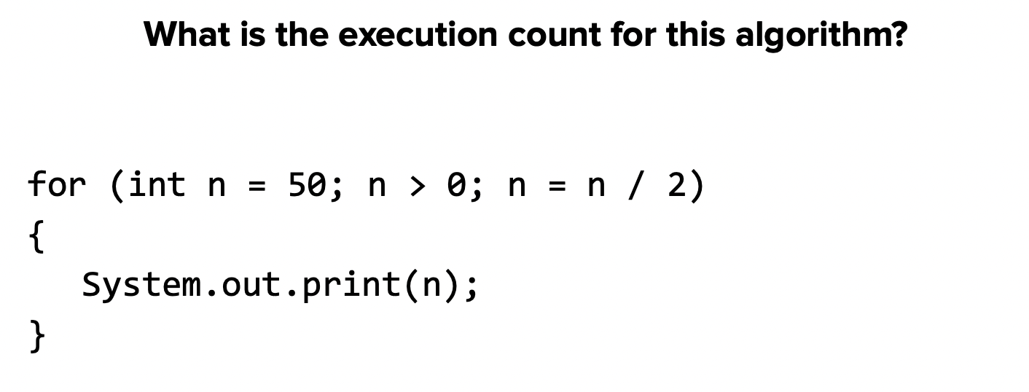
Practice problem #1
be sure to: Take notes and answer questions in your notebook.
Notes:
50 25 12 6 3 1 = 6

Slide 10
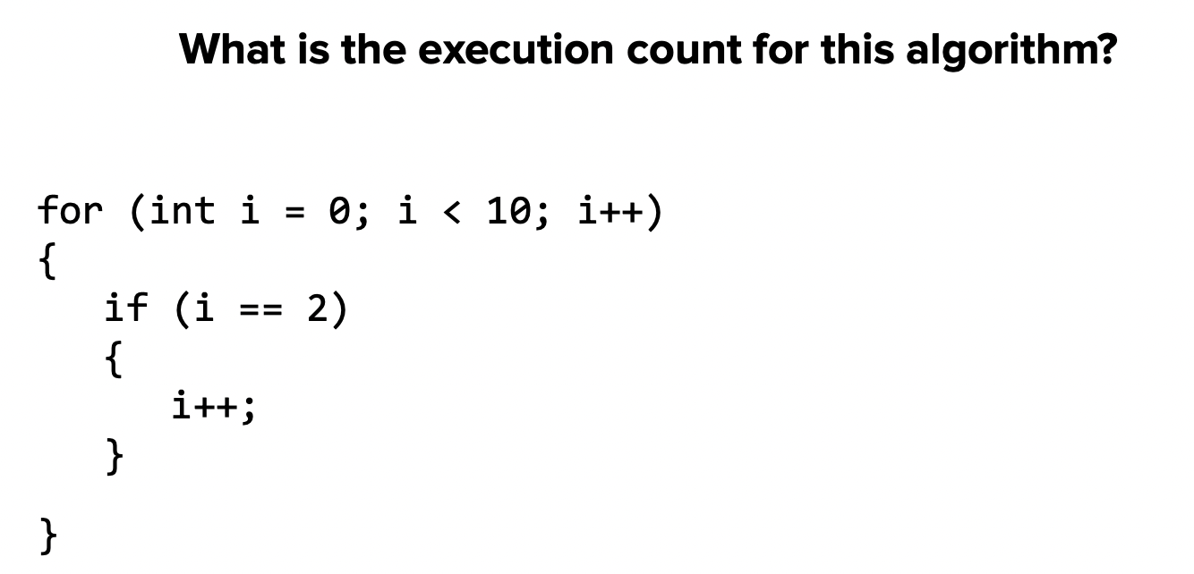
Practice problem #2
be sure to: Take notes and answer questions in your notebook.
Practice problem #2
be sure to: Take notes and answer questions in your notebook.

Slide 11
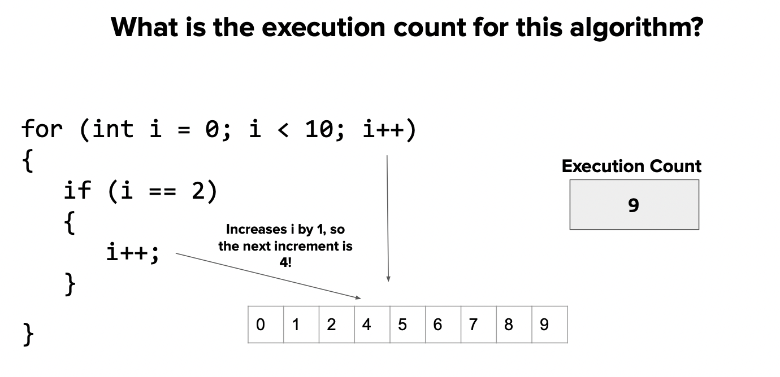
Practice problem #2
be sure to: Take notes and answer questions in your notebook.

Slide 12
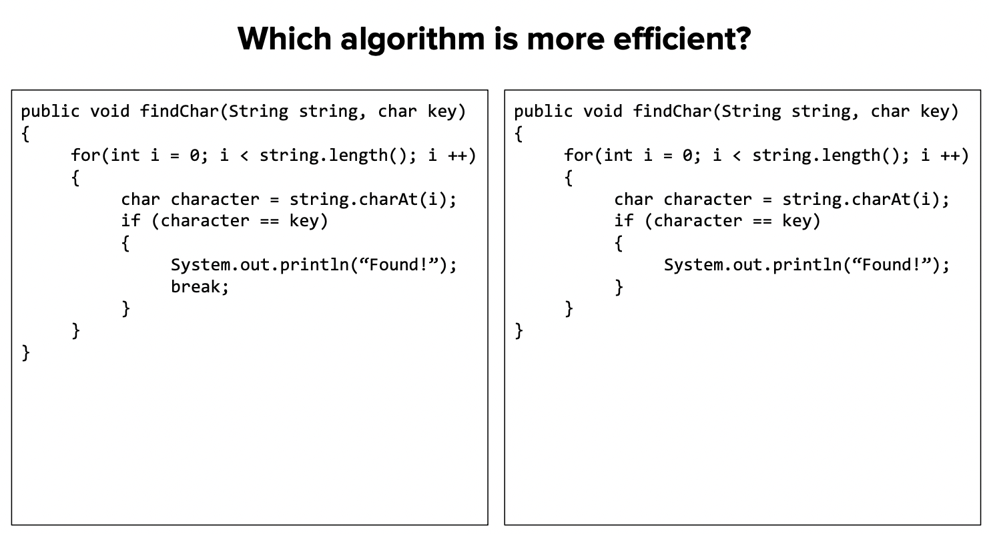
Practice problem #3
be sure to: Take notes and answer questions in your notebook.

Slide 13
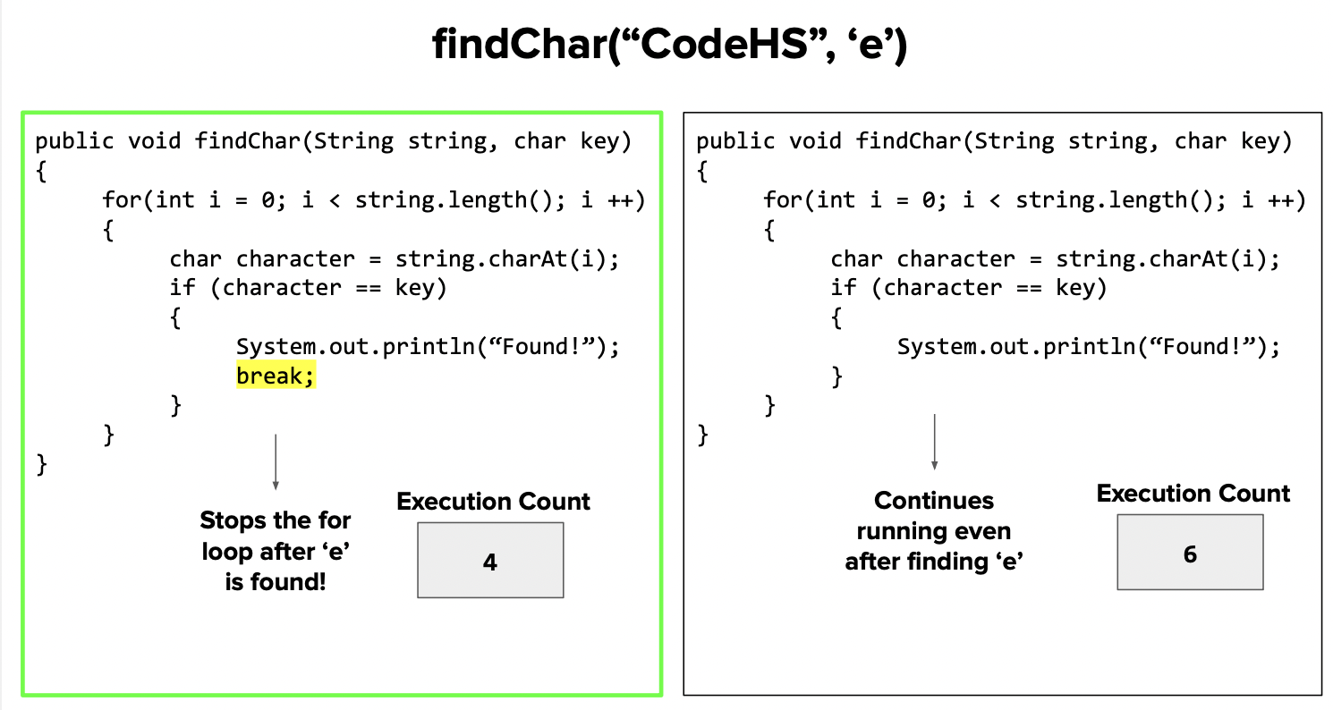
Practice problem #3
be sure to: Take notes and answer questions in your notebook.

Slide 14
Coding to learn
be sure to: Log in to Workstation. Work on CodeHS exercises below. Make sure to write out a plan before you start coding!
Algorithm
A step-by-step procedure for solving a problem
CodeHS lesson 4.5
Statement execution count
The number of times a statement is executed by a program.
Notes:
BE SURE TO WRITE OUT A PLAN
+How could you use .indexOf() to solve the password checker assignment? You could make a string containing all lower case letters. and all digits 0-9. then you could check if a given character is in them because if not you’ll return -1.
+
+How is fixing grammar similar to the ‘remove’ method we discussed in the mini-lesson? It’s similar in that we want to make a new string with the corrected form of the input string.

Slide 15
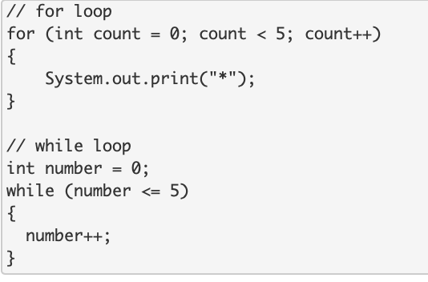
exit ticket
be sure to: Answer each question below with a complete sentence.
How many times does this code iterate?
What are some differences between the for loop and the while loop in terms of execution count?
Notes:
How many times does the for loop iterate? How many times does the while loop iterate? Why are they different?
The for loop will iterate 5 times. The while loop will iterate 6 times. The while loop will iterate one more time because the inequality <= is used instead of <. The while loop will run when the variable = 5 whereas the for loop will not.

