Slide 1
Fall 2021 Pre-calculus
Lesson 11.2
Dr. O’Brien
Lehman High School
November 30, 2021
Notes:
Circles of evaluation
Yret

Slide 2
Do now
be sure to: find seat. Get out your binder and answer the do now questions below. Show all work or answer each question with a complete sentence.
What will each function evaluate to if $x=3$ and $y=4$?
How could you describe the domain and range for these functions?
$$f(x)=x+3$$
$$g(x,y)=x+y$$
Notes:
f(3) = 6, g(3,4) = 7
The domain of f is real numbers, the domain of g is pairs of real numbers. range for each is all real numbers.
+What are the arguments for these functions? in

Slide 3
framing
what: use contracts to represent the domain and range of functions
why: In this unit we’ll be applying our mathematical knowledge to make a video game using the programming language Pyret
where to: Next we explore function composition in Pyret

Slide 4
Vocabulary
be sure to: Open your computer. Navigate to code.pyret.org. Read instructions below
data types:
Numbers: values like 1 , 0.4 , 1/3 , and -8261.003 .
Strings: values like "Evangelina" , "Juan" , “Lehman Lions" , or even "08/28/2005"
Booleans: true and false
Notes:
Remind students about definitions area and interactions area.
+Why is it useful to pay attention to error messages? because they tell you exactly what’s going wrong.

Slide 5
Contracts
We use Contracts to help keep track of all our functions. Every Contract has three important parts:
The function’s name
Domain of the function - the type(s) of data we give it
Range of the function - the type of data the function produces
$$f(x)=x+3$$
$$g(x,y)=x+y$$
Notes:
CONTRACTS:
f :: Number -> Number
g :: Number Number -> Number

Slide 6
Coding to learn
be sure to: Open your computer. Navigate to code.pyret.org. Read instructions below. Answer the questions in your notebook.
In the interactions area, type num-sqrt(16)
What does this expression evaluate to?
What’s it’s domain and range?
What will the contract for this expression look like?
Notes:
What does this expression evaluate to? 4
What’s it’s domain and range? all real numbers greater than or equal to 0
What will the contract for this expression look like? num-sqrt :: Number -> Number

Slide 7
Coding to learn
be sure to: Open your computer. Navigate to code.pyret.org. Read instructions below. Answer the questions in your notebook.
In the interactions area, type string-length(“Lehman”)
What does this expression evaluate to?
What’s it’s domain and range?
What will the contract for this expression look like?
Notes:
What does this expression evaluate to? 4
What’s it’s domain and range? all real numbers greater than or equal to 0
What will the contract for this expression look like? string-length:: String -> Number
try the following code sequence:
string-length(“Lehman”)
string-length(“Lehman Lions”)
string-length(“42”)
string-length(42)
+What’s different about the last expression? It gets an error messagebecause the function only has strings in its domain

Slide 8
In the interactions area, type triangle(50, “solid”, “red”)
What does this expression evaluate to?
What’s it’s domain and range?
What will the contract for this expression look like?
The triangle function created an example of a new data type, called an Image.
Notes:
What does this expression evaluate to? 4
What’s it’s domain and range? all real numbers greater than or equal to 0
What will the contract for this expression look like? triangle:: Number String String -> Image
+how is this function different from the previous 2? We have multiple arguments

Slide 9
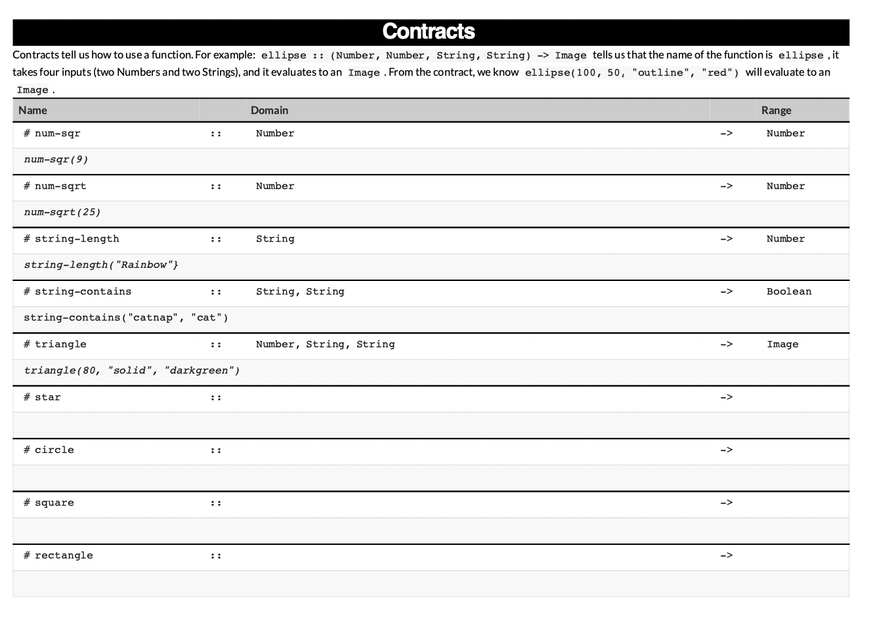
Coding to learn
be sure to: Work through each function with your partner figure out the appropriate contract..
Notes:
+what do you get if you type in…
Star
Star()
Star(5,5,5)
Etc.

Slide 10
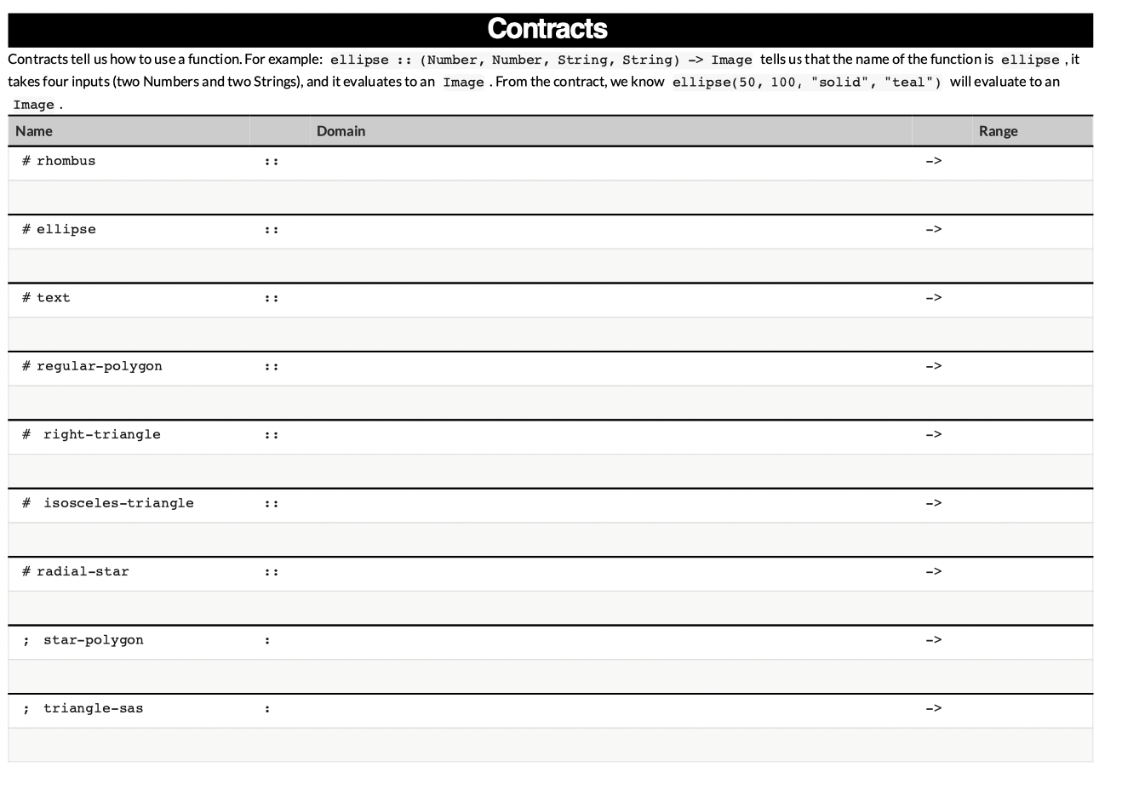
Coding to learn
be sure to: Work through each function with your partner figure out the appropriate contract..
Notes:
See bootstrap::algebra teacher resources for full answers

Slide 11
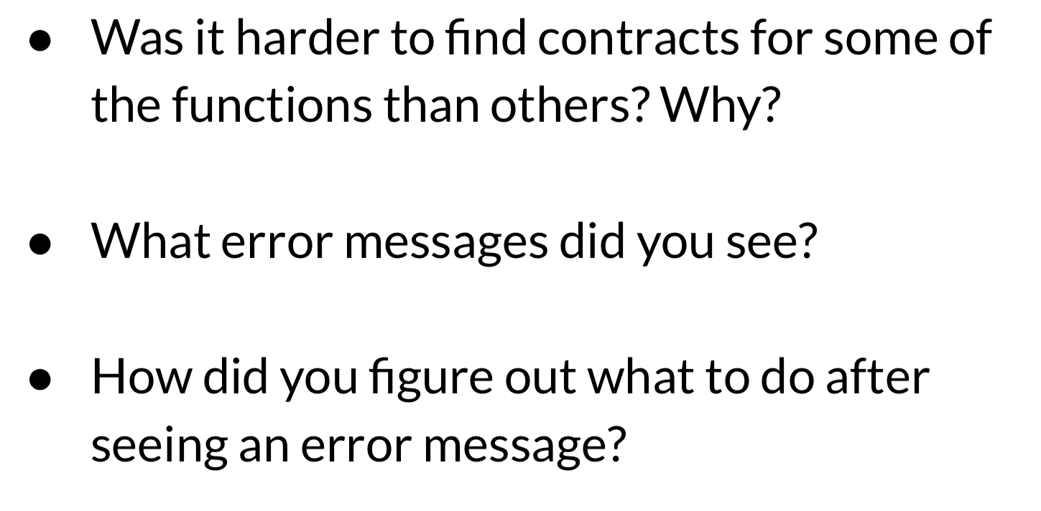
d
Reflection: Thinking about thinking
be sure to: Answer each question below with a complete sentence.
Notes:
Answers will vary. Some contracts have more arguments than others, error messages help by telling you exactly what sort of arguments you need. Students may also notice annotations specifying the type of an argument in their error messages.

