Slide 1
Fall 2021 Precalc
Lesson 8.4
Dr. O’Brien
Herbert H. Lehman High School
31 March 2022

Slide 2
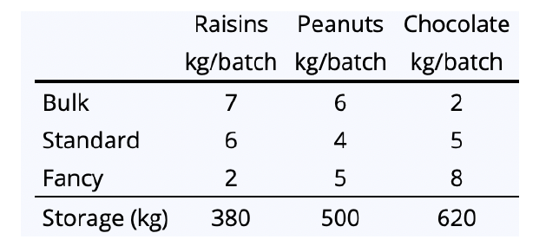
Do now…Get out your notebook/binder. Write down the date and goal.
Jada M. and Jada H. started a company (${\text{Jada}}^{2}$ inc.) that makes trail mix. Their factory makes three kinds of trail mix: bulk, standard, and fancy. The trail mix uses three ingredients: raisins, peanuts, and chocolate chips. The table below provides information about how much of each ingredient is used for each variety:
The factory has room to store ingredients in the following amounts: 380 kilograms of raisins, 500 kilograms of peanuts and 620 kilograms of chocolate chips. Jada M. and H. ask you to help determine how much they should make of each mix so that no ingredients are left over at the end of the day.
Be sure to…
Carefully read the text to your right, making a bulleted list of key information.
Why do you think the bulk mix contains more raisins and the fancy mix more chocolate chips?
Write a system of equations that goes along with this problem. Use three variables: $b$: the # of bulk batches, $s$: the # of standard batches, $f$: the # of fancy batches
Notes:
key information:
three kinds of trail mix: bulk standard and fancy
three ingredients: raisings, peanuts, chocolate chips
amount ingredients used to make a batch of each variety of trail mix listed in table
the factory can hold 380 kg. of raisins, 500 kg. of peanuts and 620 kg. of chocolate chips
Because chocolate chips are more expensive than raisins!
Each batch is a total of 15 kg. so:
(7)b + (6)s + (2)f = 380. //amount of raisins used
(6)b + (4)s + (5)f = 500. //amount of peanuts used
(2)b + (5)s + (8)f = 620. //amount of chocolate chips used.
+How can we use linear algebra to help Jada^2? We can find the inverse of this matrix and then multiply by the solutions matrix to find the value for the variable matrix [b s f]
+why do you need the denom. for the coefficeints? One batch is 15 kg. (add up the rows and colums), this means that a batch uses 7ths.

Slide 3
framing
what: find the determinant of any square matrix
why: Knowing the adjugate and determinant makes it really easy to find the inverse of a matrix. This makes it easy to solve systems of equations quickly, including in lots of real world applications.
where to: Finding the adjugate of any square matrix

Slide 4
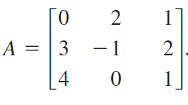
Warm up:
Be sure to… Answer answer the question below, showing all work. Be prepared to share out!
Find all of the minors for the first row in the matrix below, then find all of the cofactors for the first row.
Minor
The minor $M_{i,j}$ for entry $a_{i,j}$ is the
determinant of the matrix gotten by
deleting row $i$ and column $j$.
Cofactor
The cofactor $C_{i,j}$ for entry $a_{i,j}$ is given by
$C_{i,j}=(-1)^{i+j}×M_{i,j}$
Notes:
SEE HANDWRITTEN NOTES
+what do i and j represent in the definitions? i represents row and j column.
+ How do we find the minor for an element of a matrix?. delete the row and column containing the matrix. find the minor for the two by two matrix that’s left over.

Slide 5
stop ’n’ jot
Be sure to… Answer the question below in at least two complete sentences, in your notes. Use the four formulas below in your answerBe prepared to share out!
Explain why it’s useful to find the determinant of a matrix. Use the four formulas below in your answer:
1. $AX=B$ 3.
2. $X=A^{-1}B$ 4.
$$A^{-1}=\frac{\text{adj}(A)}{\text{det}(A)}$$
$$X=\frac{\text{adj}(A)}{\text{det}(A)}B$$
Notes:
A system of linear equations can be represented as the matrix eq. AX = B, meaning X = A^-1 * B. Because we know that the inverse A^-1 = adj(A)/det(A), if we find the adjugate and determinant then we can find the matrix X, meaning we can solve the system.

Slide 6
Mini-lesson Be sure to copy the notes below in your notebook & ask questions!
How to find the determinant for a square matrix $A$:
Pick a row $a_{i,j}$ $a_{i,k}$ $a_{i,l}$
Find the cofactors for each member of the row $c_{i,j}$ $c_{i,k}$ $c_{i,l}$
Find the determinant w/ the formula below:$\text{det}(A)=a_{i,j}×c_{i,j}+a_{i,k}×c_{i,k}+a_{i,l}×c_{i,l}$
Find the determinant for A below:
Notes:
SEE HANDWRITTEN NOTES.
+Do you think we’ll get a different formula if use start with a diff. row? Try to find out! (see handwritten notes for demonstration).

Slide 7
NOTES How to find the determinant for a square matrix $A$:
Independent work Be sure to:
If you came in late, copy notes ($→$).
Take a worksheet (pset #6) and calculator
Do all work in your notebook.
Work silently for the first 4 minutes. After that you can check in with your neighbor.
Pick a row $a_{i,j}$ $a_{i,k}$ $a_{i,l}$
Find the cofactors for each member of the row. $c_{i,j}$ $c_{i,k}$ $c_{i,l}$
Now the determinant will be $\text{det}(A)=a_{i,j}×c_{i,j}+a_{i,k}×c_{i,k}+a_{i,l}×c_{i,l}$
Notes:
see answer key for solutions
pre-planned questions:
+How do you find the determinant for a 3x3 matrix? use the formulas on the board!!!
+How do you find the det. for a 4x4 matrix? use the same method as for 3x3. IF you delete the row and column containing the element, you’re left with a 3x3 matrix. You know how to find a 3x3 matrix. The method is *recursive*, meaning you apply it to subparts.
+Why can’t I just use the determinant calculator? Because I want you to understand how the calculator works before you use it. there’s no magic in math.

Slide 8
Reflection: Thinking about thinking
be sure to: Answer each question below with a complete sentence. Be prepared to share out!
How is finding the determinant for a 4x4 matrix related to a 3x3 matrix?
What’s one thing you’d like to understand better after today’s lesson?
Notes:
1. To find a 4x4 matrix’s det., you delete a row and column, meaning you then have to find the det. for a 3x3 matrix.
last five minutes of class. share out.

Slide 9
wrapping up!
be sure to: read the directions below!
Make sure there isn’t any litter near your workstation.
If you borrowed headphones, sign them back in.
Make sure you are logged out of your computer!
Remain in your seat until the bell rings.

