Slide 1
Fall 2021 Precalc
Lesson 4.3
Dr. O’Brien
Herbert H. Lehman High School
2 March 2022

Slide 2
Today’s activity: Precal quiz review
Do now…Get out your notebook/binder. Read announcements on board. Read through the Be Sure Tos for today’s activity.
Today we’ll be working on a precal quiz review. This will look very similar to the retake on Thursday.
Be sure to…
Work on each problem. Feel free to use your notes and/or consult your neighbors.
Take a calculator.
When you finish: Compare your work to the Answer Key on Google Classroom. Get out a sheet of loose leaf. For each mistake you make, describe the mistake and what you understand better now!
Notes:
See answer key for solutions.

Slide 3
framing
what: add matrices and multiply matrices by scalars
why: Matrix algebra lets us systematically perform mathematical operations on large arrays of numbers.
where to: Quiz retake (tomorrow)/Multiplying two matrices (Friday)

Slide 4
B24 rules
Welcome to our new room, B24! Please read the information below:
When you come in, please find a seat at a desk (if one’s available) or one of the six closest desks to the screen. Do not sit in the back of the classroom. We’ll conduct the do now and mini lesson from here.
When I dismiss you for independent work, find a sit at one of the computer workstations.
No food or drink by the computers.
At the end of the period, you’ll be directed to assemble for the exit ticket/debrief. Log out of your computer, and quietly return to a seat near the front.

Slide 5
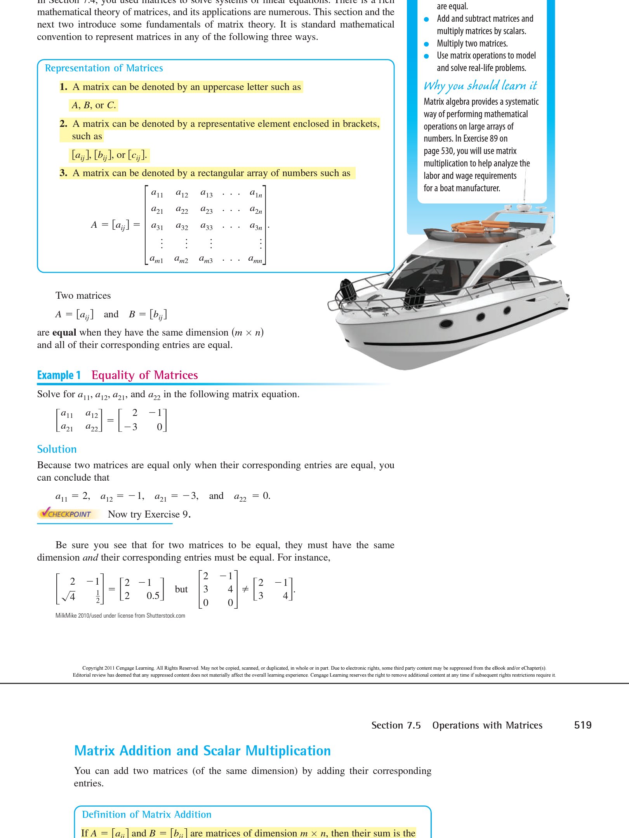
Warm up
Matrices can be denoted by uppercases letters like A or B.
We can say that $A=B$ if A and B have the same dimensions $(m×n)$ and the corresponding entries are all the same.
Are the two matrices below equal? Explain why or why not.

Slide 6
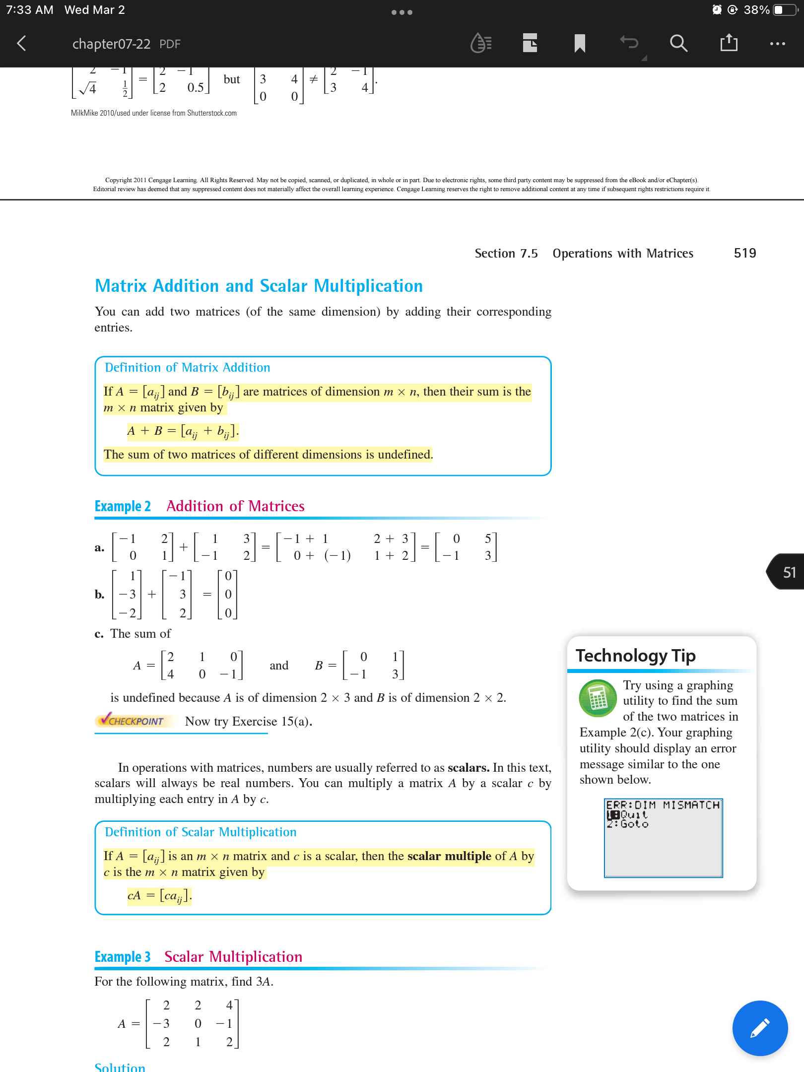
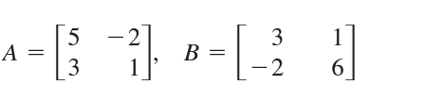
Matrix addition
We can also add matrices together, but they must have the same dimensions!
Copy these two examples!
Practice problem #1:
Find $A+B$
Practice problem #2:
Can $A+B$ be found? Explain why or why not.

Slide 7
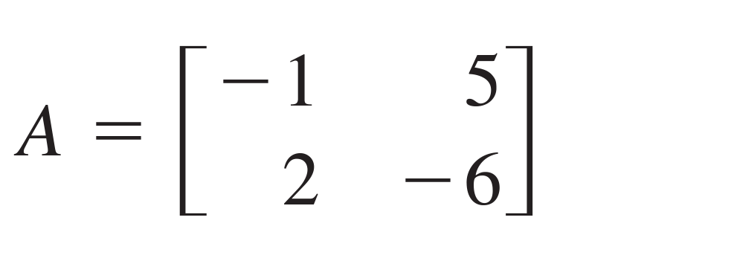
Scalar multiplication
We can also multiply a matrix by a scalar (I.e. a constant real number). This just means multiplying each entry by that number.
Let’s find $3×A$:

Slide 8
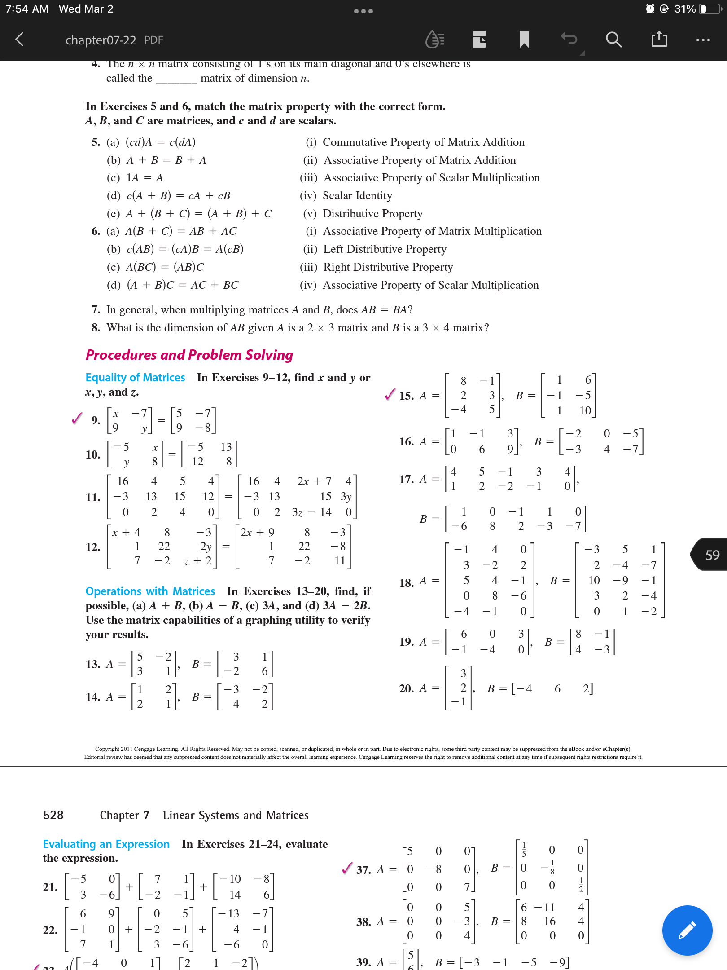
Independent work
Be sure to…
Work on Quiz Review (if unfinished). Check he answer key when you’re finished!
Work on problems below. For each pair of matrices find (a) $A+B$, (b) $2A$, and (c) $2A+3B$:
i.
ii.
iii.

Slide 9
wrapping up!
be sure to: read the directions below!
Make sure there isn’t any litter near your workstation.
If you borrowed headphones, sign them back in.
Make sure you are logged out of your computer!
Remain in your seat until the bell rings.

