Slide 1
Fall 2021 AP CS A
Lesson 4.3
Dr. O’Brien
Herbert H. Lehman High School
2 March 2022
Notes:
STANDARDS REFERENCED:
CSTA 11-12th grade standards: 3B-AP-12: Compare and contrast fundamental data structures and their uses.
NY State: 9-12.CT.7
Design or remix a program that
utilizes a data structure to maintain
changes to related pieces of data.

Slide 2
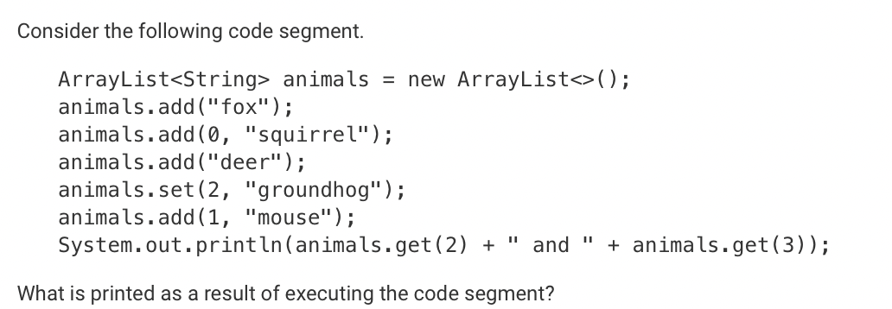
Do now
be sure to: Get out your binder. Copy goal and answer do now questions below. Show all work or write a complete sentence for each answer:
mouse and fox
fox and groundhog
groundhog and deer
fox and deer
squirrel and groundhog
Notes:
This code will return an array index out of bounds error.
You could change the test to k < arr.length
taken from AP classroom.

Slide 3
framing
what: use ArrayList traversal to solve computational problems
why: ArrayLists are a useful means to store data. Today we’ll get some practice traversing them.
where to: ArrayList traversal with enhanced for loops

Slide 4
Vocab
be sure to: Keep your notebook open. These definitions should be in your Glossary. If not Copy each definition, in your Java Glossary.
ArrayList (review)
An adjustable array. We can add new items to ArrayLists, remove, and replace items.
Traversal (review)
The process of looping through a string or array or ArrayList and accessing each element sequentially

Slide 5
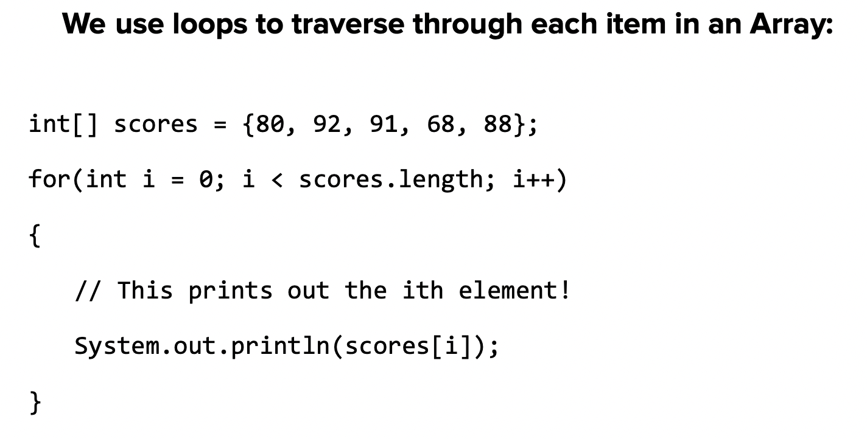
Warm up
Make a prediction: What will this program do?
Notes:
prints:
80
92
91
68
88

Slide 6
Mini-lesson
Assume scores is an ArrayList containing integers.
How is this program different from the corresponding traversal of arrays?
for(int i = 0; i < scores.size(); i++)
{
// This prints out the ith element!
System.out.println(scores.get(i));
}
Notes:
Instead of .length we use size(). Instead of [i] notation, we use get(i).

Slide 7
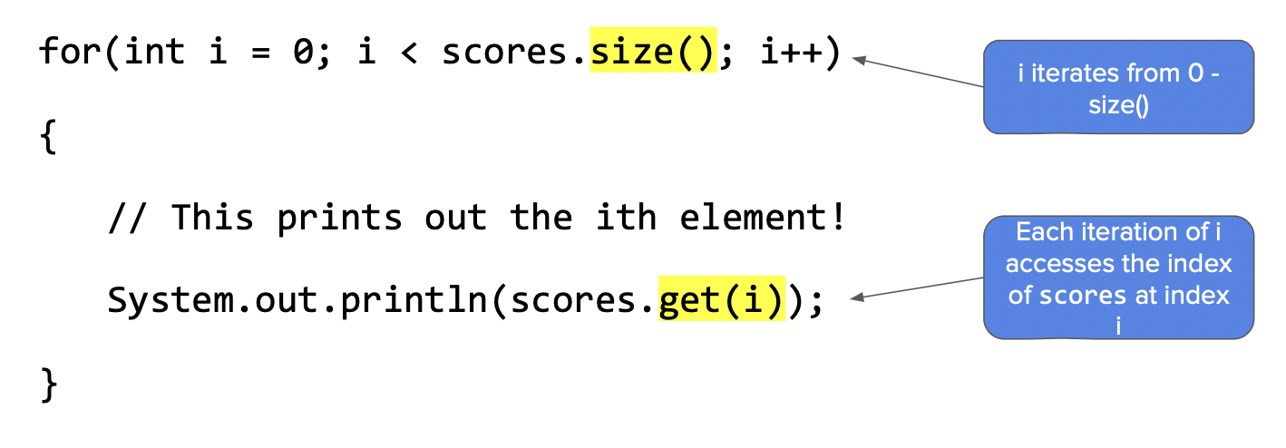
Mini-lesson
Assume scores is an ArrayList containing integers.
How is this program different from the corresponding traversal of arrays?
Notes:
Instead of .length we use size(). Instead of [i] notation, we use get(i).

Slide 8
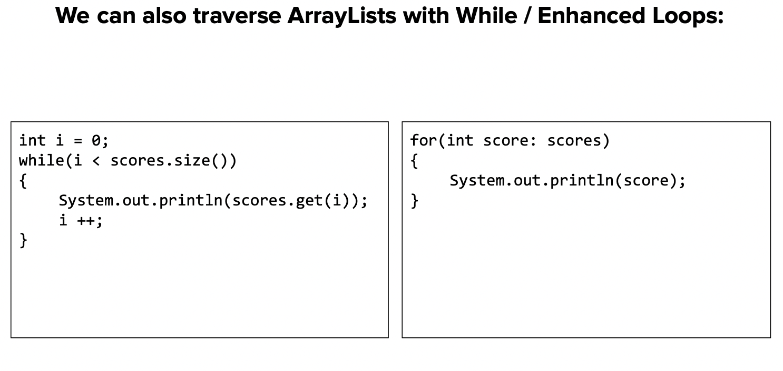
Mini-lesson
Assume scores is an ArrayList containing integers.
How is this program different from the corresponding traversal of arrays?
Notes:
Instead of .length we use size(). Instead of [i] notation, we use get(i).

Slide 9
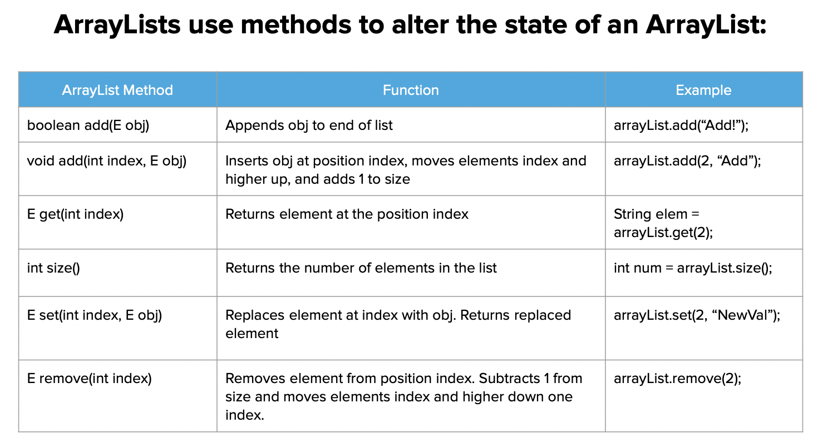
Independent work
be sure to: Complete exercises in lessons 7.1, 7.2, and 7.3 (ArrayLists) on CodeHS!

Slide 10
Reflection:
be sure to: Answer each question below with a complete sentence. Be prepared to share out!
What are some unexpected challenges that you ran into while working on the activities for today’s class?
What’s one thing you understand better about traversing arrayLists?
What lingering questions do you have?

