Slide 1
Fall 2021 Java
Lesson 6.1
Dr. O’Brien
Lehman High School
October 25, 2021

Slide 2
do now
be sure to: Grab handout. Go to desk. Take out binder. Copy goal and answer do now questions below. Write a complete sentence for each question.
What will print out if the student scores a 60, and how do you know?
How could we change this code to add a print statement that says “You have an A!” for scores 90 or above
if(assignment >= 70)
{
System.out.println(“You have passed!”);
}
else
{
System.out.println(“So sorry, but you did not pass.”);
}
Notes:
The program will print “So sorry, but you did not pass”. We know this because it prints something else if assigment is bigger than or equal to 70, so we go to the else statement.
if(assignment >= 90)
{
System.out.println(“You got an A!”);
} else If (assignment >= 70){
you passed
}else
{
System.out.println(“So sorry, but you did not pass.”);
}
+Why does it matter which order the two conditions (assignment >= 70) and assignment >= 90) matter? because other wise you’ll just print “you passed”.

Slide 3
The framing
what: use else-if statements to create more complex control structures
why: Booleans and if-statements, along with other control structures are crucial to building more sophisticated programs. Code tracing is a convenient way to understand how programs work.
where to: Compound and equivalent boolean expressions
Notes:
we already went through this the end of class yesterday, but stack frame diagrams provide a better sense of what’s happening when. code tracing tables are useful for simpler problems.
debugging, preparing to make your own program, understanding someone else’s program so you can change it or use it!

Slide 4
Announcements
retake after class this week.
Please complete the post-test self assessment by Monday.

Slide 5
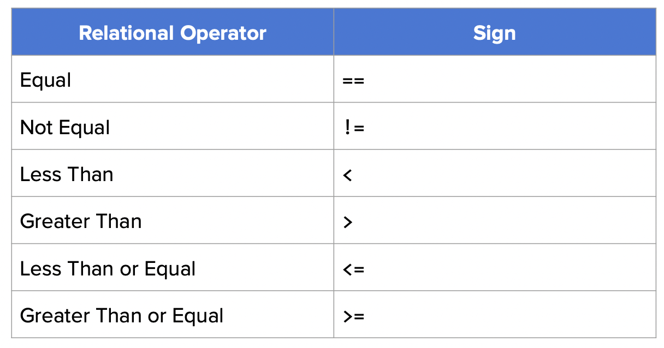
Boolean expressions: review
Booleans are expressions with a true or false value.
Booleans can use relational operators to store true/false information:
George Boole (1815-1864). Author of the “Laws of Thought”, a famous book on logic.
Notes:
If you wonder why we call them Booleans, they’re named after a guy named George Boole.

Slide 6
if-else statements: review
If statements are used when there are a set of statements that should be executed only when statements are met.
if(booleanExpression)
{
//code to execute if boolean expression is true!
}
else
{
//code to execute if boolean expression is false!
}
Else execute if the initial boolean condition is false.

Slide 7
else-if statements
Else-If statements allow us to incorporate additional conditions into our control structure.
if(booleanExpression)
{
//code to execute if boolean expression is true!
}
else if(booleanExpressionTwo)
{
//code to execute if else if boolean expression is true!
}
else
{
//code to execute if all boolean expressions are false!
}

Slide 8
Be sure to…
Work on your own.
Complete Salmon Spawn exercise
If you finish that, complete Berries exercise.
Notes:
+HDW order our if-else if statements: It depends on how you do it, but one way is with one if-else if-else if… control structure that determines what is printed to the console. As the exercise description states, the months should be ordered from 1-12, so that the correct if statement is called. For example, the statement if(months < 6) is accurate for the month 2. If this is the first conditional statement, then the result will print spawning season, but month 2 is not spawning season.
If you use compound booleans, you can make it even simpler.
+If student finishes by using compound booleans: +how can you redo it without && statements?

Slide 9
CodeHS: Salmon spawn
Every year, salmon return from the salt water they usually live in to a freshwater river to spawn (lay eggs). Some people like to go and watch the salmon swim upstream to their favorite spawning places, especially at fish farms.
There are several different varieties of salmon. Some spawn in the spring and most spawn in the fall.
Your task is to write a program that takes the month of the year as an integer and output if it is “Spring spawning season”, “Fall spawning season”, or “Not spawning season”.
The spring spawning season lasts from March to June (month 3 - 6). The fall spawning season lasts from September to November (month 9 - 11).
Remember that in an if-else if statement, the first if statement that evaluates to true is the one whose body is executed. Therefore, you will need to check the months in numerical order.
Notes:
+have student go through their answer with and without compound statements.

Slide 10
exit ticket
Why are else-if statements necessary?
What’s the bug that will lead to an error in this code?
if(ticketPrice > 5)
{
System.out.println("Great deal!");
}
else if(ticketPrice > 10)
{
System.out.println("Typical");
}
else if(ticketPrice > 15)
{
System.out.println("Too expensive!");
}
else
{
System.out.println("Must be a scam");
}
Notes:
+Why are else if statements necessary?
Else if statements allow for multiple conditions to be checked instead of a true or false case.
+What is the error in the code that will cause a bug in the program?
The terms of the comparison operators are in the wrong order.

