Slide 1
Fall 2021 Precalc
Lesson 7.4
Dr. O’Brien
Herbert H. Lehman High School
24 March 2022
Notes:
VOCAB
adjugate
determinate

Slide 2
Do now…Get out your notebook/binder. Write down the date and goal.
Dr. Galvez and Dr. Guillermo are testing a new experimental medicine (Precalodine) at Montefiore Hosptial. The medicine is being given to a total of 100 patients. Patients take the medicine in a 1 liter solution, meaning that some percent of the solution is the medicine, and the rest is water. Patients are being given 2% or 4% solutions, and 2.5 liters of the medicine are on hand. You want to know how many patients can be given each dosage, using up all 2.5 liters.
Be sure to…
read the text to the right (same as yesterday)
How could you write a system of linear equations that goes along with this problem? Assume $x$ represents the # of patients given 2% solution, and $y$ the # of patients given 4% solution.s
Write down any remaining questions you have
Notes:
Answers will vary. the stduent could recognize that this can be transformed into the system of linear equations below:
x + y = 100
0.02x + 0.04y = 2.5
where x represents the number of patients who take the 2% solution and y the rest. Then it can be solved in a variety of ways, including with matrix algebra.

Slide 3
framing
what: use the inverse of a matrix to solve real world problems
why: Knowing the adjugate and determinant makes it really easy to find the inverse of a matrix. This makes it easy to solve systems of equations quickly, including in lots of real world applications.
where to: Using adjugate and determinant to find the inverse of bigger square matrices.

Slide 4
Warm up: Stop ’n’ Jot
Be sure to… Answer the question below in at least two complete sentences, in your notes. Be prepared to share out!
Why are the formulas below useful for solving systems of equations?
$$AX=B$$
$$X=A^{-1}B$$
Notes:
AX = B is another way of writing a system of linear equations, where A is the coefficient matrix, B the solutions matrix and X the variables matrix. We typically want to figure out what variables satisfy all of the equations in a system, so our goal is to solve for X. The second formula tells us that if we can find the inverse of A we can multiply it by B to find X.
2 min. writing -> turn & talk -> share out.

Slide 5
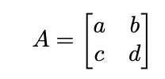
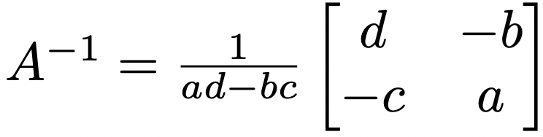

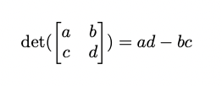
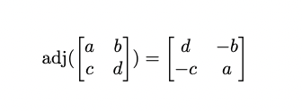
Mini-lesson Be sure to copy the notes below in your notebook & ask questions!
Last week we learned a formula for finding the inverse of a $2×2$ matrix:
Vocabulary:
We can now write:
The determinant of a $2×2$ matrix A, written det(A):
Practice problem: for the matrix below (i) find the determinant and adjugate (ii) use the formula above to find the inverse. Be sure to…Show all work in your notebook!
The adjugate of a $2×2$ matrix A, written adj(A):
$$X=\left[\begin{matrix}9 & 5 \\ 5 & 3\end{matrix}\right]$$
Notes:
We’ll learn more next week about how to find the determinant and adjugate for bigger matrices.
Why are the two Matrix inverse equations the same? because (1/x)*y = y/x.
Practice problem:
det(X) = 9*3 - 5*5 = 27 - 25 = 2
adj(X) = [ 3 -5
-5 9]
+HDW find the inverse?
X^-1 = adj(X)/det(X) = [ 3/2 -5/2
-5/2 9/2]. = [ 1.5. -2.5
-2.5. 4.5]

Slide 6
Today’s activity: practice problems
Today we’ll be working on Pset #5.
If you choose to work in a group with Dr. O’Brien
Be sure to:
Sit at a desk.
Ask questions!
Formula to find the inverse
of matrix A:
If you feel confident enough to do the pset on your own…
Be sure to:
Move to a seat near a computer.
Follow directions carefully. For each problem show all work or answer in a complete sentence.
Feel free to work with a partner!
The determinant of a $2×2$ matrix A,
The adjugate of a $2×2$ matrix A, written adj(A):
Notes:
see answer key for solutions
pre-planned questions:
+How do you find the adjugate/determinant? use the formulas on the board!!!
+How can I use the adjugate/determinant to find the inverese? adj(A)/det(A)
+How do I convert to AX=B? A is the coefficient matrix, X reprsents the variables and B the solutions
+Why can’t I just use substitution? Because we’re practicing using adjugates and determinates. It might seem silly here, but with bigger matrices it will be a LOT easier.

Slide 7
Reflection: Thinking about thinking
be sure to: Answer each question below with a complete sentence. Be prepared to share out!
Why is it useful to be able to find the adjugate and determinant of a matrix?
What’s one thing you’d like to understand better after today’s lesson?
Notes:
last five minutes of class. share out.

Slide 8
wrapping up!
be sure to: read the directions below!
Make sure there isn’t any litter near your workstation.
If you borrowed headphones, sign them back in.
Make sure you are logged out of your computer!
Remain in your seat until the bell rings.

