Slide 1
Fall 2021 AP CS A
Lesson 15.3
Dr. O’Brien
Herbert H. Lehman High School
5 January 2022

Slide 2
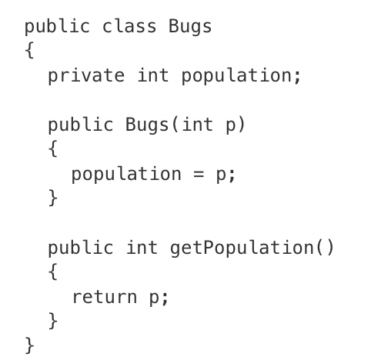
Do now
be sure to: Get out your binder. Copy goal and answer do now questions below. Answer the questions below and write a sentence justifying your answer.
Consider the following Bugs class, which is intended to simulate variations in a population of bugs. The population is stored in the method’s int attribute. The getPopulation method is intended to allow methods in other classes to access a Bugs object’s population value; however, it does not work as intended.
The getPopulation method should be declared as private .
The return type of the getPopulation method should be void.
The getPopulation method should have at least one parameter.
The variable population is not declared inside the getPopulation method.
The instance variable population should be returned instead of p, which is local to the constructor.
Notes:
answer: E.

Slide 3
framing
what: define the behavior of an object using mutator methods
why: We want to develop facility with writing mutator methods, so we can efficiently write more complex classes.
where to: How to change formal parameters in methods

Slide 4
Vocab (review)
be sure to: Keep your notebook open. Copy the definitions in your notebook, if they are not there already.
getter method
Allows us to access specific instance variables in an object. Aka accessor methods.
setter method
Allows us to change specific instance variables in an object. Aka mutator methods

Slide 5
Coding to lean: Independent work
be sure to:
Go to your workstation.
Watch the video 5.5.1: Mutator Methods
Work on following problems in CodeHS:
5.5.5: Student Setters
5.5.6: Full Fraction Class
5.5.7: Weekly routine
5.4.8 A Chef’s best Meal
We’ll go over the exercises at tehe end of class!
Notes:
see for full solutions: https://codehs.com/library/solution_references/assignment/55325723?section_id=256470
+Why aren’t the methods returning anything? Make sure that the return variable for the getter methods are the instance variables, NOT the formal parameters from the constructor.
+How do I implement the fight method (4.3.6)? The fight method takes the attack String and multiplies it by the level of the Dragon. Students should implement this using a for loop. The for loop should run from 0-level, and add the attack String to another String to create the correct length of the fight String.
+ How can I set canBreatheFire? (4.3.7)? canBreatheFire is based on the level of the Dragon. When the constructor is called, it should immediately test the level of the Dragon to determine if it can breathe fire. In the method gainExperience, canBreatheFire should also be updated depending on the level of the Dragon after the level has increased.
4.3.8:
+How can the Chef’s best meal be a Meal object? You can refer to the previous examples to see how to make instance variables of user-defined types. Essentially, just like we can have private int anIntField as an instance variable, we can have private Meal favoriteMeal as an instance variable! To define the best meal in the Chef constructor, first make a Meal object. Then pass that object to the Chef constructor.
+How can the Chef access the Meal instance variables?Since the Meal class has private instance variables, you cannot directly access them. You need to use the Meal accessor methods!

Slide 6
Exit ticket
be sure to: Get out a sheet of loose leaf paper. Write your name and the date on the top. Answer each question below with a complete sentence. Be prepared to turn in!
Answer the questions below.
Why are instance variables in a class kept private?
What are getter (aka accessor) and setter (aka mutator) methods used for?
What is the toString() method used for?
Notes:
They are kept private so that they cannot be altered or accessed outside of the class accept by special, programmer defined methods.
These are the programmer defined methods for accessing (getter) and changing (setter) data in a class. This allows the programmer to control whether and how the data in an object can be accessed and changed.
toString is a special method that always returns a string. It’s what accessed by the Java print methods.

