Slide 1
Fall 2021 Precalc
Lesson 15.4
Dr. O’Brien
Herbert H. Lehman High School
6 January 2022
Notes:
make google form to submit published code.
make google meet link for better live coding experience.

Slide 2
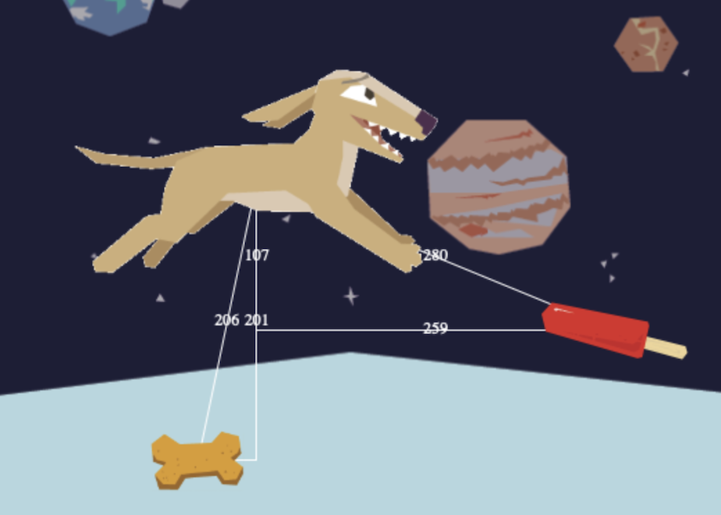
Do now
be sure to: take a seat near the front of the room. Get out your binder. Copy the goal and date. Answer the questions below with complete sentences:
Examine the image to your right.
What do you notice about the image? Write down at least two things.
What questions do you have? Write down at least one thing.
What do you think the relationship is between the different numbers you see?
Notes:
lines with numbers connecting the various objects. They all form right triangles.
answers will vary. Students might wonder where the numbers come from.
pythagorean theorem…

Slide 3
B24 rules
Welcome to our new room, B24! Please read the information below:
When you come in, please find a seat at a desk (if one’s available) or one of the six closest desks to the screen. Do not sit in the back of the classroom. We’ll conduct the do now and mini lesson from here.
When I dismiss you for independent work, find a sit at one of the computer workstations.
No food or drink by the computers.
At the end of the period, you’ll be directed to assemble for the exit ticket/debrief. Log out of your computer, and quietly return to a seat near the front.

Slide 4
framing
what: implement the Pythagorean theorem in Pyret to calculate distance
why: this lets us add effects for when the characters collide
where to: finish our game this week

Slide 5
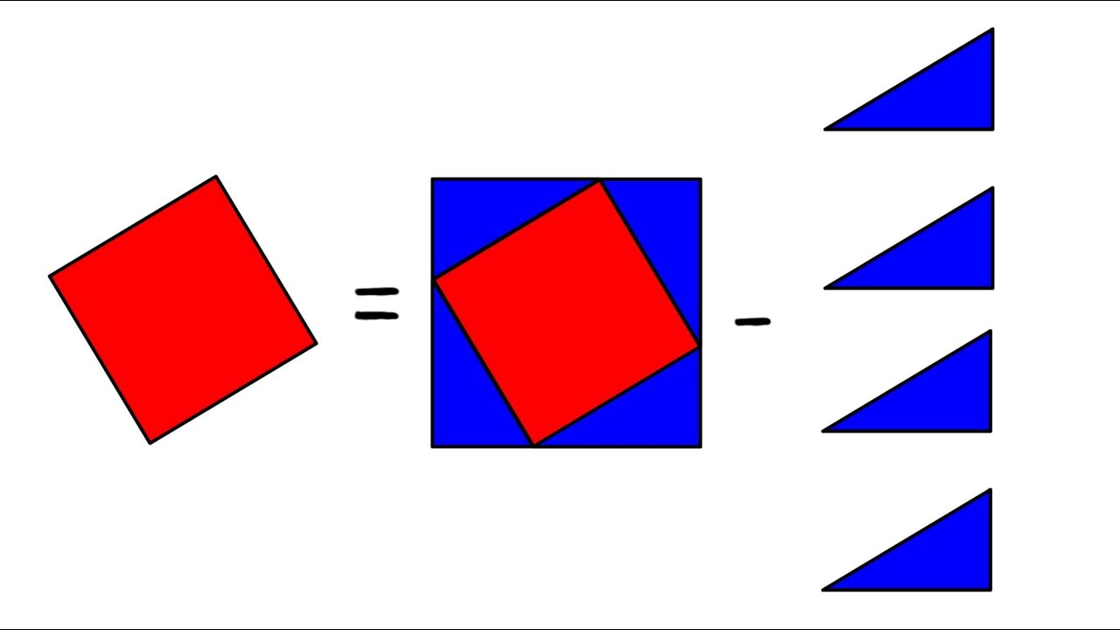
Mini-lesson: Pythagorean theorem
Be sure to:
Watch this four minute video.
Write down any questions you have.
Notes:
+How can I move to the left and write? experiment with using the posn(x,y) function.
+example of fully implemented update-player function:
fun update-player(x, y, key):
ask:
| (key == "up") and (y >= 480) # Wrap from top to bottom
then: posn(x, 0)
| (key == "down") and (y <= -120) # Wrap from bottom to top
then: posn(x, 480)
| (key == "up") # default up
then: posn(x, y + 10)
| (key == "down") # default down
then: posn(x, y - 10)
| (key == "left") # default up
then: posn(x - 10, y)
| (key == "right") # default down
then: posn(x + 10, y)
|otherwise: posn(x, y) # any other key
end
end

Slide 6
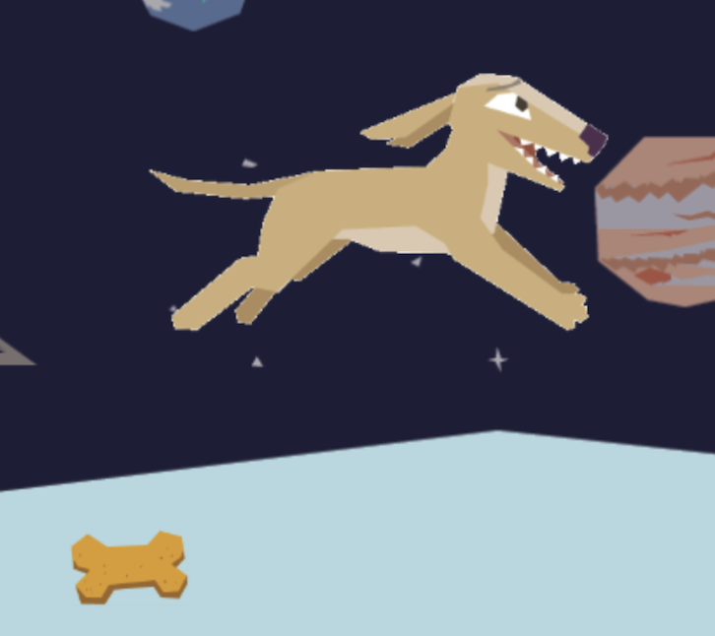
Mini-lesson: Pythagorean theorem
How could we use the Pythagorean theorem to find the distance between these two characters?
(250, 300)
(100,50)
Notes:
Draw right triangle on screen.
+hdw find the vertical and horizontal difference:
300 - 50 : vertical
250 - 100 : horizontal
plug these into the Pythagorean theorem.
d = sqrt(( (300 - 50

Slide 7
Mini-lesson: Pythagorean theorem
The distance formula:
$$d=\sqrt{(x2-x1)^{2}+(y2-y1)^{2}}$$
(x2, y2)
(x1, y1)
Notes:
draw right triange on diagram again.

Slide 8
Coding to learn: Activity
What you should have done with your video game:
Add your own images for player, danger, and target
Make sure the danger and target are moving horizontally, by modifying the update-danger() and update-target() functions
Make sure that the player can move up and down, by modifying the update-player() function
Use the Pythagorean theorem to finish the distance() function. The finish the is-collision() function.
Advanced: use the posn() function to make sure the characters in the game can move in more interesting directions.
Be sure to:
Read through the video game expectations (to your right).
Move to your computer, open your saved game file. If your game doesn’t yet meet expectations, start working on it!
When you’re done with that see the next slide (on Google Classroom). Work on extending your game.
If you have any questions, raise your hand!

Slide 9
Coding to learn: live coding
Be sure to:
Open the Standing Meet Link on Google Classroom. This will make it easier to follow along from your computer.
Follow along with Dr. O’Brien. Try to stay one step ahead! Let’s use our update-player function to control the player’s movements.
Notes:
distance :: Number, Number, Number, Number -> Number
# The distance between two points on screen:
# We have the player's x and y, and a character's x and y.
# How far apart are they?
examples:
distance(0, 0, 3, 4) is
num-sqrt((num-sqr(3 - 0)) + (num-sqr(4 - 0)))
distance(30, 12, 54, 3) is-roughly
num-sqrt((num-sqr(54 - 30)) + (num-sqr(3 - 12)))
end
fun distance(x1, y1, x2, y2):
num-sqrt((num-sqr(x2 - x1)) + (num-sqr(y2 - y1)))
end
is-collision :: Number, Number, Number, Number -> Boolean
# How close is close enough?
# We have the player's x and y, and a character's x and y.
# We can ask how far apart they are. Did they collide?
fun is-collision(px, py, cx, cy):
distance(px, py, cx, cy) < 50
end

Slide 10
Coding to learn: extension Activity
Be sure to: Carefully follow the instructions below:
Now is your time to customize your game! Try implementing some of the following features, or make your own!
Warping - program one key to "warp" the player to a set location, such as the center of the screen
Boundaries - change update-player such that PLAYER cannot move off the top or bottom of the screen
Wrapping - add code to update-player such that when PLAYER moves to the top of the screen, it reappears at the bottom, and vice versa
Hiding - add a key that will make PLAYER seem to disappear, and reappear when the same key is pressed again
Reminder: Use # to add comments to code!
Adding useful comments to code is an important part of programming. It lets us leave messages for other programmers, leave notes for ourselves, or "turn off" pieces of code that we don’t want or need to debug later.
Notes:
+How can I move to the left and write? experiment with using the posn(x,y) function.
+example of fully implemented update-player function:
fun update-player(x, y, key):
ask:
| (key == "up") and (y >= 480) # Wrap from top to bottom
then: posn(x, 0)
| (key == "down") and (y <= -120) # Wrap from bottom to top
then: posn(x, 480)
| (key == "up") # default up
then: posn(x, y + 10)
| (key == "down") # default down
then: posn(x, y - 10)
| (key == "left") # default up
then: posn(x - 10, y)
| (key == "right") # default down
then: posn(x + 10, y)
|otherwise: posn(x, y) # any other key
end
end

Slide 11
reflection
Be sure to: get out a sheet of loose leaf paper. Write your name and the date on top. Answer each question below with a complete sentence. Be prepared to hand in as you leave!
What would it take to make the player move left and right?
Why can’t we do this without changing the contract?

