Slide 1
Fall 2021 AP CS A
Lesson 9.5
Dr. O’Brien
Herbert H. Lehman High School
8 April 2022

Slide 2
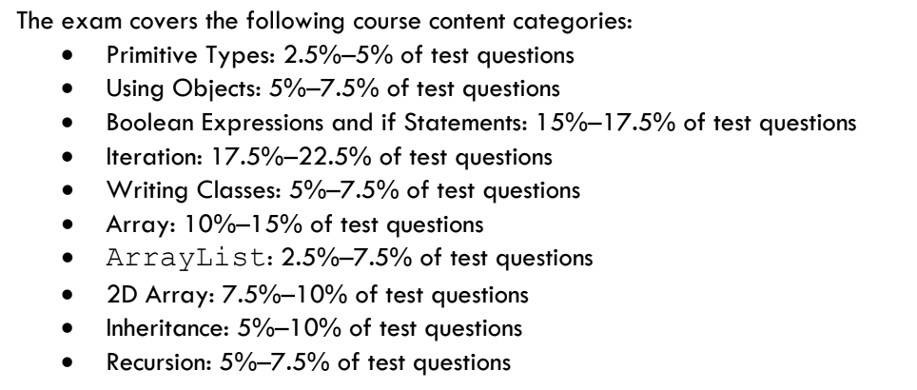
Do now
Be sure to…
Examine the breakdown in AP questions to the right.
Answer the question: How can you use this guide to aid in studying
Write down any additional questions you have.
Notes:
5! = 5*4*3*2*1 = 120
num combinations:
4! / 3!(4-3)! = 4! / 3!*1! = 4! / 3! = 4*3*2*1 / 3*2*1 = 4

Slide 3
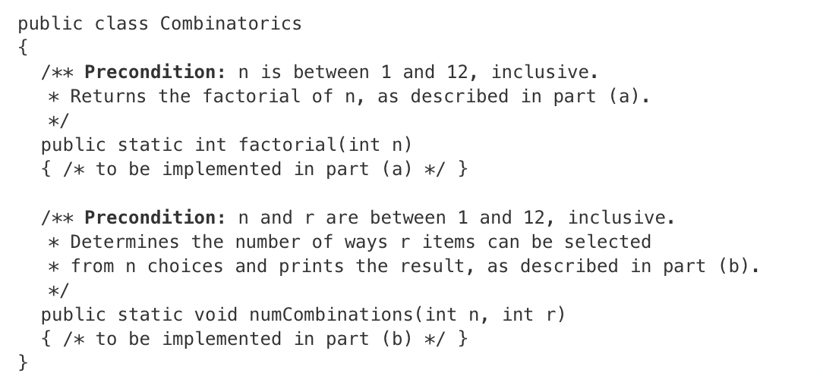
Warm up: writing to learn
Be sure to…
Review the unfinished class to the left
Answer the questions below:
What methods need to be completed?
What do you think these methods do?
What remaining questions do you have?

Slide 4
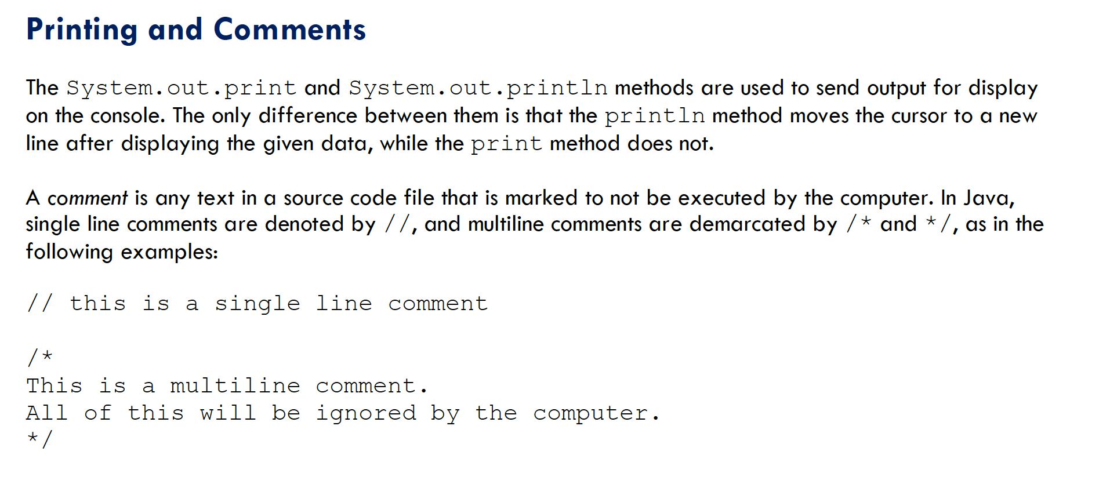

Slide 5
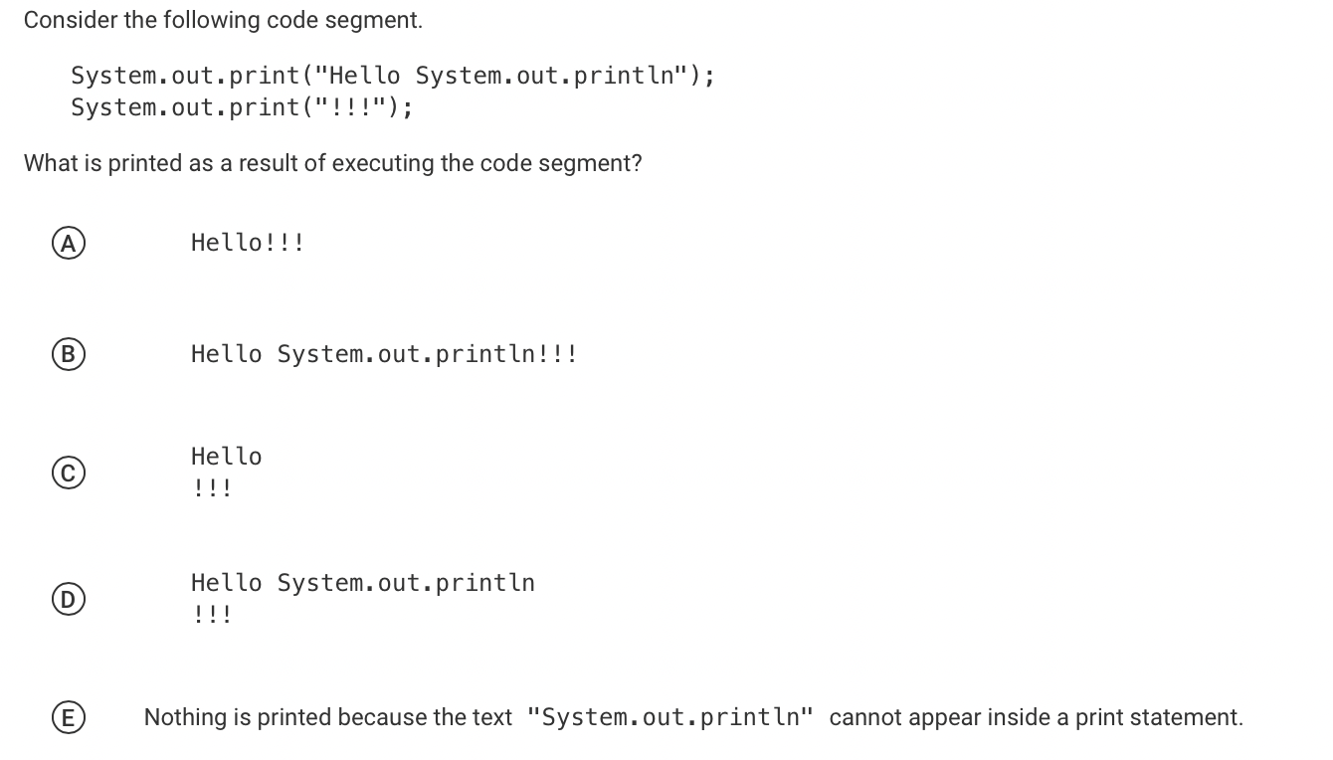

Slide 6
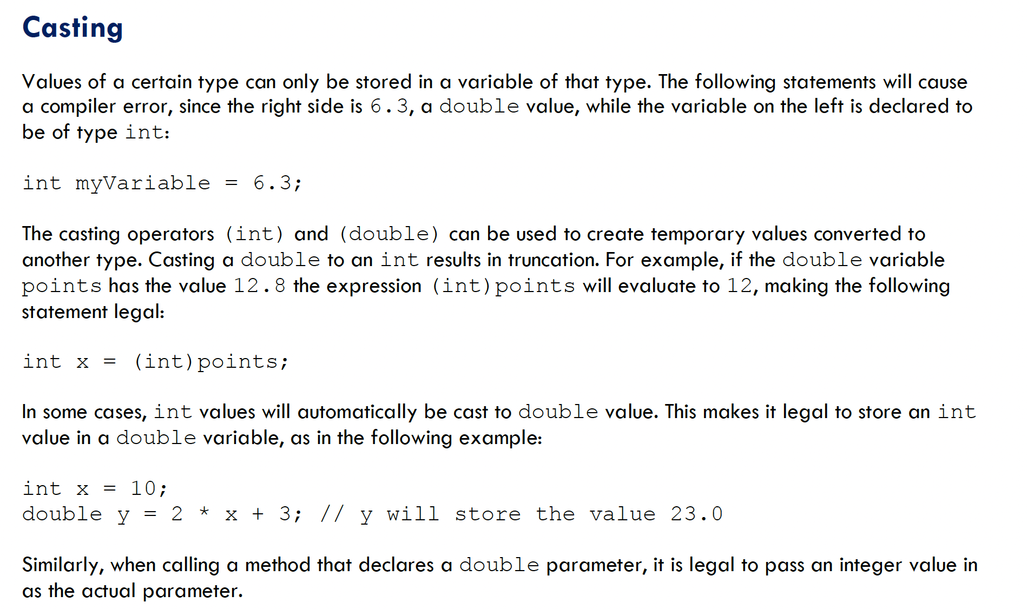

Slide 7
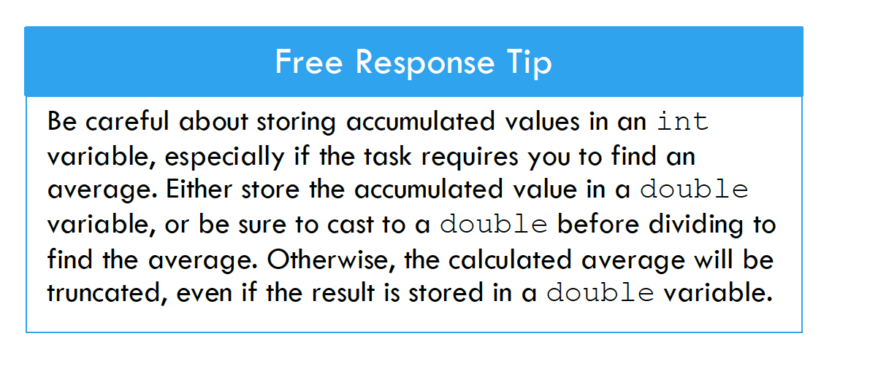

Slide 8
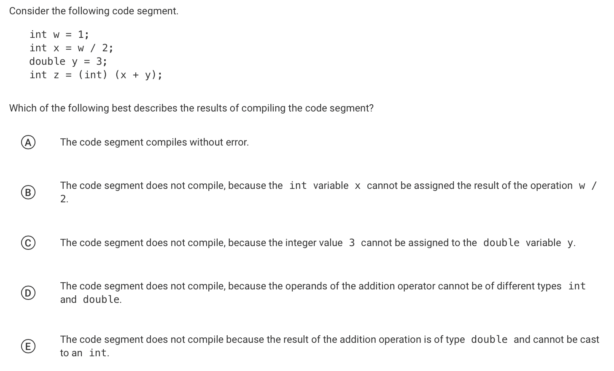

Slide 9
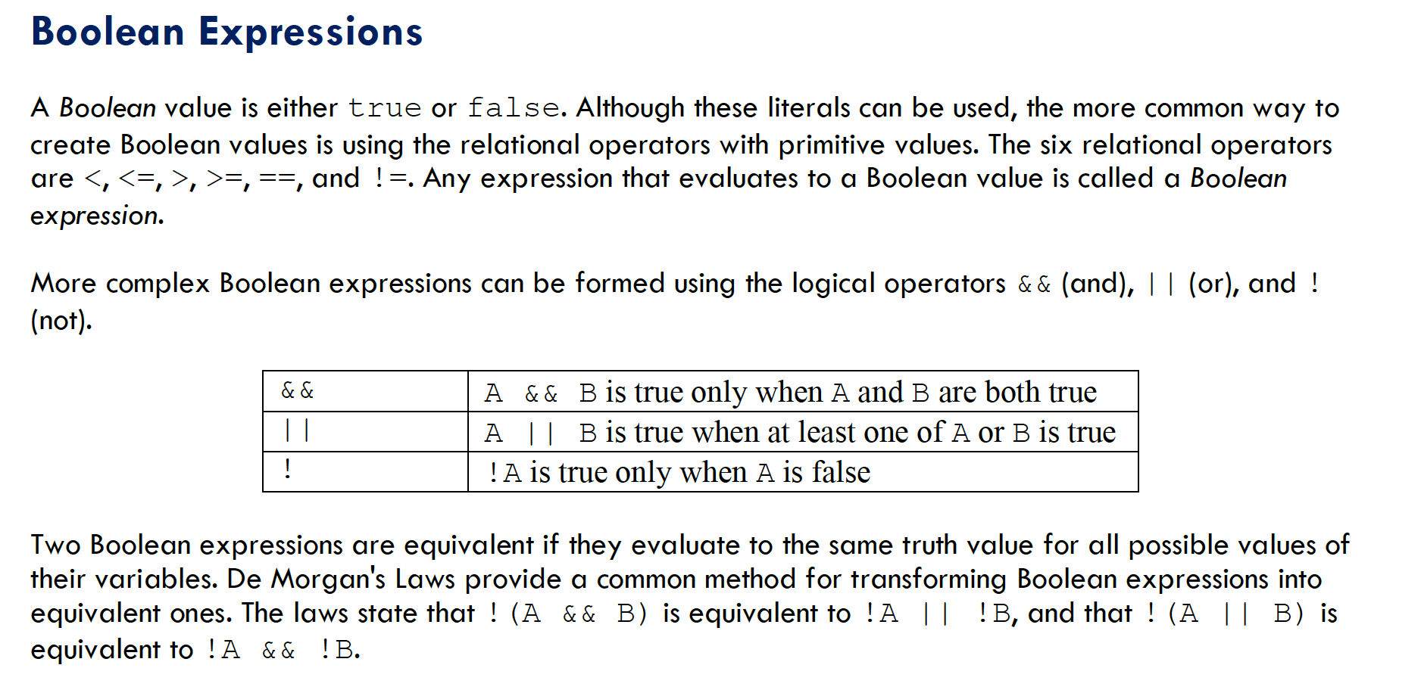

Slide 10
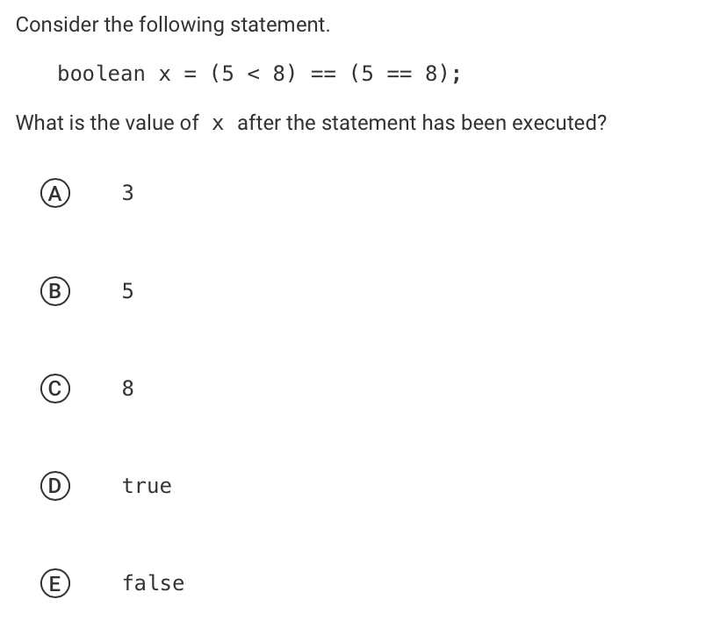

Slide 11
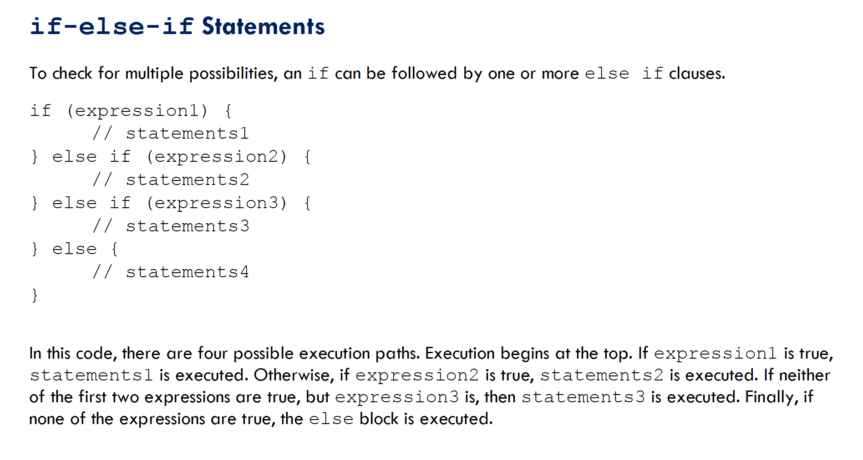

Slide 12
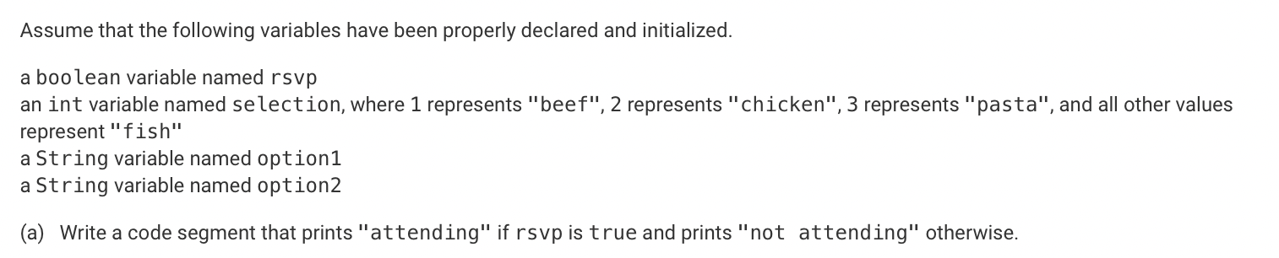

Slide 13
(c) Write a code segment that will store a dinner selection in option1 based on the values of rsvp and selection. The intended behavior of the code segment is described below.
If rsvp is true, the code segment should store in option1 a string indicating the person’s attendance and food choice. For example, if rsvp is true and selection is 1, the following string should be stored in option1.
"Thanks for attending. You will be served beef."
If rsvp is false, the following string should be stored in option1, regardless of the value of selection.
"Sorry you can't make it."

Slide 14
framing
what: use recursion to search through data
why: Recursion is a very powerful tool for making algorithms. We’ll see how it makes search easier.
where to: Using recursion in sorting algorithms

