Slide 1
Fall 2021 AP CS A
Lesson 9.3
Dr. O’Brien
Herbert H. Lehman High School
6 April 2022

Slide 2
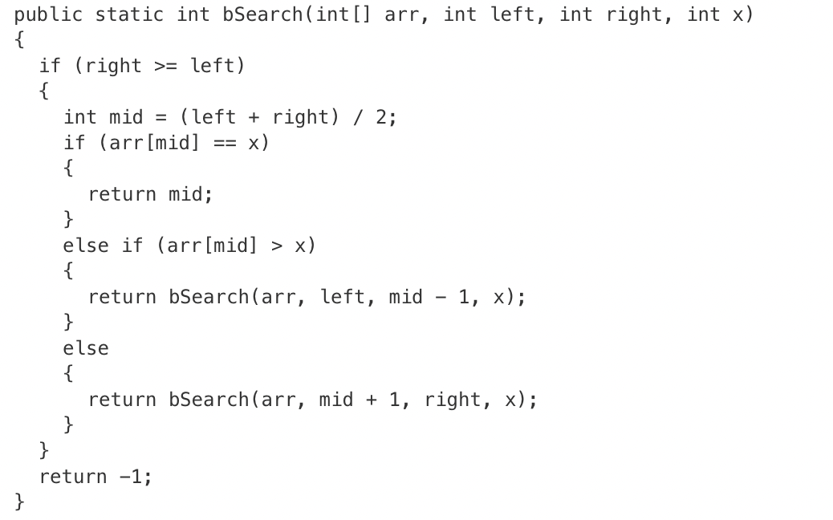
Do now
The following code segment appears in a method in the same class as bSearch.
int[] nums = {0, 4, 4, 5, 6, 7};
int result = bSearch(nums, 0, nums.length - 1, 4);
Be sure to answer the questions below:
What are the parameters for bsearch and what do they represent?
How does the bsearch algorithm work (hint: think about tearing up dictionaries)?
Notes:
the list has to be sorted
the algo works by dividing the list into two, then it’s executed on one of the sub lists, until the desired element is found

Slide 3
framing
what: use recursion to search through data
why: Recursion is a very powerful tool for making algorithms. We’ll see how it makes search easier.
where to: Using recursion in sorting algorithms

Slide 4
warm up: linear vs. binary search
Watch Dr. O’Brien carefully.
Stop ’n’ Jot: (1)How are the two search algorithms different. Which one do you like better?
(2) What has to be true about data for binary search to work?

Slide 5
Vocabulary
The linear search algorithm starts at the middle of an array or ArrayList and search through each element until the desired value is found or all elements have been eliminated.
The binary search algorithm starts at the middle of a sorted array or ArrayList and eliminates half of the array or ArrayList in each iteration until the desired value is found or all elements have been eliminated.

Slide 6
Independent work
Complete exercises in lessons 10.1 and 10.2 on CodeHS!
Go to your work station
Complete Recusive Binary Search Assignment on AP Classroom!
Use code tracing tables or other means to make your thinking visible!
Notes:
In order to make use of the ArrayLists we create, we need to learn some of the methods that make them useful. ArrayLists offer a series of methods that allow us to alter the state of an ArrayList. In this lesson, we are going to explore some of the more useful methods that may be tested on the AP exam. These methods will be included on your Java Quick Reference.
See problem guides on CodeHS for detailed solutions.

