Slide 1
Fall 2021 Precalc
Lesson 9.3
Dr. O’Brien
Herbert H. Lehman High School
6 April 2022
Notes:
VOCAB
transpose
cofactor matrix
Adjugate

Slide 2
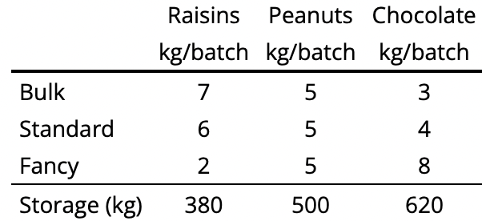
Do now…Get out your notebook/binder. Write down the date and goal.
The marketing department at ${\text{Jada}}^{2}$ Inc. has suggested that the company's trail mix products standardize with every mix being one-third peanuts. Adjusting the peanut portion of each recipe by also adjusting the chocolate portion leads to revised recipes, as given in the following table:
The production manager insists that enough of each mix should be made so that no ingredients are left over at the end of the day.
Be sure to…
Carefully read the text to the left, bulleting important information
Write a system of linear equations to represent the table.
Devise a strategy that uses linear algebra to determine how much of each mix the factory should make. If your unsure, write down at least one question you have.
Notes:
THIS PROBLEM CONTINUES ONE FROM PAST WEEKS HW.
Every batch has the same amount of peanuts (5 kg). The table contains info with new recipes.
7b + 6s + 2f = 380 5b + 5s + 5f = 500 2b + 5s + 8f = 620
You could try to find the inverse for the coefficient matrix, the multiply that by the solution matrix to find the value of [b s f].
+how could we know of this strategy won’t work? If the determinant is 0, then A doesn’t have a inverse

Slide 3
framing
what: Use linear algebra strategies to solve real world problems
why: These strategies are useful for solving problems in business, science, and engineering!
where to: What to do when a problem has more than one solution

Slide 4
Warm up: Stop ‘n’ jot
Be sure to… make sure the vocab below is in your notes (should be in yesterday’s notes). Then answer the questions below. Be sure to write at least a complete sentence in your notes for each question.
How is the cofactor matrix for a matrix A related to A?
How is the adjugate for a matrix A related to A?
Why is it useful to find the adjugate of a matrix? Make reference to the equations below in your answer:
$$AX=B$$
$$X=A^{-1}B$$
$$A^{-1}=\frac{\text{adj}(A)}{\text{det}(A)}$$
What does it mean if the determinant of a matrix is 0?
Transpose
If B is the transpose of $A$ than the first row of $A$ becomes the first column of B, and so on.
Cofactor matrix
The cofactor matrix $C$ for a matrix $A$ replaces every element $a_{i,j}$ in $A$ with its cofactor $c_{i,j}$ in $C$
Adjugate
The adjugate of a matrix A $\text{adj}(A)$ is the transpose of the cofactor matrix $C^{T}$
Notes:
Each element in the cofactor matrix represents the cofactor for the corresponding element of A.
The adjugate is the transpose of the cofactor matrix of A.
If you know the adjugate and determinant for a matrix, you can find its inverse by dividing the adjugate by the determinant. The variable matrix X for a matrix equation AX=B can be found by multiplying the inverese by B.
IT means the matrix has no inverse!

Slide 5
Today’s activity
Your goal today is to determine how much of each mix should be made, so that both the marketing department and the production manager are happy. You’ll be using a worksheet to help guide your work.
Be sure to…
Do all work on notebook paper
Carefully follow the directions on the worksheet
Be prepared to turn in your work at the end of the period!
The marketing department at ${\text{Jada}}^{2}$Inc. has suggested that the company's trail mix products standardize with every mix being one-third peanuts. Adjusting the peanut portion of each recipe by also adjusting the chocolate portion leads to revised recipes, as given in the following table:
The production manager insists that enough of each mix should be made so that no ingredients are left over at the end of the day.
Notes:
See handwritten answer key for solutions
Pre-planned questions:
+What does it tell you if the matrix has no inverse? It means that there isn’t just one solution for this problem, so the quick formula won’t work
+How do determine if the system has no solutions or infinitely many? Apply gaussian elimination to [A | B]. You’ll get row echelon form [A’ | B’] if you get any rows where all the values of A’ are 0 then there isn’t one solution (but you already know this because the determinant is 0). If the value for B’ in that row is not 0, then there’s no solution, otherwise infinitely many.
+ How can I find a solution that works? Pick an arbitrary value for for f, then think about how you can use your row echelon form to figure out the amount of b and s to use.

Slide 6
Reflection: Thinking about thinking
be sure to: Answer each question below with a complete sentence. Be prepared to share out!
Why is it important that the coefficient matrix doesn’t have an inverse?
How does using linear algebra make this problem easier to solve than without it?
Notes:
last five minutes of class. share out.
It means that the problem doesn’t have a unique solution. It either has none or infinitely many.
We have multiple strategies available. First finding the inverse, then using Gaussian elimination to find one of infinitely many solutions

Slide 7
wrapping up!
be sure to: read the directions below!
Make sure there isn’t any litter near your workstation.
If you borrowed headphones, sign them back in.
Make sure you are logged out of your computer!
Remain in your seat until the bell rings.

