Slide 1
Spring 2022 precal
Lesson 16.4
Dr. O’Brien
Herbert Lehman High School
26 May 2022

Slide 2
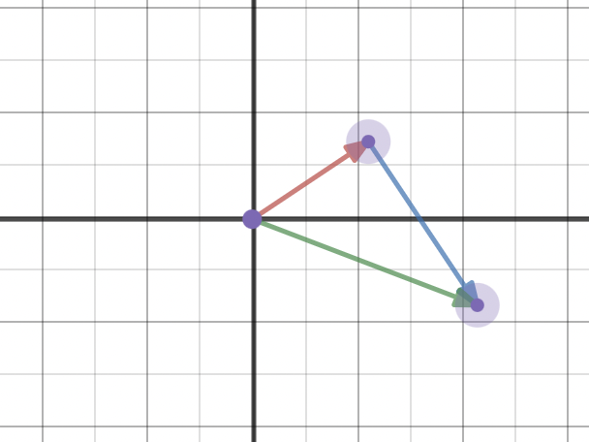
Do now
Be sure to…
Grab handout. Find seat. Take out the notebook/binder. Copy date and goal.
Answer the two questions below in your notebook:
Describe the graph to the right. Be as detailed as possible.
What is a linear combination and how is it related to the diagram?

Slide 3
Mini lesson
Scalar multiple of vector (Review)
The product of multiplying a vector by a scalar
Be sure to…
Copy the vocab item to the right.
Follow along with work on board.
Linear combination (Review)
Sum of the scalar multiples of two vectors
Vector space $R^{2}$
The set of all vectors with two components
Column space of a matrix M
The set of all linear combinations of the column vectors of M. For $AX=B$, B must be in the column space of $AX$
Notes:
See notes.
The vector space R squared can be drawn as an xy grid.
Any two vectors in a vector space can be added, the third vector will be in the same vector space. Any vector ,multiplied by a scalar will be in the same vector space.
Eg if (2,4) and 3 4 are in required than obviously 5 8 are in r squared as well.

Slide 4
Independent work
Draw $\overset{⃗}{v}=\left[\begin{aligned}4 \\ 1\end{aligned}\right]$and $\overset{⃗}{w}=\left[\begin{aligned}2 \\ 2\end{aligned}\right]$, find $\overset{⃗}{v}+\overset{⃗}{w}$ and $\overset{⃗}{v}-\overset{⃗}{w}$ and represent on an xy grid.
If $\overset{⃗}{v}+\overset{⃗}{w}=\left[\begin{aligned}5 \\ 1\end{aligned}\right]$and $\overset{⃗}{v}-\overset{⃗}{w}=\left[\begin{aligned}1 \\ 5\end{aligned}\right]$, what is $\overset{⃗}{v}\text{and}\overset{⃗}{w}$?
On an xy grid, draw all nine linear combinations for $c\left[\begin{aligned}2 \\ 1\end{aligned}\right]+d\left[\begin{aligned}0 \\ 1\end{aligned}\right]$, where $c=0,1,2$ and $d=0,1,2$.
Notes:
Make sure students are working quietly. See CodeHS problem guides for specific Python activities.
Frequently asked questions:
+I don’t know what to do!?! Make sure to carefully read the instructions. Take notes when watching the video.
+What are you trying to do with your program? answers will vary, direct student to assignment instructions.
+how can I figure out why my code doesn’t work? Try getting out a piece of paper, and following your commands yourself. What do you draw. Where do things go wrong?
+What do I do if I forget a command? See the docs section of CodeHS.

Slide 5
wrapping up!
be sure to: read the directions below!
Make sure there isn’t any litter near your workstation.
If you borrowed headphones, sign them back in.
Make sure you are logged out of your computer!
Remain in your seat until the bell rings.

