Slide 1
Fall 2021 AP CS A
Lesson 2.2
Dr. O’Brien
Herbert H. Lehman High School
8 February 2022
Notes:
VOCAB:
nested loop

Slide 2
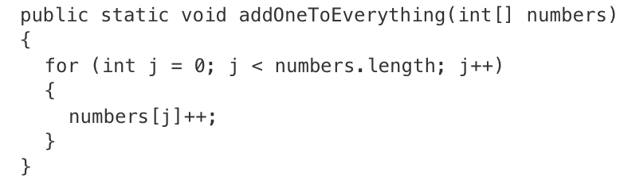
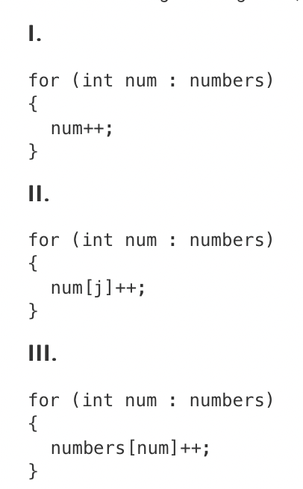
Do now
be sure to: Get out your binder. Copy goal and answer do now questions below. Show all work or write a complete sentence for each answer:
Which of the following code segments, if any, can be used to replace the body of the method so that numbers will contain the same values?
Notes:
1. only. The num will return an element of the array, not an index, so II and III won’t work.
use code tracing table to illustrate how enhanced for loop works.

Slide 3
framing
what: traverse the elements in a 1D array object using an enhanced for loop
why: This provides us with a simplified structure for traversing a collection of items
where to: Common algorithms using arrays

Slide 4
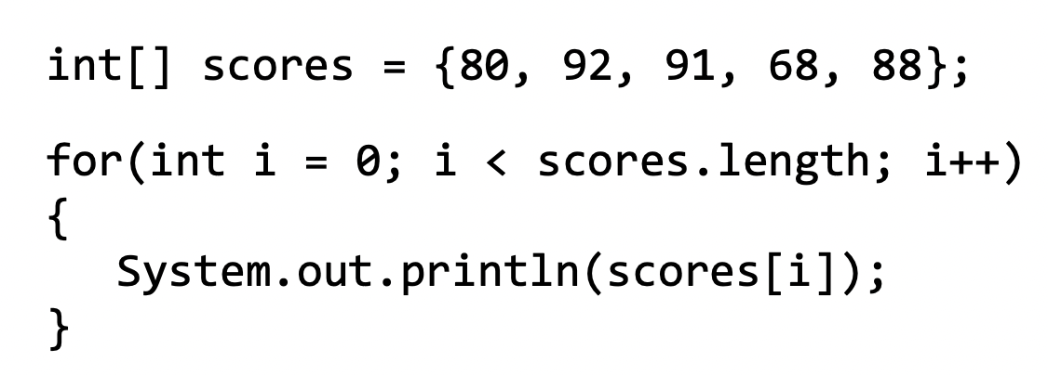
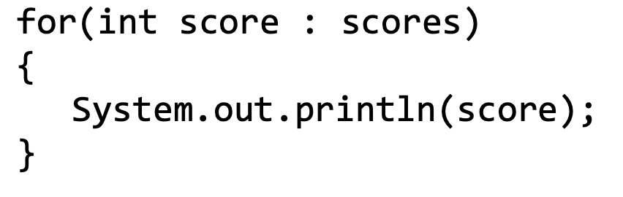
Vocab (review)
be sure to: Keep your notebook open. These definitions should be in your Glossary. If not Copy each definition, in your Java Glossary.
A regular for loop:
Enhanced for loop
A simplified, but less flexible way to loop through a collection of items. Often called a a for-each loop.
An enhanced for loop:
Notes:
Inside the loop, the enhanced for loop variable is assigned a copy from the array without using the array index. Making changes to the enhanced for loop variable does not change the original value in the array.
+What are some reasons it could be useful to use an enhanced for loop? Enhanced for loops offer a simplified structure and are especially good when using nested loops. They tend to be easier to write
+What are some reasons to use a standard for loop? A for loop uses a counter variable which is sometimes needed in your loop. Since enhanced for loops only make a copy with no reference to the index, they are not optimal if you need to update values in the array

Slide 5
Coding to learn
be sure to: Log in to Workstation. Work on CodeHS exercises below. Make sure to write out a plan before you start coding!
A regular for loop:
Exercise 6.3.6: Print Odds
Excercise 6.3.7: Largest Value
Excercise 6.3.8: Classroom Array
Excercise 6.3.9: Array average
Complete any exercises you don’t finish here as homework!
An enhanced for loop:
Notes:
SOLUTION CODE (REQUIRES CODEHS):
Exercise 6.3.6: Print Odds
Excercise 6.3.7: Largest Value
Excercise 6.3.8: Classroom Array
Excercise 6.3.9: Array average
Go through student solutions at the end of class.

Slide 6
Reflection: Thinking about thinking
be sure to: Answer each question below with a complete sentence.
What are the advantages of using an enhanced loop?
When would a standard for loop be a better choice?
Notes:
+What are the advantages of using an enhanced loop?
Enhanced for loops offer a simplified structure and are especially good when using nested loops.
+When would a standard for loop be a better choice?
When the counter variable is needed or if you are looking at updating values in your array, you need to use a for loop.

