Slide 1
Fall 2021 AP CS A
Lesson 9.5
Dr. O’Brien
Herbert H. Lehman High School
8 April 2022

Slide 2
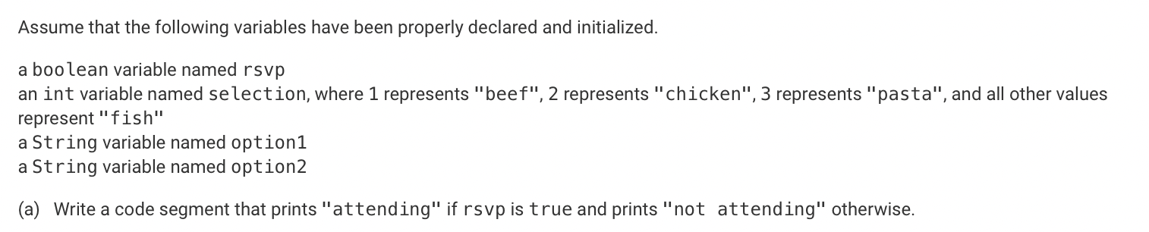
Do now
Be sure to…
Examine the prompts below, writing down key info.
Identify the preset variables.
What topic do you think these questions come from?
Notes:
5! = 5*4*3*2*1 = 120
num combinations:
4! / 3!(4-3)! = 4! / 3!*1! = 4! / 3! = 4*3*2*1 / 3*2*1 = 4

Slide 3
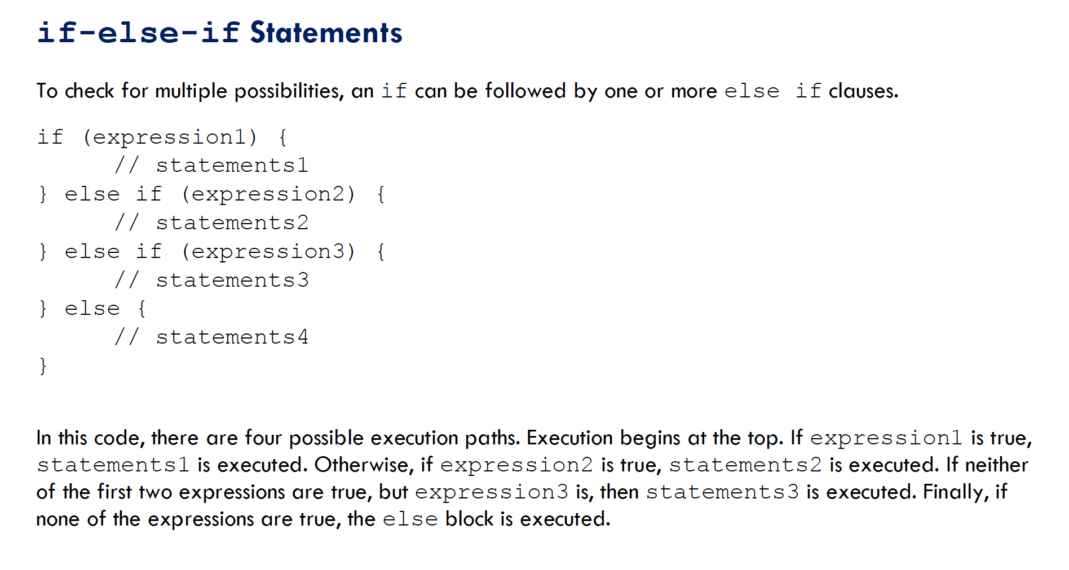

Slide 4
Notes:
if (rsvp){
System.out.println(“attending”);
} else{
System.out.println(“not attending”);
}
+Why don’t you need to declare rsvp? it’s assumed to already hae been delcared
b.
if selection == 1:
print(“Beef”)
else if selection == 2:
etc.
else:
print fish

Slide 5
(c) Write a code segment that will store a dinner selection in option1 based on the values of rsvp and selection. The intended behavior of the code segment is described below.
If rsvp is true, the code segment should store in option1 a string indicating the person’s attendance and food choice. For example, if rsvp is true and selection is 1, the following string should be stored in option1.
"Thanks for attending. You will be served beef."
If rsvp is false, the following string should be stored in option1, regardless of the value of selection.
"Sorry you can't make it."
(d) Write a code segment that will print true if the strings option1 and option2 contain the same values and will print false otherwise.
Notes:
if selection == 1:
food = (“Beef”)
else if selection == 2:
food = “chicken”
etc.
else:
food = fish
if rsvp:
option1 = “THanks for attending. You will be served” + food;
else:
“Sorry you can’t make it

Slide 6
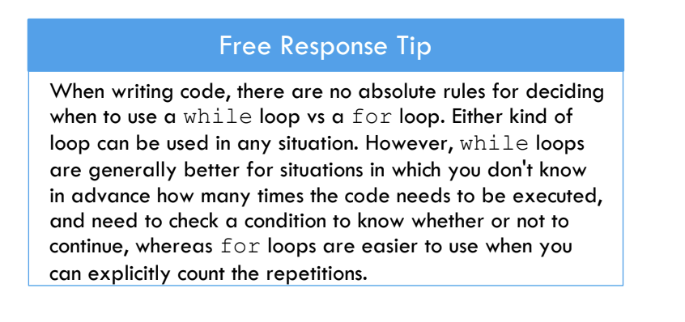
Iteration
This just refers to using while loops and for loops

Slide 7
practice problem: question 1
work on Unit 4 progress check on AP Classroom!
The method longestStreak is intended to determine the longest substring of consecutive identical characters in the parameter str and print the result.
For example, the call longestStreak("CCAAAAATTT!") should print the result "A 5" because the longest substring of consecutive identical characters is "AAAAA".
Complete the method. Your implementation should conform to the example above.

Slide 8
Reflection: Thinking about thinking
be sure to: Answer each question below with a complete sentence.
What do you understand better after today’s review session?
What do you still need to work on?

