Slide 1
Fall 2021 Pre-calculus
Lesson 12.2
Dr. O’Brien
Lehman High School
April 26, 2021
Notes:
students need calculators
no new vocab

Slide 2
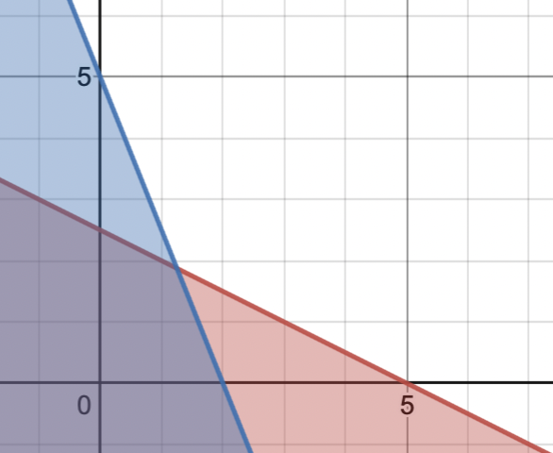
do now
be sure to: Get out your binder. Copy goal and answer do now questions below. Show all work or write a complete sentence for each answer:
How are these two equations related to the graph to the right?
How can this be used to find the maximum value of $x+y$?
$$5x+2y≤10$$
$$x+2y≤5$$
Notes:
see handwritten notes for solution

Slide 3
framing
what: use graphical method to find the optimal solution for a problem?
why: this is actually another way to represent the algorithm we learned before break
where to: Fun with polynomial functions
Notes:
the plan: We’ll go through one of the Pset #5 word problems together.
You’ll work with a partner to solve some other word problems

Slide 4
Warm up
be sure to: Carefully reread the paragraph below, then answer each question below with a complete sentence.
A carpenter makes tables and bookshelves. Tables take 10 units of lumber and five units of labor, and are sold for $180. Bookshelves take 20 units of lumber and four units of labor, and are sold for $200. The carpenter doesn’t want to work more than 80 hours in a week and only has 200 units of lumber.
Review from your notes. What are the relevant constraints for this problem?
How can the graphical method be used to solve this problem? (write a paragraph explanation using the vocab below, you don’t need to solve the problem).
Feasible region
The part of a graph that satisfies all the constraints for an optimization problem
Graphical method
The optimal solution for a problem is always one of the vertices of the feasible region
Notes:
see handwritten notes
see handwritten notes. Also BST from next slide

Slide 5
Independent work :the carpenter problem
Now the carpenter only wants to work 40 hours and has 120 units of lumber on hand. Tables still take 10 units of lumber and five units of labor, and are sold for $180. Bookshelves take 20 units of lumber and four units of labor, and are sold for $200. How many tables and bookshelves should the carpenter make to maximize revenue?
How does the problem change if the carpenter can only work 20 hours in one week?
be sure to: For each question:
Read the problem, bulleting key info.
Write down the constraints as inequalities.
Use Desmos graphing calculator to find the feasible region.
Use verticies of feasible region to solve the problem.
Feasible region
The part of a graph that satisfies all the constraints for an optimization problem
Graphical method
The optimal solution for a problem is always one of the vertices of the feasible region
Notes:
preplanned questions:
+What are you trying to optimize for this problem? The revenue, based number of bookshelves and tables to be made?
+How do you figure out the inequalities? Focus on lumber and labor, how much is used for each product, and what the maximum amount is.
+What do the variables x and y represent? tables and bookshelves?
+How can the desmos graphing calculator be useful? plot the feasible region and find the vertices. Those represent possible solutions.

Slide 6
d
Reflection
How is the graphical method different from the algorithm we learned before break? How is it similar?
Why is the graphical method useful?
What lingering questions do you have about the graphical method?

