Slide 1
Fall 2021 AP CS A
Lesson 5.5
Dr. O’Brien
Herbert H. Lehman High School
11 March 2022

Slide 2
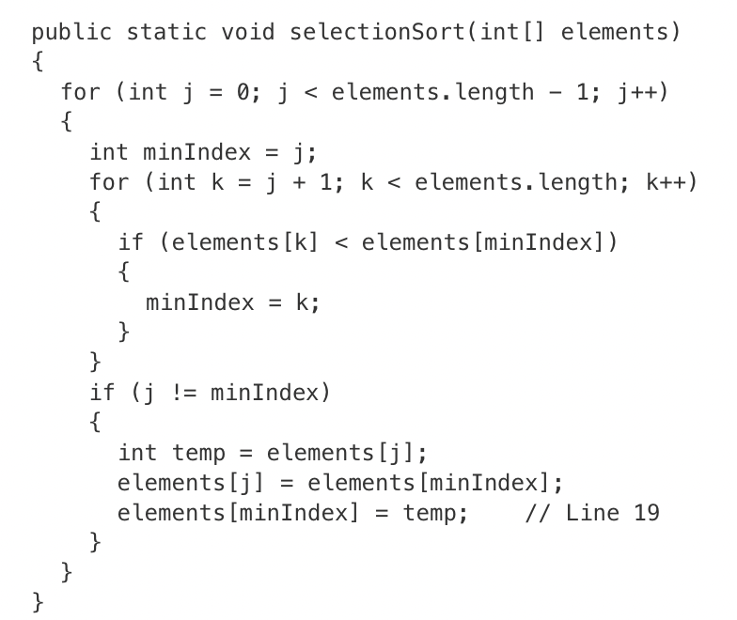
Do now
be sure to: Get out your binder. Copy goal and answer do now question below. Show all work or write a complete sentence for each answer:
The following declaration and method call appear in a method in the same class as selectionSort.
int[] arr = {9, 8, 7, 6, 5};
selectionSort(arr);
How many times is the statement elements[minIndex] = temp; in line 19 of the method executed as a result of the call to selectionSort ?
Notes:
2. The statement in line 19 executes each time a value is swapped into the correct position in the array. For the given array, the values 9 and 5 are swapped. Then the values 8 and 6 are swapped. Then, since 7, 8, and 9 are already in the correct position, no additional swaps occur.

Slide 3
framing
what: sort array lists with selection sort and insertion sort
why: ArrayLists are a useful means to store data. Today we’ll get some practice traversing them.
where to: ArrayList traversal with enhanced for loops

Slide 4
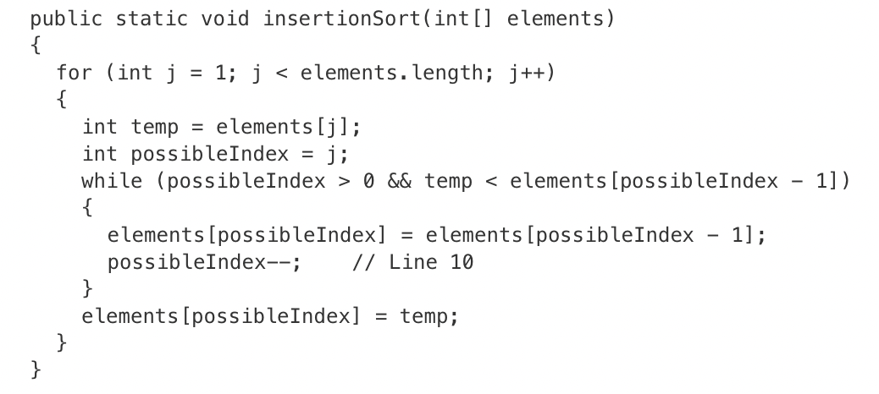
Warm up
The following declaration and method call appear in a method in the same class as insertionSort.
int[] arr = {9, 8, 7, 6, 5};
insertionSort(arr);
How many times is the statement possibleIndex—-; in line 10 of the method executed as a result of the call to insertionSort ?
Notes:
5.
The statement in line 10 is executed each time an element is moved in the array. In the second iteration of the for loop, the 12 located at index 1 is moved to index 2, and 4 is inserted at index 1. The array now contains {4, 4, 12, 7, 19, 6} and line 10 has executed 1 time. In the third iteration of the for loop, the 12 located at index 2 is moved to index 3, and 7 is inserted at index 2. The array now contains {4, 4, 7, 12, 19, 6} and line 10 has executed 1 additional time, for a total of 2 times. In the fifth iteration of the for loop, the 19 located at index 4 is moved to index 5, the 12 located at index 3 is moved to index 4, the 7 located at index 2 is moved to index 3, and 6 is inserted at index 2. The array now contains {4, 4, 6, 7, 12, 19} and line 10 has executed 3 additional times, for a total of 5 times.

Slide 5
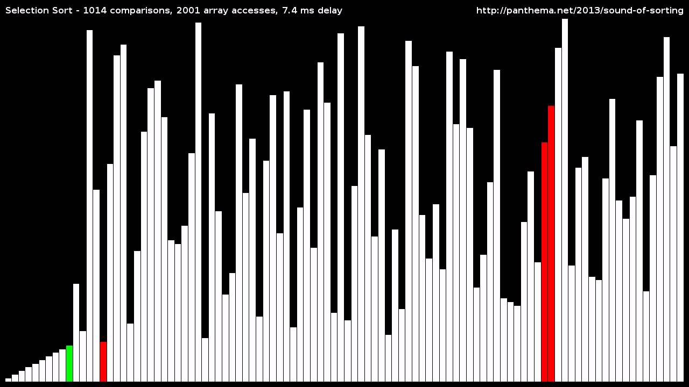
Warm up: Videos of selection sort and insertion sort
Watch the videos below
Notes:
selection sort: https://www.youtube.com/watch?v=92BfuxHn2XE
insertion sort: https://www.youtube.com/watch?v=8oJS1BMKE64
KEPT HERE FOR SMALL GROUP WORK WITH STUDENTS

Slide 6

Warm up: Videos of selection sort and insertion sort
Notes:
selection sort: https://www.youtube.com/watch?v=92BfuxHn2XE
insertion sort: https://www.youtube.com/watch?v=8oJS1BMKE64
merge sort:

Slide 7
Warm up: selection sort and insertion sort
Writing to learn: What similarities and differences did you notice between the two videos?
Notes:
selection sort: https://www.youtube.com/watch?v=92BfuxHn2XE
insertion sort: https://www.youtube.com/watch?v=8oJS1BMKE64
do activity with paper. explain insertion sort

Slide 8
Vocab
be sure to: Keep your notebook open. These definitions should be in your Glossary. If not Copy each definition, in your Java Glossary.
Selection sort (Review)
Sorts an array by repeatedly finding the minimum value, and moving it to the front of the array.
Insertion sort
Sorts an array by sorting each element compared to the elements already sorted to their left.

Slide 9
Independent work
be sure to: Follow directions below
Selection sort
Sorts an array by repeatedly finding the minimum value, and moving it to the front of the array.
Write out a pseudocode algorithm for selection sort. Show Dr. O’Brien.
Implement the algorithm (on board) for selection sort in 3/7: Selection Sort in Spring 2022: In-class Activities
Complete activity 3/8 insertion sort activity. Dr. O’Brien was trying to implement an insertion sort algorithm in Java, but he was tired and made a bunch of mistakes. Help him about by doing the following:
Comment in the code to make sure you understand it in the places indicated!
Determine what error’s Dr. O’Brien made. Explain where the errors are at the bottom of the program. Then fix the errors and make sure everything works correctly.
Insertion sort
Sorts an array by sorting each element compared to the elements already sorted to their left.
Notes:
1.
public static int findMinIndex(int start, ArrayList<Integer> arr){
int minIndex = start;
for (int index = start + 1; index < arr.size(); index++){
if (arr.get(index) < arr.get(minIndex)){
minIndex = index;
}
}
return minIndex;
}//end findMinIndex
public static void swapIJ(int i, int j, ArrayList<Integer> arr){
int temp = arr.get(i);
arr.set(i, arr.get(j));
arr.set(j, temp);
}// end swapIJ
public static void selectionSort(ArrayList<Integer> arr){
int nextMindex;
for (int index = 0; index < arr.size() - 1; index++){
nextMindex = findMinIndex(index+1, arr);
swapIJ(index, nextMindex, arr);
displayArrList(arr);
}
}
}
2.
see code
‘<‘ needs to be reveresed. for loop should extend to ‘last’ not ‘last -1’.

Slide 10
Reflection:
be sure to: Answer each question below with a complete sentence. Be prepared to share out!
What are some unexpected challenges that you ran into while working on the activities for today’s class?
What’s one thing you understand better about traversing arrayLists?
What lingering questions do you have?

