Slide 1
Fall 2021 AP CS A
Lesson 15.4
4Dr. O’Brien
Herbert H. Lehman High School
5 January 2022

Slide 2
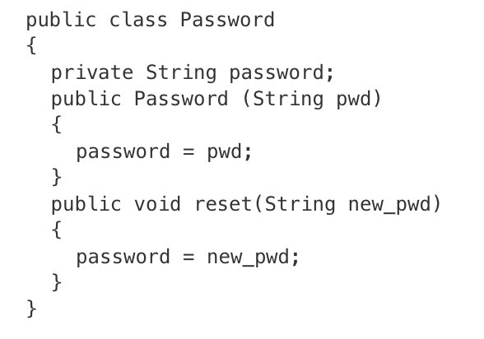
Do now
be sure to: Get out your binder. Copy goal and answer do now questions below. Answer the questions below and write a sentence justifying your answer.
Consider the following code segment, which appears in a method in a class other than Password. The code segment does not compile.
Password p = new Password("password");
System.out.println("The new password is " + p.reset(“password"));
Which of the following best identifies the reason the code segment does not compile?
The code segment attempts to access the private variable password from outside the Password class.
The new password cannot be the same as the old password.
The Password class constructor is invoked incorrectly.
The reset method cannot be called from outside the Password class.
The reset method does not return a value that can be printed.

Slide 3
framing
what: use methods to define the behavior of an object
why: It is a good programming practice to avoid altering objects within methods unless the method specifically calls for alterations to the object. Accessor and getter methods make obvious changes to objects, but most methods should not attempt to make changes unless it’s explicitly necessary.
where to: How to change formal parameters in methods

Slide 4
Vocab (review)
be sure to: Keep your notebook open. Copy the definitions in your notebook, if they are not there already.
getter method
Allows us to access specific instance variables in an object. Aka accessor methods.
setter method
Allows us to change specific instance variables in an object. Aka mutator methods

Slide 5
Coding to lean: Independent work
be sure to:
Go to your workstation.
Watch the video 5.6.1: Writing Classes
Work on following problems in CodeHS:
5.6.5: Distance conversions
5.6.6: Food App Demo
5.6.7: Car Class
We’ll go over the exercises at tehe end of class!
Notes:
see for full solutions: https://codehs.com/library/solution_references/assignment/55325723?section_id=256470
+Why aren’t the methods returning anything? Make sure that the return variable for the getter methods are the instance variables, NOT the formal parameters from the constructor.
+How do I implement the fight method (4.3.6)? The fight method takes the attack String and multiplies it by the level of the Dragon. Students should implement this using a for loop. The for loop should run from 0-level, and add the attack String to another String to create the correct length of the fight String.
+ How can I set canBreatheFire? (4.3.7)? canBreatheFire is based on the level of the Dragon. When the constructor is called, it should immediately test the level of the Dragon to determine if it can breathe fire. In the method gainExperience, canBreatheFire should also be updated depending on the level of the Dragon after the level has increased.
4.3.8:
+How can the Chef’s best meal be a Meal object? You can refer to the previous examples to see how to make instance variables of user-defined types. Essentially, just like we can have private int anIntField as an instance variable, we can have private Meal favoriteMeal as an instance variable! To define the best meal in the Chef constructor, first make a Meal object. Then pass that object to the Chef constructor.
+How can the Chef access the Meal instance variables?Since the Meal class has private instance variables, you cannot directly access them. You need to use the Meal accessor methods!

Slide 6
Exit ticket
be sure to: Get out a sheet of loose leaf paper. Write your name and the date on the top. Answer each question below with a complete sentence. Be prepared to turn in!
Answer the questions below.
Why are instance variables in a class kept private?
What are getter (aka accessor) and setter (aka mutator) methods used for?
What is the toString() method used for?
Notes:
They are kept private so that they cannot be altered or accessed outside of the class accept by special, programmer defined methods.
These are the programmer defined methods for accessing (getter) and changing (setter) data in a class. This allows the programmer to control whether and how the data in an object can be accessed and changed.
toString is a special method that always returns a string. It’s what accessed by the Java print methods.

