Slide 1
Fall 2021 AP CS A
Lesson 7.4
Dr. O’Brien
Herbert H. Lehman High School
March 25 2022

Slide 2
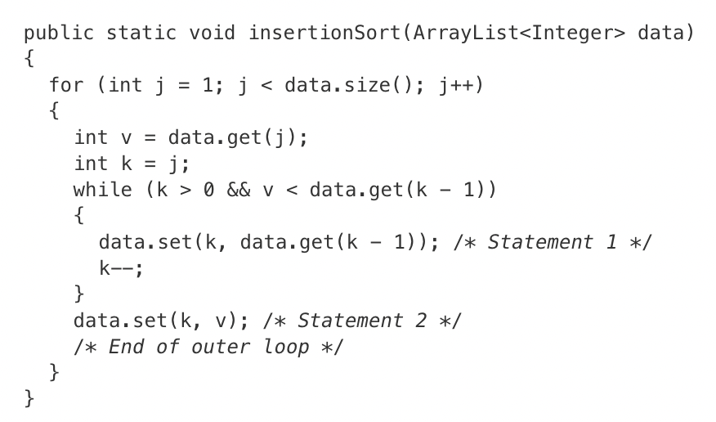
Do now
Be sure to…
Get out your binder. Copy goal and date.
Answer the question below:
Consider the following correct implementation of the insertion sort algorithm. The insertionSort method correctly sorts the elements of ArrayList data into increasing order.
How many times will the statements indicated by /* Statement 1 */ and /* Statement 2 */ execute?
statement1 1: 0, statement 2: 0
statement 1: 0, statement 2: 5
statement 1: 0, statement 2: 6
statement 1: 5, statement 2: 5
statement 1: 6, statement 2: 6
Assume that insertionSort is called with an ArrayList parameter that has been initialized with the following Integer objects.
[1, 2, 3, 4, 5, 6]
Notes:
A. this means that you use some other means, such as indentation, to indicate the scope of a function or control structure. If you forget a bracket, semi-colon, or parens but it’s clear from the code what’s going on, you won’t be docked points. In other words, the code is allowed to look more Python-like than actual code that would be read by a Java compiler (which begs the question why we aren’t just using Python…).
B. No, only one variable actually has to be declared. I assume this shows you know how to declare variables so they don’t care if you fail to consistently declare new variables.
C. Possible questions:
+what is a side-effect? code has a side effect if it has effects outside of its intended scope. +What is a non-op? A ‘non-op’ is a statement that has no effect on the program. This would be a ; with nothing else in Java (or pass in Python). Also a slang term in coding world for someone who doesn’t contribute anything to a project. +What does collection access refer to? A collection is another way to store data in Java. We’ll learn about it next unit. +What does it mean to use a keyword as an identifier? This means, e.g., to use a word like ‘class’ as a variable name

Slide 3
framing
what: use AP scoring guidelines to self-assess on free response questions
why: This will help you understand what a good answer looks like on AP free response questions.
where to: Review (tomorrow). Arrays exam (Thursday)

Slide 4
Independent work: How to grade a free response question
Be sure to…
Read the question scoring rubric for each problem
Examine the student’s solution (handout).
In your notebook
use the penalty points guidelines and rubric criteria to assign a grade to this student’s work, citing specific reasons to justify your grade.
Remember: You can give points for the reasons indicated and also take points away.
Notes:
+Why don’t we take points away for missing curly brackets? Because curly brackets are unnecessary as long as “structure conveys intent”, which in this case is accomplished through indentation
why does the student lose points for not declaring the sum variable? because they don’t declare any other variables anywhere else.
This student would end up with +1 point. They gain two points for (i) traversing the elements of arr with an enhanced for loop, and (ii) identifying divisibility with %. They fail to gain points for not correctly incrementing sum. They lose one point for not declaring any variables.

Slide 5
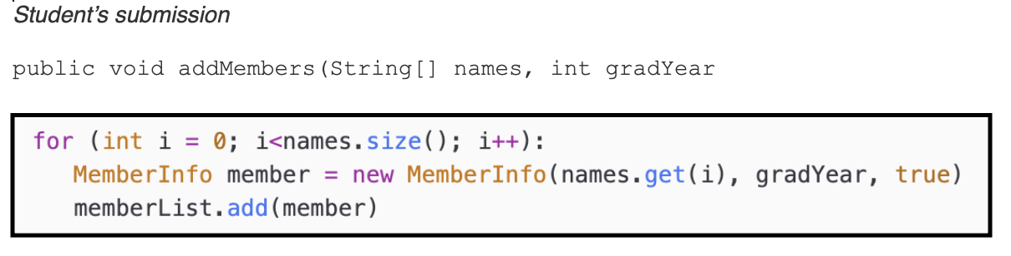
Free response: Part a
be sure to: Share out on the discussion questions below!
Discussion questions:
What questions do you have about this problem?
How would you grade this student’s work??
Scoring Guideline
+1 Access all elements of names (no bounds errors)
+1 Instantiates a MemberInfo object with names from array, provided year, and good standing.
+1 Adds memberInfo objects to memberList (in the context of a loop)
−1 Array/collection access confusion ([ ] get)
−1 (Extraneous code that causes side-effect (e.g., printing to output, incorrect precondition check)
−1 Local variables used but none declared
−1 Destruction of persistent data (e.g., changing value referenced by parameter)
Notes:
What is this problem asking you to do? Traverse a loop, finding each word ending in “-ing”, then printing that word.
How could you make a plan by writing a pseudo code algorithm for each item in ARRAY: if last three letters of item == “ing”: then print(item)
How do you implement this in Java?
for (String word : words){
int length = word.length();
String ending = word.substring(length - 3, length);
if (ending.equals(“ing”){
System.out.println(word)
}
} +Why is it important to use .equals(), instead of == here? because “==“ means reference equality (comparing locations in memory). we want to compare the content of the two strings.
+how do I isolate the final three characters in a string? Use the subString method.

Slide 6
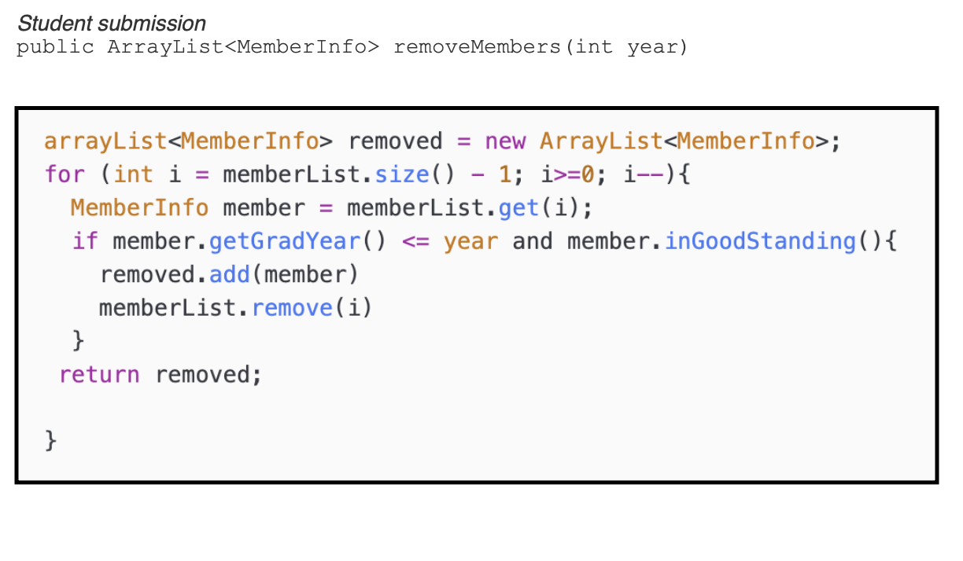
Free response: Part b
be sure to: Share out on the discussion questions below!
Discussion questions:
What questions do you have about this problem?
How would you grade this student’s work??
Scoring Guideline
+1 Declares and initializes an ArrayList of MemberInfo objects
+1 Accesses all elements of memberList for potential removal
+1 calls getGradYear or inGoodStanding
+1 distinguishes any three cases, based on graduation status and standing
+1 Identifies graduating members
+1 Removes appropriate members from MemberList and adds appropriate members to the ArrayList to be returned
Notes:
What is this problem asking you to do? Traverse a loop, finding each word ending in “-ing”, then printing that word.
How could you make a plan by writing a pseudo code algorithm for each item in ARRAY: if last three letters of item == “ing”: then print(item)
How do you implement this in Java?
for (String word : words){
int length = word.length();
String ending = word.substring(length - 3, length);
if (ending.equals(“ing”){
System.out.println(word)
}
} +Why is it important to use .equals(), instead of == here? because “==“ means reference equality (comparing locations in memory). we want to compare the content of the two strings.
+how do I isolate the final three characters in a string? Use the subString method.

Slide 7
Reflection: Thinking about thinking
be sure to: Answer each question below with a complete sentence. Be prepared to share out!
In what ways do you better understand the scoring process on Free response questions?
How does this change the way you approach free response questions in the future?
Notes:
Answers will vary, but students should have a better understanding of how the questions will be graded.
Students should pay less attention to certain details of Java syntax (brackets, parens, and so on) and more to the logical structure of their programs. This is why making a plan with pseudocode is helpful.

