Slide 1
Fall 2021 Java
Lesson 5.5
Dr. O’Brien
Lehman High School
October 22, 2021

Slide 2
do now
be sure to: Grab handout. Go to desk. Take out binder. Copy goal and answer do now questions below. Write a complete sentence for each question.
What are some similarities and differences between stack frame diagrams and the other code tracing tables we saw yesterday?
Why is it a good idea to be able to trace through code manually, instead of just running it on your computer?
The framing
what: use code tracing understand programs with booleans and if-statements?
why: Booleans and if-statements, along with other control structures are crucial to building more sophisticated programs. Code tracing is a convenient way to understand how programs work.
where to: Compound and equivalent boolean expressions
Notes:
we already went through this the end of class yesterday, but stack frame diagrams provide a better sense of what’s happening when. code tracing tables are useful for simpler problems.
debugging, preparing to make your own program, understanding someone else’s program so you can change it or use it!

Slide 3
Announcements
retake after class next week.
Please complete the post-test self assessment by Monday.

Slide 4
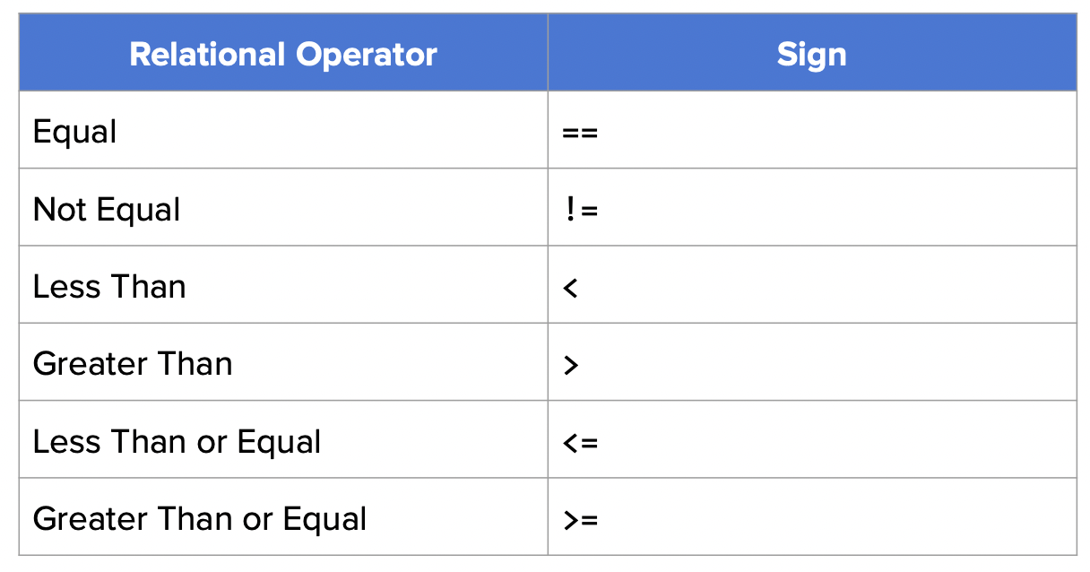
Boolean expressions
Booleans are expressions with a true or false value.
Booleans can use relational operators to store true/false information:
George Boole (1815-1864). Author of the “Laws of Thought”, a famous book on logic.
Notes:
If you wonder why we call them Booleans, they’re named after a guy named George Boole.

Slide 5
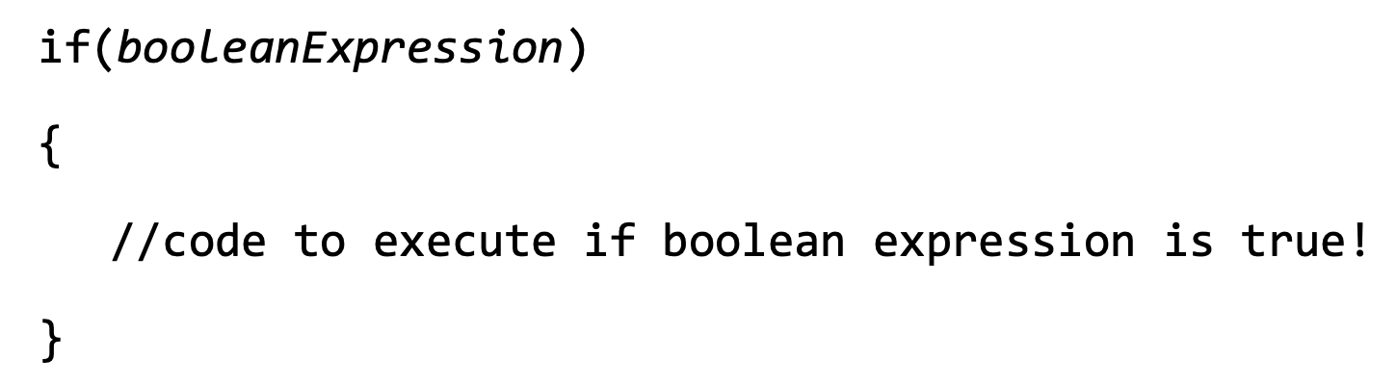
If statements
If statements are used when there are a set of statements that should be executed only when statements are met.

Slide 6
else statements
Else execute if the initial boolean condition is false.
if(booleanExpression)
{
//code to execute if boolean expression is true!
}
else
{
//code to execute if boolean expression is false!
}

Slide 7
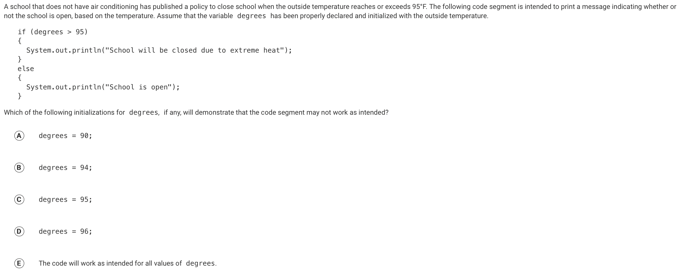
Notes:
C. The key phrase here is “reaches”.

Slide 8
Code tracing
Go to your computer. Find code tracing example (10/22) on Google Classroom
Be prepared to follow along in your notebook.
Notes:
see hand written notes

Slide 9
Be sure to…
Work in groups of 2.
Figure out what will happen when LSdriver is run.
Justify your answer (so that you would convince a skeptic)
Hint: Use a code tracing table!
Notes:
+ go through on board… see handwritten notes for solution and preplanned question

Slide 10
reflection
What was the most challenging thing about this activity?
What do you feel like you understand better than you did before?
What’s one question you still have?

