Slide 1
Fall 2021 Pre-calculus
Lesson 5.5
Dr. O’Brien
Lehman High School
October 22, 2021
Notes:
students need calculator
Parabola
Vertex

Slide 2
do now
be sure to: Get out your binder. Copy goal and answer do now questions below. Show all work or write a complete sentence for each answer:
Group work
Today we will be doing group work. Be sure to:
Work on each problem. Show all work and answer any questions in a complete sentence.
Stay together! Do not move on to the next problem until everyone in your group agrees on an answer.
After you finish a section, ask for the section answer key.
Fill out the Answer record (more on this next slide!).
Read the directions to the right.
What questions do you have? Write
them down for your do now.

Slide 3
framing
what: use vertex form and x-intercepts to graph quadratic equations.
why: Quadratic equations can be used to model things in science, engineering, and more!
where to: Use quadratic functions to solve real world problems

Slide 4
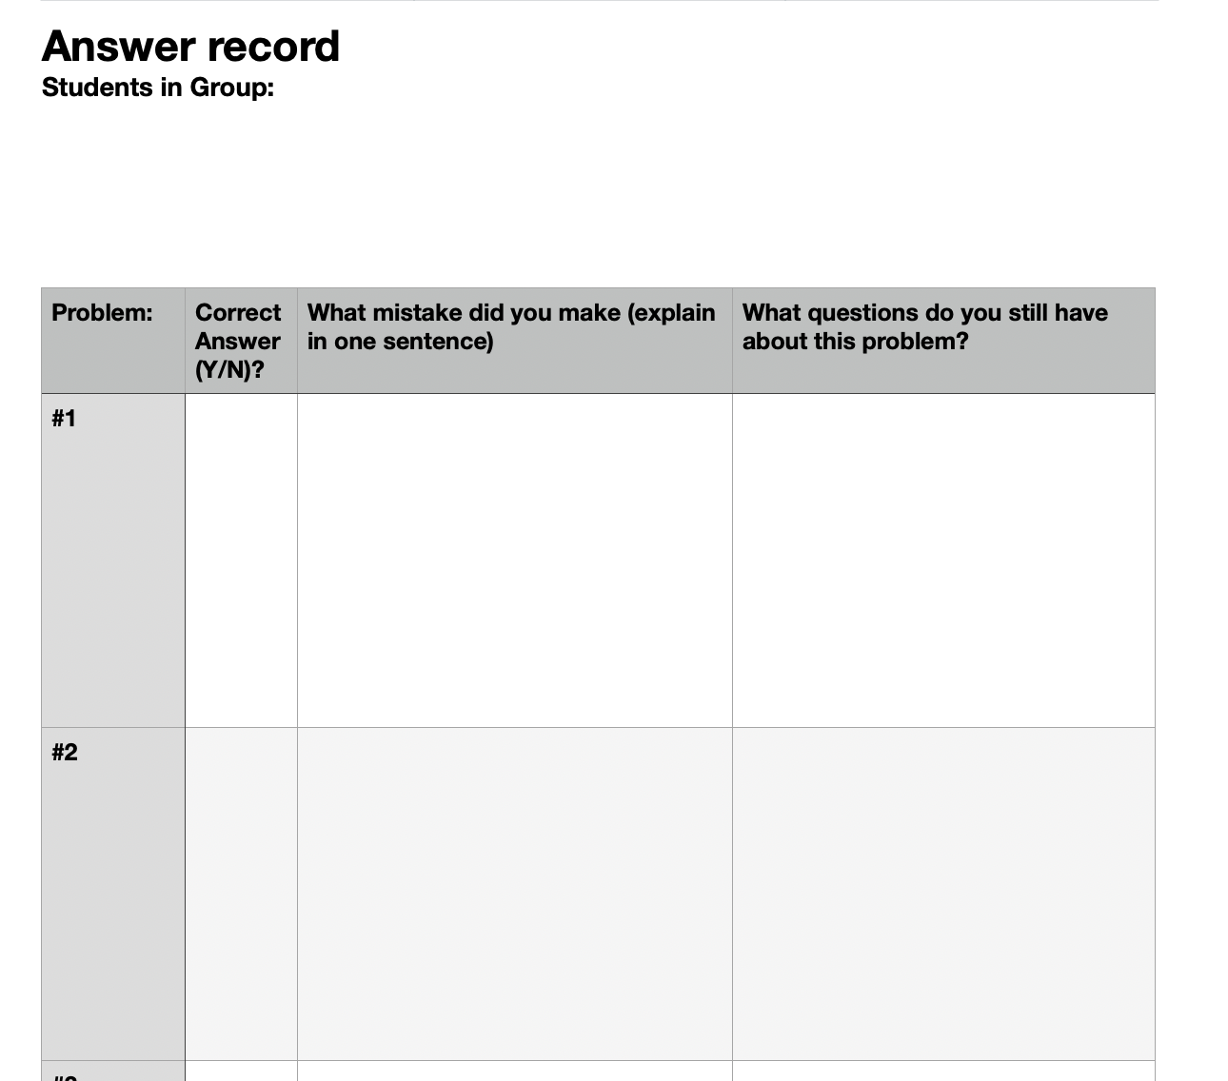
This is what you will turn in today!
Group work
Today we will be doing group work. Be sure to:
Work on each problem. Show all work and answer any questions in a complete sentence.
Stay together! Do not move on to the next problem until everyone in your group agrees on an answer.
After you finish a section, ask for the section answer key.
Fill out the Answer record (more on this next slide!).

Slide 5
Vocabulary
Vertex: Minimum or maximum point of a quadratic function
Parabola: The curve formed by the graph for a quadratic function.

Slide 6
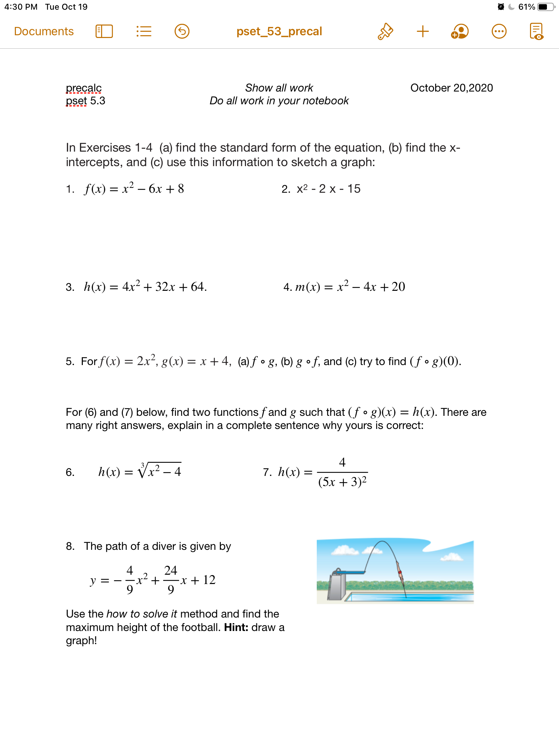
Notes:
See answer key

Slide 7
Notes:
+how rewrite in standard form?check notes!
How identify composite functions? Find a simpler function in the bigger one

Slide 8
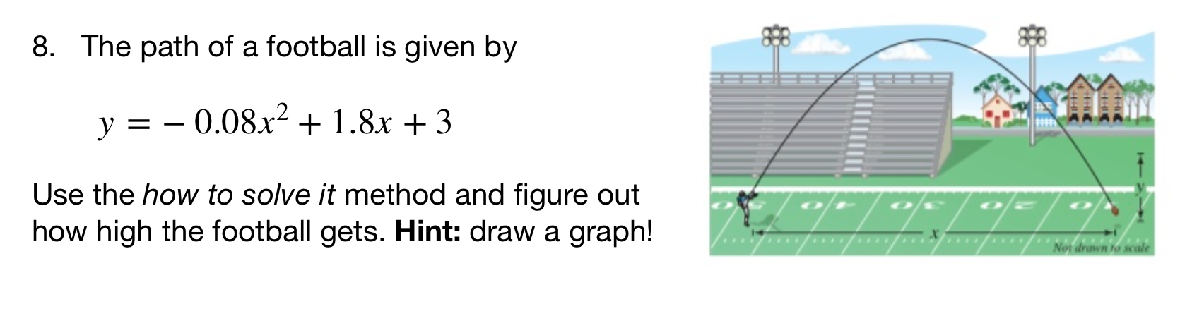
Notes:
See answer key
+hdw rewrite in standard form? Factor out-0.08, then it’s the same strategy as normal
+hdw know this graph will be a frowns face? It’s what the path of a football should look like. Also when we rewrite in standard form the coefficient is -.
+how do you tell from a sketch the highest point? It’s the vertex

Slide 9
d
exit ticket
be sure to: Answer on a sheet of loose leaf paper. Show all work or write a complete sentence for each answer:
Rewrite $h(x)=x^{2}-2x-12$ in standard form.
Find the x-intercepts then sketch a graph for the equation.
Notes:
(x^2 - 2x - 1) + 1 + 1
(x - 1)^2 + 2
vertex = (1,2)
2. sketch an upward facing quadratic with vertex at (1,2).

