Slide 1
Fall 2021 Precalc
Lesson 8.2
Dr. O’Brien
Herbert H. Lehman High School
29 March 2022
Notes:
VOCAB
adjugate
determinate

Slide 2
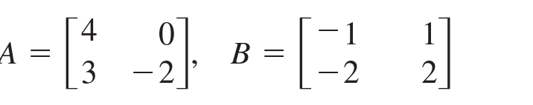
Do now…Get out your notebook/binder. Write down the date and goal.
Be sure to…
Find det($A$) and det($B$)
Find det($AB$)
What do you notice about the relationship between the three determinants?
Notes:
det(A) = -2*4 - 0*3 = -8. det(B) = -2 - -2 = 0
AB = [-4 4, 1 -1]. Det AB = 0.
Det AB = det A * det B

Slide 3
framing
what: find the minors and cofactors of a $3×3$ matrix
why: This will be useful to finding the adjugate and determinant (remember those?) of a square matrix.
where to: Using adjugate and determinant to find the inverse of bigger square matrices.

Slide 4
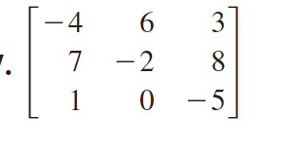
Warm up: Stop ’n’ Jot
Be sure to… Answer the question below in at least two complete sentences, in your notes. Be prepared to share out!
Find all of the minors for row 2.
Notes:
M11 = 2. M12 = -43. M13 = 2
M21 = -30 M22 = 17 M23 = -6
M31 = 54. M32 = -51. M33 = -34

Slide 5
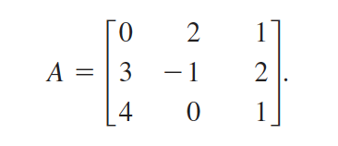
Mini-lesson Be sure to copy the notes below and on the board in your notebook & ask questions!
Practice problem #1: Find
the minors $M_{2,2}$ and $M_{3,3}$ for
the matrix below.
Vocabulary: if $A$ is a square matrix:
Minor
The minor $M_{i,j}$ for entry $a_{i,j}$ is the determinant of the
matrix gotten by deleting row $i$ and column $j$.
Practice problem #2: Find
the cofactors $C_{2,2}$ and $C_{3,3}$ for
the matrix below.
Cofactor
The cofactor $C_{i,j}$ for entry $a_{i,j}$ is given by
$C_{i,j}=(-1)^{i+j}×M_{i,j}$
Notes:
PP#1: M_11 = det ( [ -1 2, 0 1]) = -3
M_23 = det ( [ 0 2, 4 0]) = -8
PP2
C_11 = (-1)^{2) M_11 = -3
C_23 = -M_23 = 8

Slide 6
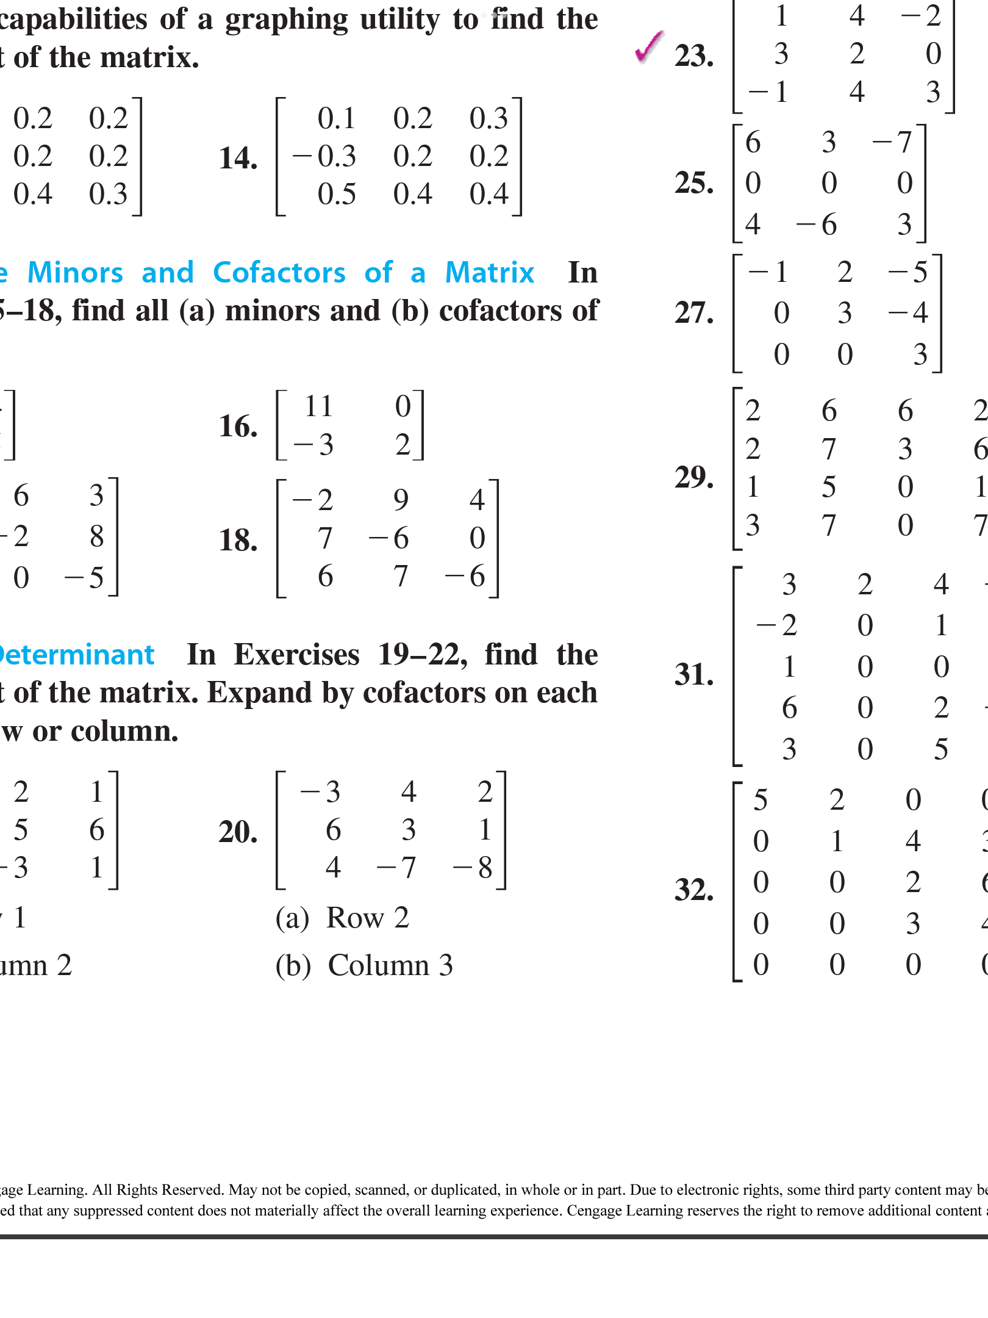
Independent work Be sure to:
Copy notes below (if you came in late).
Do problems to your left in your notebook..
Work silently for the first 4 minutes. After that you can check in with your neighbor.
Find all the minors for the matrix below. Then find all the cofactors.
How do you think you could find the minors and cofactors for a $2×2$ matrix? Explain in a complete sentence then find them for the matrix below.
Minor
The minor $M_{i,j}$ for entry $a_{i,j}$ is the determinant of the
matrix gotten by deleting row $i$ and column $j$.
Cofactor
The cofactor $C_{i,j}$ for entry $a_{i,j}$ is given by
$C_{i,j}=(-1)^{i+j}×M_{i,j}$
Notes:
see answer key for solutions
pre-planned questions:
+How do you find the adjugate/determinant? use the formulas on the board!!!
+How can I use the adjugate/determinant to find the inverese? adj(A)/det(A)
+How do I convert to AX=B? A is the coefficient matrix, X reprsents the variables and B the solutions
+Why can’t I just use substitution? Because we’re practicing using adjugates and determinates. It might seem silly here, but with bigger matrices it will be a LOT easier.

Slide 7
Reflection: Thinking about thinking
be sure to: Answer each question below with a complete sentence. Be prepared to share out!
Why do you think it’s important to find the cofactor and minor of a matrix (think back to framing)?
What’s one thing you’d like to understand better after today’s lesson?
Notes:
last five minutes of class. share out.

Slide 8
wrapping up!
be sure to: read the directions below!
Make sure there isn’t any litter near your workstation.
If you borrowed headphones, sign them back in.
Make sure you are logged out of your computer!
Remain in your seat until the bell rings.

