Slide 1
Fall 2021 AP CS A
Lesson 4.1
Dr. O’Brien
Herbert H. Lehman High School
28 February 2022

Slide 2
Do now
Be sure to…
Get out your binder. Copy goal and date.
Look through your exam. Write down any initial questions you have.

Slide 3
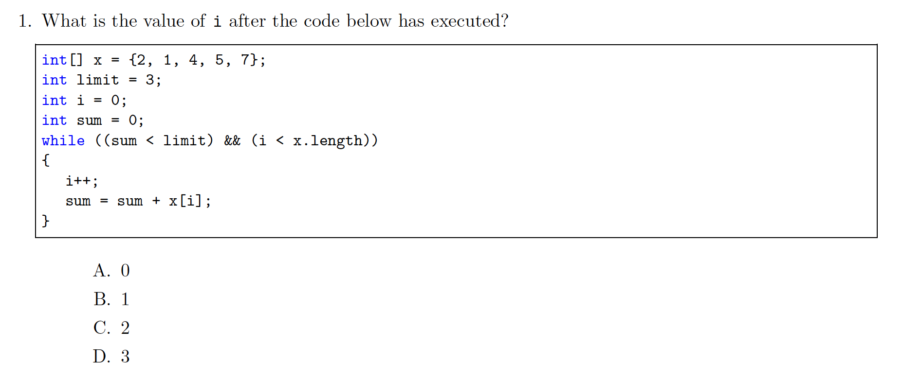
MC question 1
Canonical solution:
Notes:
answer: C (2)
i | sum
———-
0 | 0
1 | 0+1 = 1
2 | 1+4 = 5
sum !< limt -> halt

Slide 4
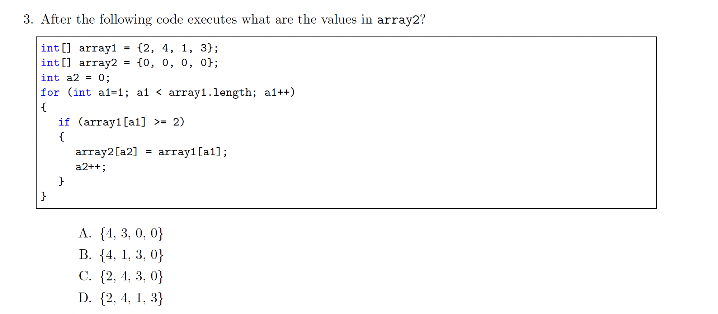
Canonical solution:
Notes:
answer: C {2,4,3,0}
array1 = {2,4,1,3}
array2 = {0,0,0,0}
a1 = 0
a2 = 0
array2 = {2,0,0,0}
a2 = 1
a1 = 1
array2 = {2,4,0,0}
a2 = 2
a1 = 2
a1 = 3
array2 = {2,4,3,0}
a2 = 3
halt.

Slide 5
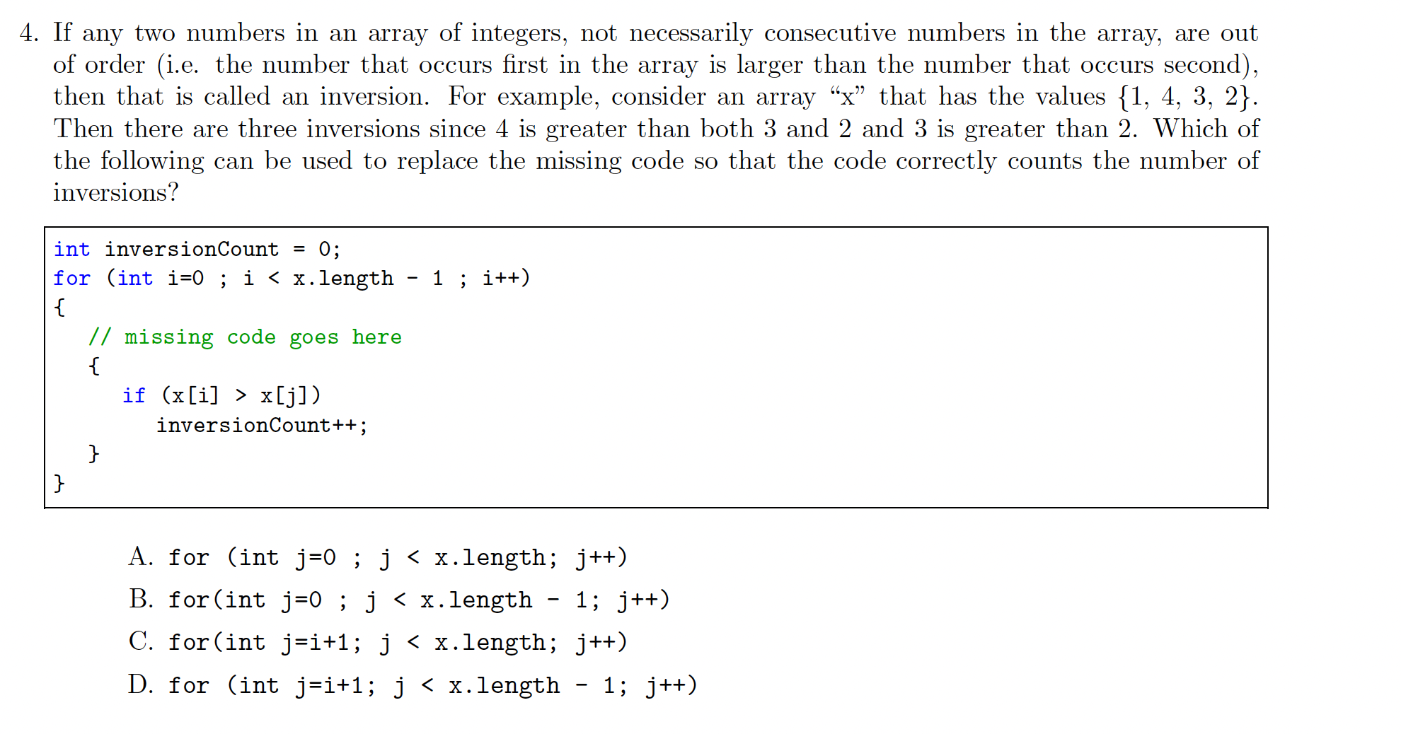
Notes:
C. You want to go through all remaining integers and check if they are greater than the current integer i.

Slide 6
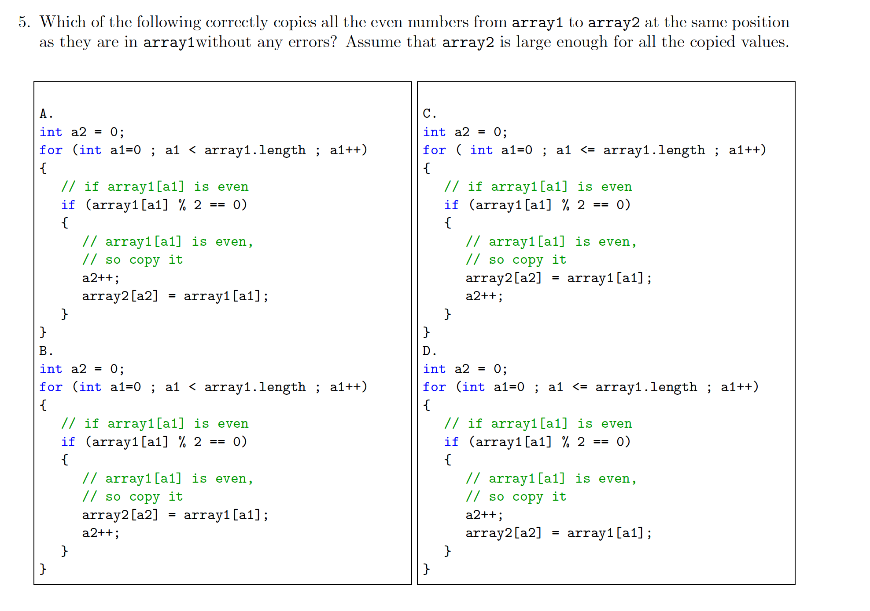
Notes:
array1 = {4,3,6}
array2 = {0,0,0}
a1=0
4 % 2 == 0
a2=0
array2 = {4,0,0}
a2 = 1
a1 = 1
3 % 2 != 0
a1=2
6%2 == 0
array2 = {4,2,0}

Slide 7
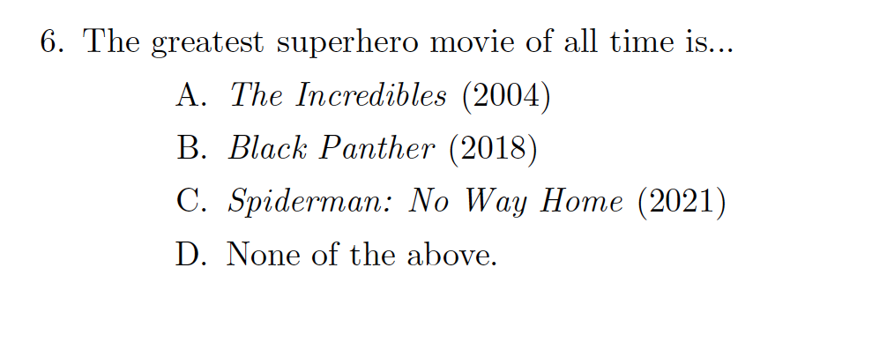
Notes:
“Tombstone” is not a superhero movie.

Slide 9
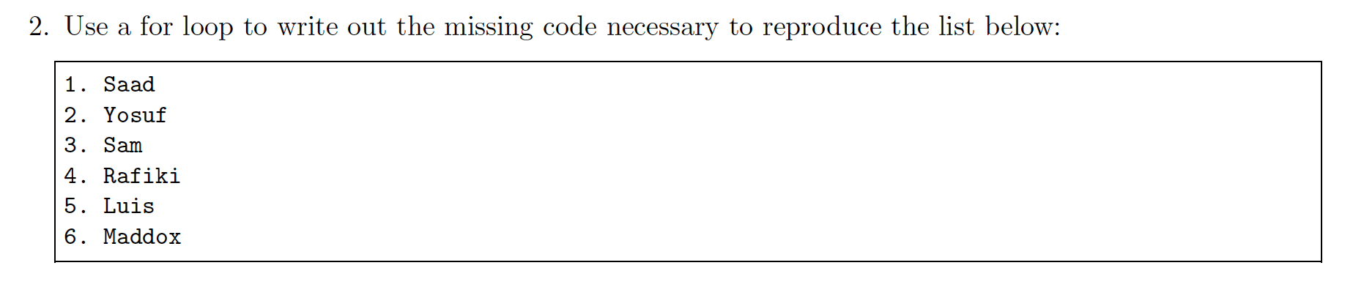
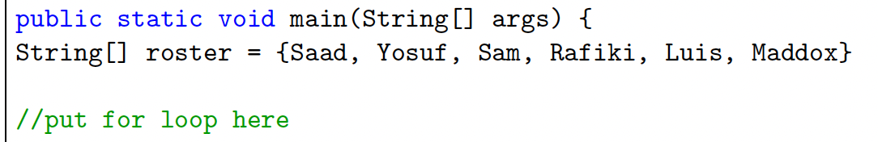
Notes:
have yosuf explain his solution at board.

Slide 10
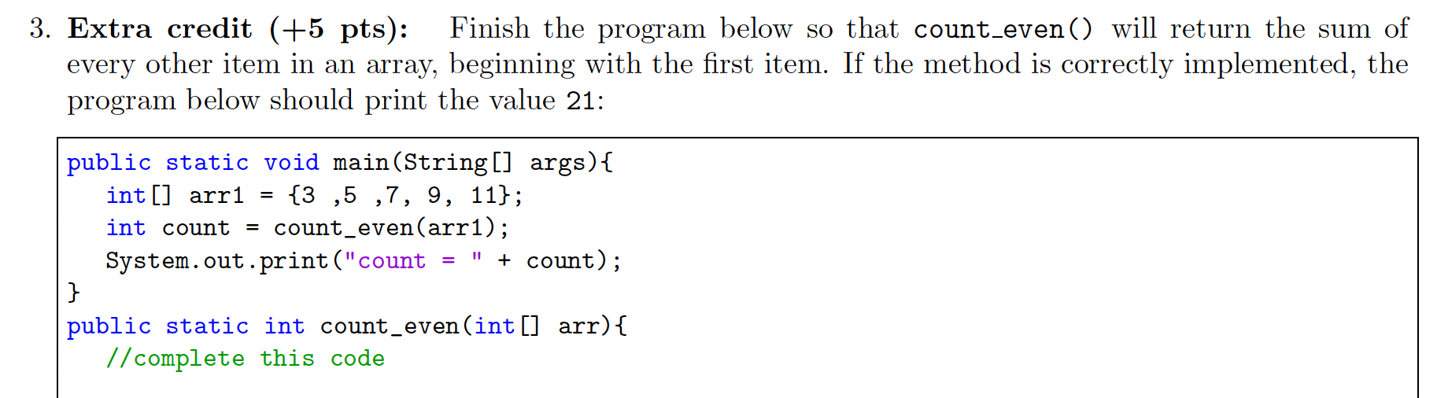
Notes:
int sum = 0;
for (int i = 0; i <arr.length; i+2){
sum+=arr[i];
}
return sum

Slide 11
Reflection: Thinking about thinking
be sure to: Answer each question below with a complete sentence. Be prepared to share out!
In what ways do you better understand arrays?
How does this change the way you approach MC and short response questions in the future?
Notes:
Answers will vary, but students should have a better understanding of how the questions will be graded.
Students should pay less attention to certain details of Java syntax (brackets, parens, and so on) and more to the logical structure of their programs. This is why making a plan with pseudocode is helpful.

