Slide 1
Fall 2021 AP CS A
Lesson 6.1
Dr. O’Brien
Herbert H. Lehman High School
14 March 2022

Slide 2
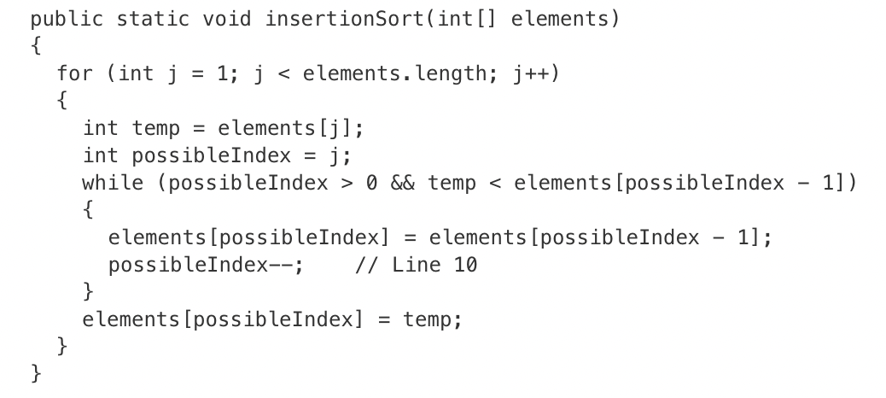
Do now
be sure to: Get out your binder. Copy goal and answer do now question below. Show all work or write a complete sentence for each answer:
The following declaration and method call appear in a method in the same class as insertionSort.
int[] arr = {9, 8, 7, 6, 5};
insertionSort(arr);
How many times is the statement possibleIndex—-; in line 10 of the method executed as a result of the call to insertionSort ?
Notes:
2. The statement in line 19 executes each time a value is swapped into the correct position in the array. For the given array, the values 9 and 5 are swapped. Then the values 8 and 6 are swapped. Then, since 7, 8, and 9 are already in the correct position, no additional swaps occur.

Slide 3
framing
what: use arrayList traversal to solve computational problems
why: ArrayLists are a useful means to store data. Today we’ll get some practice writing methods that use them.
where to: ArrayList traversal with enhanced for loops

Slide 4
Vocab
be sure to: Keep your notebook open. These definitions should be in your Glossary. If not Copy each definition, in your Java Glossary.
Selection sort (Review)
Sorts an array by repeatedly finding the minimum value, and moving it to the front of the array.
Insertion sort
Sorts an array by sorting each element compared to the elements already sorted to their left.

Slide 5
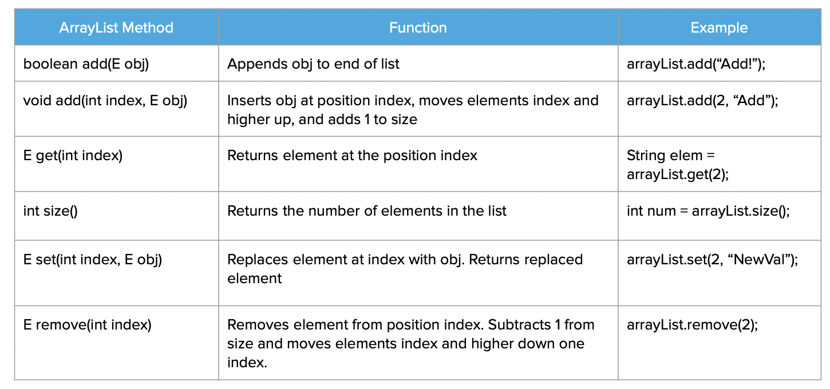
Independent work: ArrayList Free Response Question
be sure to…
Carefully read the instructions.
Review the grading rubric to the left.
With a partner work through each problem.
Points earned:
+1 [Skill 3.D] Constructs possibleNames
+1 [Skill 3.C] Generates substrings of all possible lengths in the context of a loop
+1 [Skill 3.A] Generates a user name in the correct format using substring and concatenation
+1 [Skill 3.D] Adds possible user names to possibleNames
General Penalties:
-1 (v) Array/collection access confusion ([] get)
-1 (w) Extraneous code that causes side effect (e.g., printing to output, incorrect precondition check)
-1 (x) Local variables used but none declared
-1 (z) Void method or constructor that returns a value

Slide 6
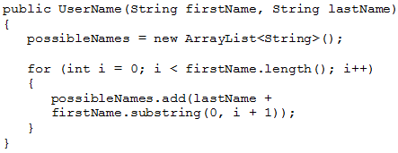
Independent work: ArrayList Free Response Question
be sure to…
Carefully read the instructions.
Review the grading rubric to the left.
With a partner work through each problem.
Part (1) solution:

Slide 7
Reflection:
be sure to: Answer each question below with a complete sentence. Be prepared to share out!
What are some unexpected challenges that you ran into while working on the activities for today’s class?
What’s one thing you understand better about traversing arrayLists?
What lingering questions do you have?

