Slide 1
Fall 2021 Java
Lesson 8.1
Dr. O’Brien
Herbert H. Lehman High School
November 8, 2021
Notes:
VOCAB:
for loop, boolean expression, variable initialization, increment

Slide 2
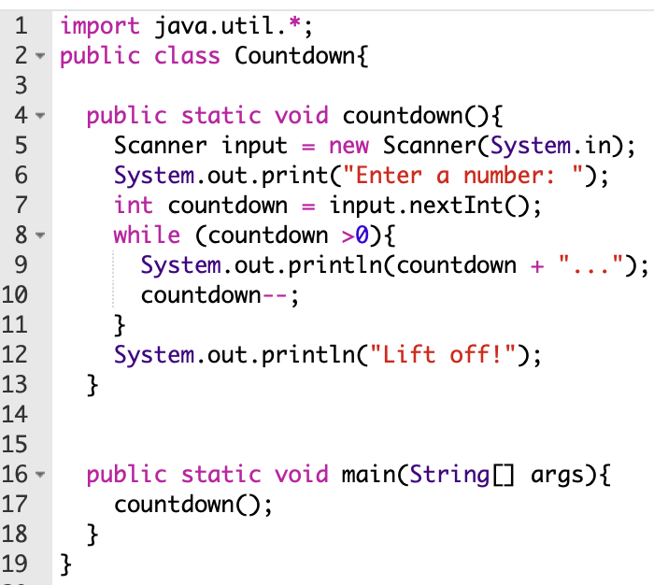
do now
be sure to: Get out your binder. Copy goal and answer do now questions below. Show all work or write a complete sentence for each answer:
Examine the code to the right.
Describe in your own words how it works, so that someone who’s never coded before could understand you.
Do you think you could rewrite this could using a for loop? Explain why or why not.
Notes:
answers will vary. Student might say that someone inputs a number. Then that number is printed out. and decreased by one; this continues to happen as long as the number is greater than 0. When you reach zero you print out “Lift off!” on the screen.
Answers will vary, students might say no because they expected the counter to increase by 1, but not decrease. Students might say yes if they recognize that the counter can increment, as well as decrement.

Slide 3
framing
what: use for loops loops to iterate code in Java
why: Along with the while loop, for loops are basic control structures that are crucial to any programming language. Today we’ll explore them in Java.
where to: Basic algorithms that use loops.

Slide 4
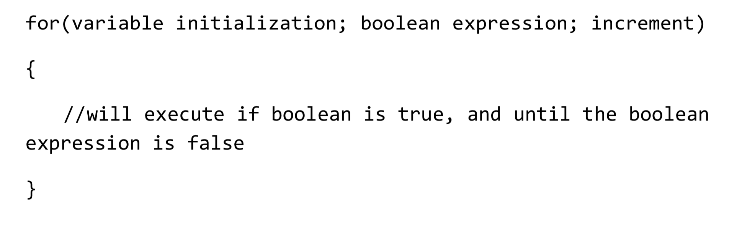
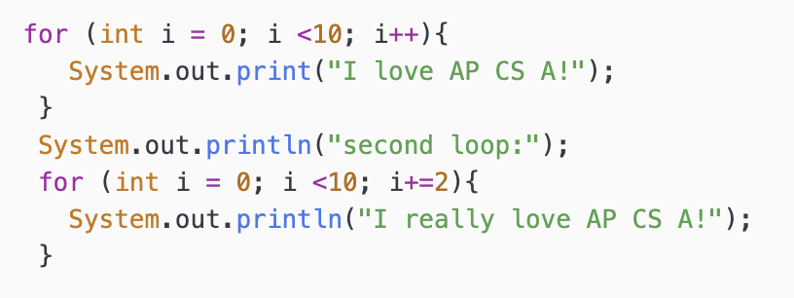
Vocab
be sure to: Keep your notebook open. Copy each definition, including the code sample, in your Java Glossary.
For loop
Variable initialization gives us the starting value for the counter.
Boolean expression sets the upper bound.
Increment sets how the counter changes with each iteration.
Notes:
copy in notes
Important thing to notice, increemnt can decrease as well as increase, or change by whatever increment/decrement we want.

Slide 5
Coding to learn: live coding
be sure to: Move to your workstations. Log Into CodeHS and visit Countdown in In Class Examples.
Let’s see how we could code this up in Java
Using a for loop.
Make sure you follow along at your workstation!
Enter a number: 6
6…
5…
4…
3…
2…
1…
Lift off!
Notes:
public static void countdown2(){
Scanner input = new Scanner(System.in);
System.out.print("Enter a number: ");
int countdown = input.nextInt();
int max_num = countdown;
for (int i = 0; i <max_num; i++){
System.out.println(countdown + "...");
countdown--;
}
+what will go wrong here if we don’t separate max_num and countdown? if countdown is included in the boolean expression (e.g. i < countdown) then it will decrease. test this out // out int max_num and stuff.
+how could we make it simpler?
public static void countdown3(){
Scanner input = new Scanner(System.in);
System.out.print("Enter a number: ");
int countdown = input.nextInt();
for (int i = countdown; i >0; i--){
System.out.println(i + "...");
}
}
+how is countdown2 different from countdown3?

Slide 6
Thinking about thinking
be sure to: Answer each question below with a complete sentence.
How are the three loops used differently in this problem?
Which one do you like better? Why?
Why do you think the same control structures are used in different programming language, including Python and Java?
Notes:
They have different syntax, we can use for loop with decrement to make our lives a little simpler.
answers will vary, for loop is simpler but while loop may seem more transparent for students.
Because we can use these structures to do basically anything a computer can do. Computers are machines, machines are good at doing the same thing over and over again, and that’s what loops do.

Slide 7
Independent work
be sure to: Continue working on the problems below. What you don’t finish, complete at home tonight.
Exercise 4.1.6: Making Taffy
Exercise 4.2.6: Print the Odds
Exercise 4.2.10: Multiplication table
Notes:
Go through one problem at the end of class. See problem guides for details on solutions.
Make sure students are working quietly. See problem guides for specific Python activities.
Frequently asked questions:
+I don’t know what to do!?! Make sure to carefully read the instructions. Take notes when watching the video.
+What is the problem asking you to do?
+how can I figure out why my code doesn’t work? Try getting out a piece of paper, and try code tracing. What do you write? Where do things go wrong?
+What do I do if I forget a command or the syntax for a control structure? See the docs section of CodeHS.

