Slide 1
Fall 2021 Pre-calculus
Lesson 8.1
Dr. O’Brien
Lehman High School
November 9, 2021
Notes:
Quadratic formula

Slide 2
Do now
be sure to: find seat. Get out your binder and answer the do now questions below. Show all work or answer each question with a complete sentence.
Find the the roots of f(x).
Explain why x=0 is one of the roots.
If we factor out x from each term, how could we find the remaining roots?
Why do you think it’s useful to be able to find the roots of a polynomial?
$$f(x)=x^{3}+4x^{2}+4x$$
Notes:
Because if 0 is plugged in to x, each term goes to zero.
Well Abe a quadratic remaining. X=-2. Use quadratic formula
So we can find x intercepts. This helps us sketch polynomials. Polynomials are used all over science, business, and engineering

Slide 3
Exam next Friday, Nov. 12!
We’ll review the rest of the week
Topics to be covered:
Combining functions
arithmetic combinations
composition of functions
Polynomials:
Applying leading coefficient test,
finding roots,
and sketching quadratics and higher order polynomials
long division of polynomials

Slide 4
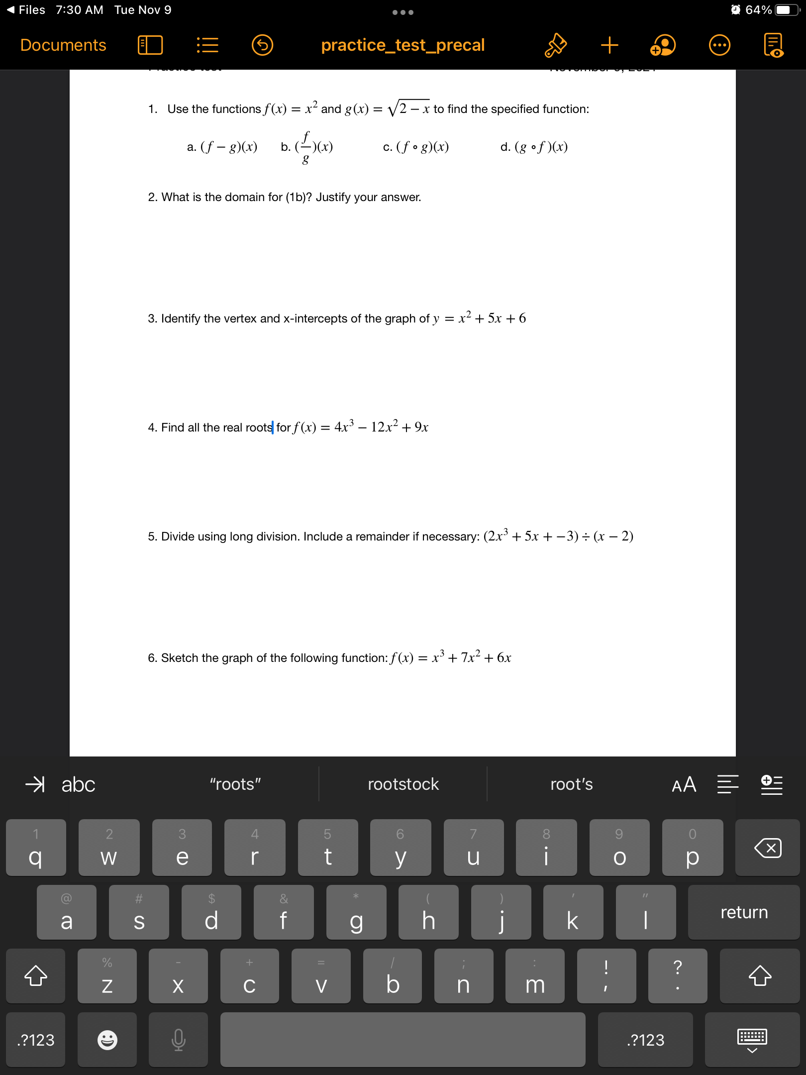
Partner work
be sure to: Work with a partner on each problem. After finishing a section, ask Dr. O’Brien to review your answers. Be prepared to turn in one of your assignments (with both names on it).
Notes:
See answer keys.
+How do you treat negative coefficients? remember to include the ‘-‘ when you plug the value into your formula
How are the answers from (1) useful for sketching the graph of these functions? They tell us what the x-intercepts are.
How do I find the vertex? convert to vertex form: (x +a)^2 + b, then vertex is (a,b).
How could I check my work for (1)? plug in the values of x and see if it gets you 0. You could also use another method to calculate roots, such as completing the square.

Slide 5
Partner work
be sure to: Work with a partner on each problem. After finishing a section, ask Dr. O’Brien to review your answers. Be prepared to turn in one of your assignments (with both names on it).
Notes:
See answer keys.

Slide 6
Partner work
be sure to: Work with a partner on each problem. After finishing a section, ask Dr. O’Brien to review your answers. Be prepared to turn in one of your assignments (with both names on it).
Notes:
See answer keys.
+

Slide 7
Partner work
be sure to: Work with a partner on each problem. After finishing a section, ask Dr. O’Brien to review your answers. Be prepared to turn in one of your assignments (with both names on it).
Notes:
See answer keys.

Slide 8
Partner work
be sure to: Work with a partner on each problem. After finishing a section, ask Dr. O’Brien to review your answers. Be prepared to turn in one of your assignments (with both names on it).
Notes:
Extra space for work.

Slide 9
d
Reflection
be sure to: Discuss in class
Exam next Friday, Nov. 12!
We’ll review the rest of the week
Topics to be covered:
Combining functions
arithmetic combinations
composition of functions
Polynomials:
Applying leading coefficient test,
finding roots,
and sketching quadratics and higher order polynomials
long division of polynomials
Review the exam topics to the right:
Which topics do you feel most/least comfortable with?
How do you plan to prepare for topics you feel least comfortable with?

