Slide 1
Fall 2021 precal
Lesson 12.4
Dr. O’Brien
Herbert H. Lehman High School
9 December 2021
Notes:
VOCAB:
nested loop

Slide 2

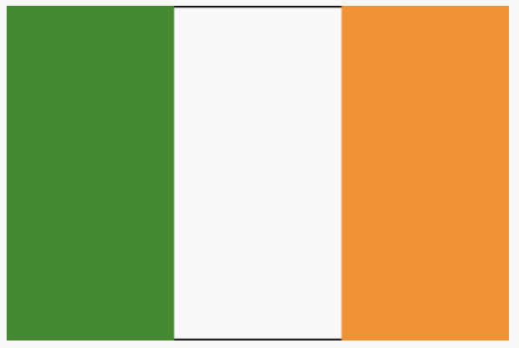
Coding to learn: activity
(0,200)
(150,$5×(\frac{200}{6})$)
be sure to:
Grab a worksheet and find your assigned seat.
Complete worksheet with your partner. Be prepared to turn in worksheet.
Reopen your save flags file from yesterday. (Otherwise Open the Flags of Netherlands, Ireland & Mauritius. Save a copy.)
Use your worksheet to complete flags for Ireland and Mauritius.
Be prepared to submit your code.
(150,$\frac{200}{6}$)
(0,0)
(300,0)
(0,200)
(0,0)
(300,0)
Notes:
Annotate bard w coordinate grid. Fill in top left flag with o,o
Draw 200 on y axis and 300 on x axis.

Slide 3
framing
what: combine and manipulate image functions to create more complex images
why: We’ve learned to use functions and variables in Pyret. today we’ll apply that to making flags
where to: Defining our functions in Pyret

Slide 4
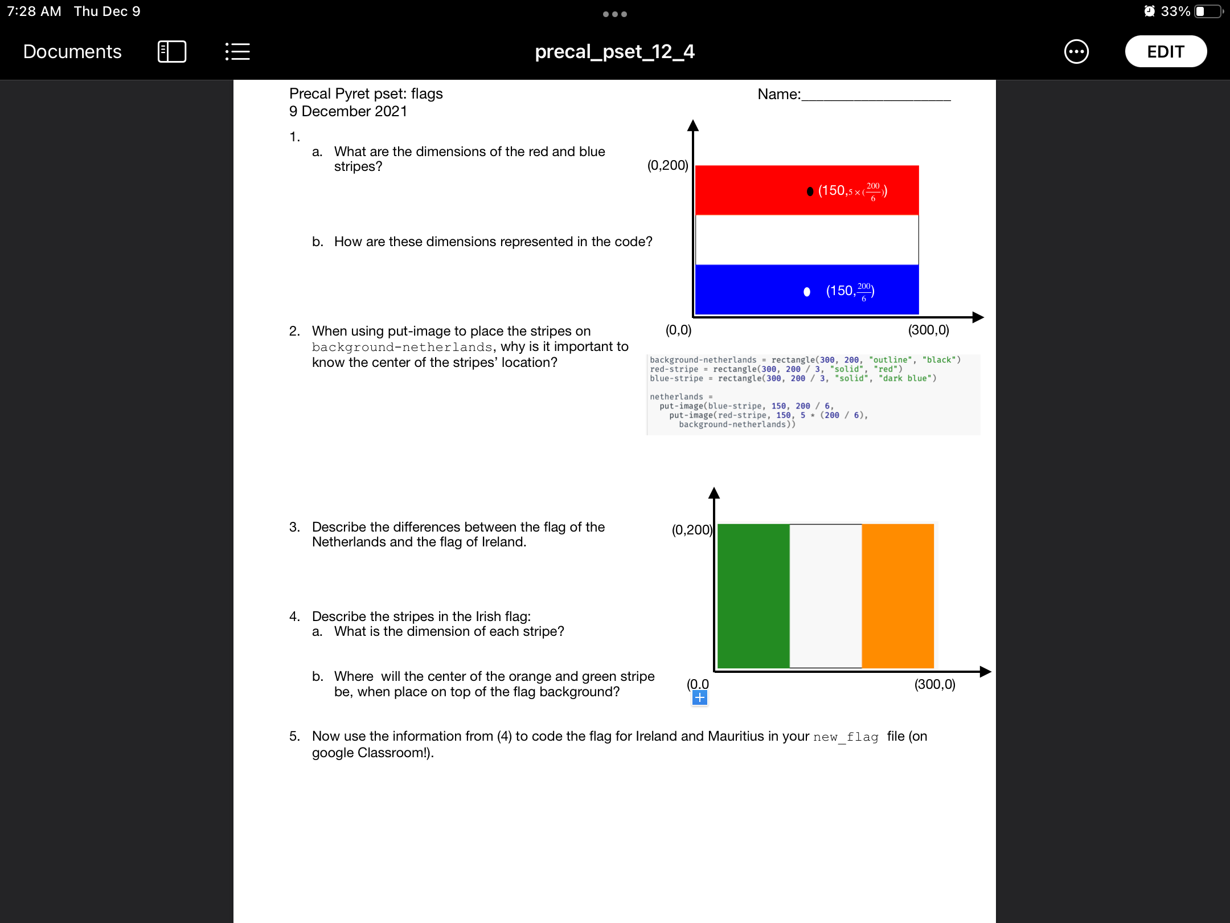
Coding to learn: Activity:
Be sure to: be prepared to share out your answers to (1-2).
Notes:
1a. Width 300 height 200 / 3
b. In the dimensions of the rectangle for the two stripe variables.
2. These are used to specify the location of the stripes on top of the background. That’s there represented as the coordinates in the put image functions.

Slide 5
Coding to learn: Activity:
Be sure to: be prepared to share out your answers to (3-4).
Notes:
The stripes are vertical in one horizontal in the other.
Height 200, width 100.
Green stripe: (50, 100)
Orange stripe: (250, 100)

Slide 6
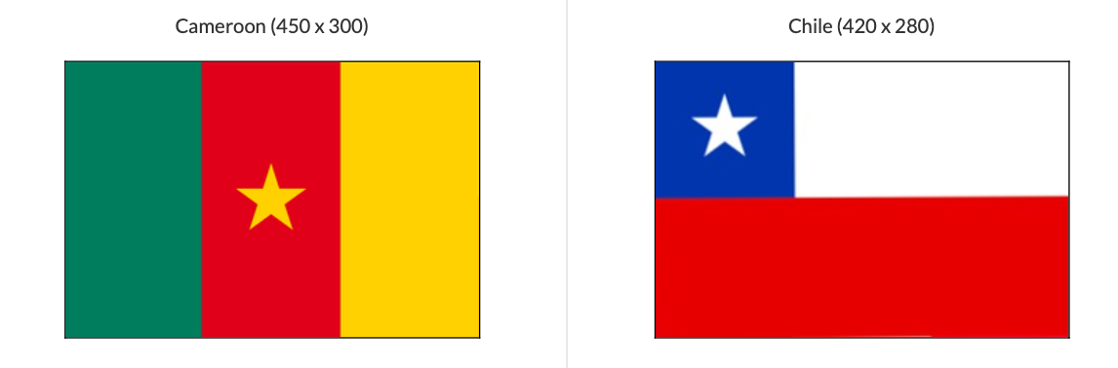
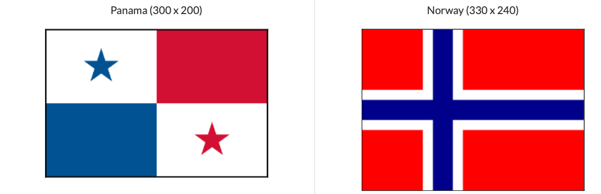
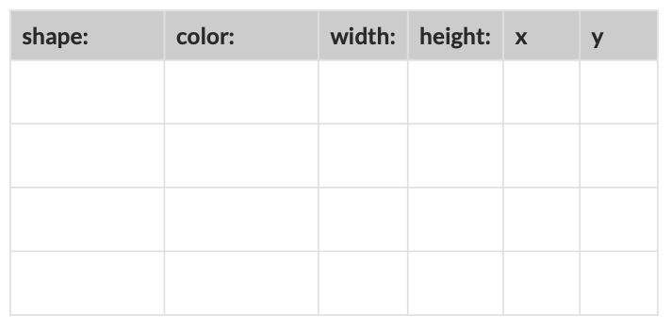
Coding to learn: bonus Activity
Log in to computer. Read the BSTs below.
be sure to:
Pick one of the flags in the work sheet. Use the table below the flag to identify the dimensions and positions of the shapes that make up the flag.
Use your knowledge of Pyret to make the flag.

Slide 7
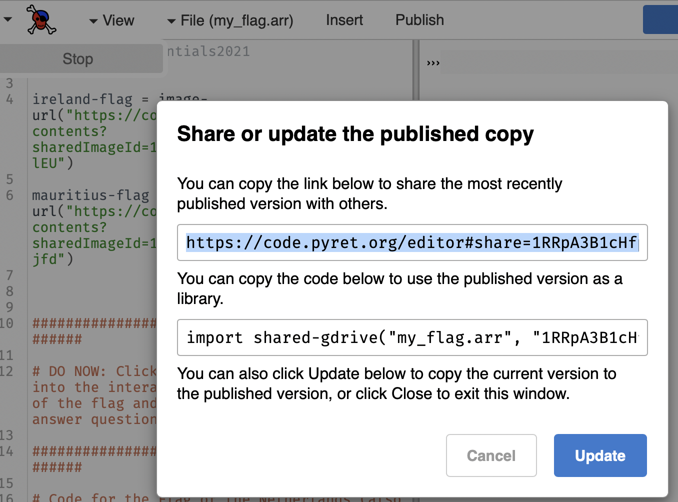
Submitting your work
When your finished coding the Ireland Mauritius flags click on publish (to the left of Run).
Copy the link and submit it

Slide 8
Reflection: Thinking about thinking
be sure to: Answer each question below with a complete sentence in your notebook. Be prepared to share out.
What is easy about making flags? What’s hard?
How can it be helpful to use variables and flags if you want to make a flag, or any other image, in Pyret?

