Slide 1
Fall 2021 AP CS A
Lesson 2.1
Dr. O’Brien
Herbert H. Lehman High School
7 February 2022
Notes:
VOCAB:
nested loop

Slide 2
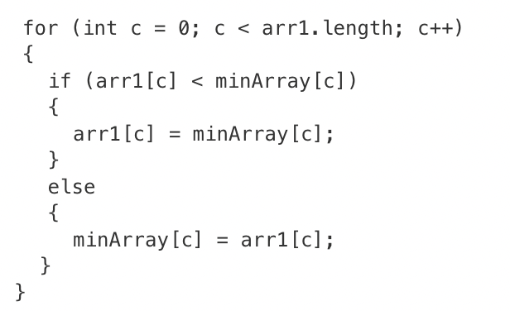
Do now
be sure to: Get out your binder. Copy goal and answer do now questions below. Show all work or write a complete sentence for each answer:
Consider the following code segment, which traverses two integer arrays of equal length. If any element of arr1 is smaller than the corresponding (i.e., at the same index) element of minArray, the code segment should replace the element of minArray with the corresponding element of arr1. After the code segment executes, minArray should hold the smaller of the two elements originally found at the same indices in arr1 and minArray and arr1 should remain unchanged.
Why will this program not work as expected?
What could you change to make it work correctly?
Notes:
The way the code is written, it actually replaces arr1 with the larger element.
Flip arround the 5th line minArray[c] = arr1[c]. Remove the else statement.

Slide 3
framing
what: traverse the elements in a 1D array object using an enhanced for loop
why: This provides us with a simplified structure for traversing a collection of items
where to: Common algorithms using arrays

Slide 4
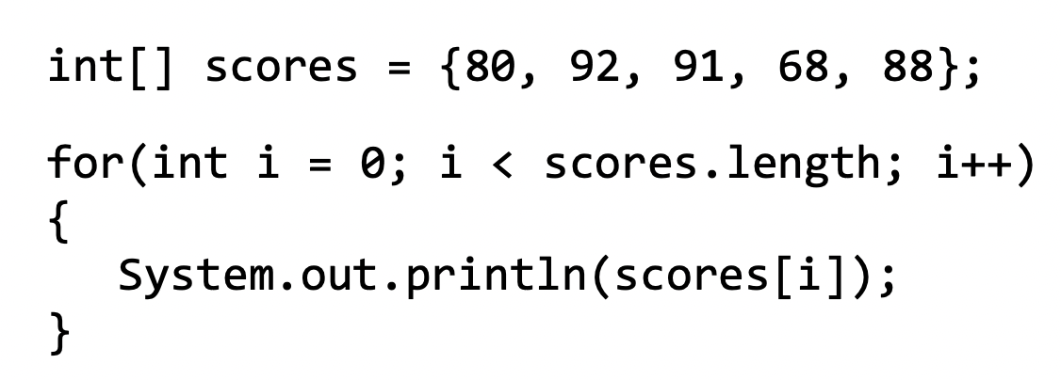
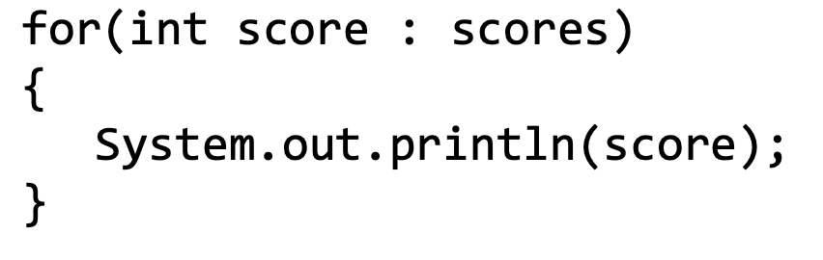
Vocab
be sure to: Keep your notebook open. These definitions should be in your Glossary. If not Copy each definition, in your Java Glossary.
A regular for loop:
Enhanced for loop
A simplified, but less flexible way to loop through a collection of items. Often called a a for-each loop.
An enhanced for loop:
What are some reasons it could be useful to use an enhanced for loop?
Notes:
Inside the loop, the enhanced for loop variable is assigned a copy from the array without using the array index. Making changes to the enhanced for loop variable does not change the original value in the array.
+What are some reasons it could be useful to use an enhanced for loop? Enhanced for loops offer a simplified structure and are especially good when using nested loops. They tend to be easier to write
+What are some reasons to use a standard for loop? A for loop uses a counter variable which is sometimes needed in your loop. Since enhanced for loops only make a copy with no reference to the index, they are not optimal if you need to update values in the array

Slide 5
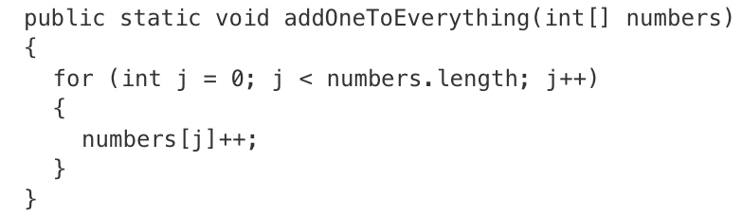
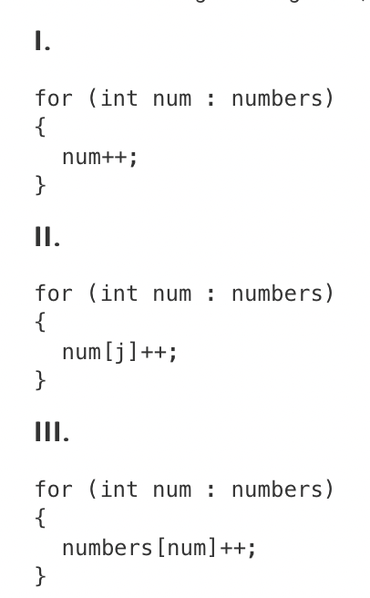
Practice problem
be sure to: Take notes and answer questions in your notebook.
Which of the following code segments, if any, can be used to replace the body of the method so that numbers will contain the same values?
Notes:
1. only. The num will return an element of the array, not an index, so II and III won’t work.

Slide 6
Coding to learn
be sure to: Log in to Workstation. Work on CodeHS exercises below. Make sure to write out a plan before you start coding!
A regular for loop:
Exercise 6.3.6: Print Odds
Excercise 6.3.7: Largest Value
Excercise 6.3.8: Classroom Array
Excercise 6.3.9: Array average
Complete any exercises you don’t finish here as homework!
An enhanced for loop:
Notes:
SOLUTION CODE (REQUIRES CODEHS):
Exercise 6.3.6: Print Odds
Excercise 6.3.7: Largest Value
Excercise 6.3.8: Classroom Array
Excercise 6.3.9: Array average
Go through student solutions at the end of class.

Slide 7
Reflection: Thinking about thinking
be sure to: Answer each question below with a complete sentence.
What are the advantages of using an enhanced loop?
When would a standard for loop be a better choice?
Notes:
+What are the advantages of using an enhanced loop?
Enhanced for loops offer a simplified structure and are especially good when using nested loops.
+When would a standard for loop be a better choice?
When the counter variable is needed or if you are looking at updating values in your array, you need to use a for loop.

