Slide 1
Fall 2021 AP CS A
Lesson 12.4
Dr. O’Brien
Herbert H. Lehman High School
9 December 2021
Notes:
VOCAB:
private access
data encapsulation

Slide 2
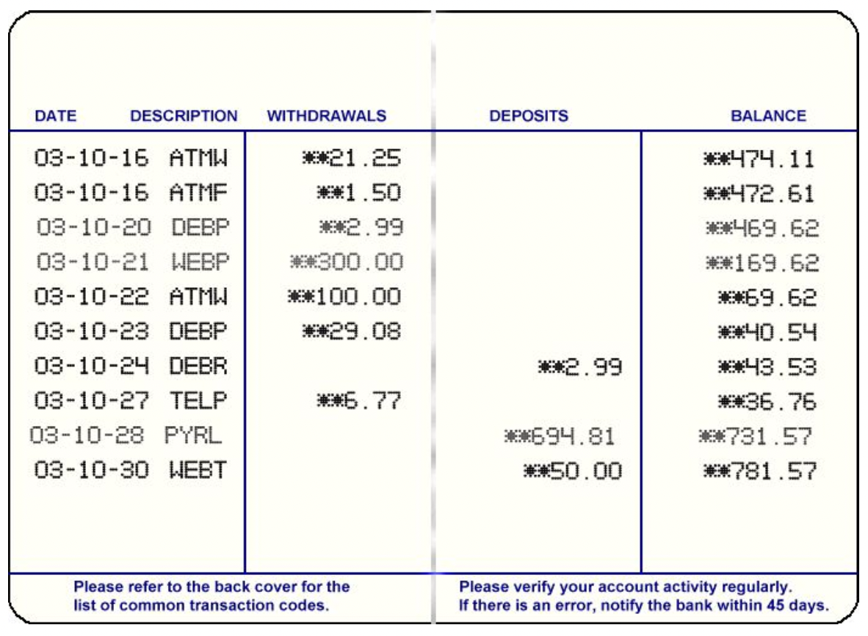
Do now
be sure to: Get out your binder. Copy goal and answer do now questions below. Write a complete sentence for each answer:
What does private access mean?
What are some reasons we might want to encapsulate information in our programs?
Review the data you decided to encode for your CheckingAccount class (Tuesday). What are some issues that could arise if all the data were both accessible and modifiable?
Notes:
the idea that some data should not be accessible outside of a specific clas/by outside users.
It makes it easier for outside users to use your class (they don’t have to think about the gory details). also outside users can’t screw things up for everyone else. This is actually a major reason why Java is favored by companies with big teams of developers.
ANSWERS WILL VARY. e.g. if balance is modifiable you could change it randomly (without having to first modify withdrawal/deposit).

Slide 3
framing
what: control access to data when building a class in Java
why: a key decision when building a class in Java is how information is to be handled by outside users of the class.
where to: constructors, and embedding classes inside of each other

Slide 4
Vocab recap
be sure to: Keep your notebook open. These definitions should be in your Glossary. If not Copy each definition, in your Java Glossary.
private access
Controls how users interact with methods and data in an object. Is used to manage complexity.
Encapsulation
The process of hiding implementation details in a program.

Slide 5
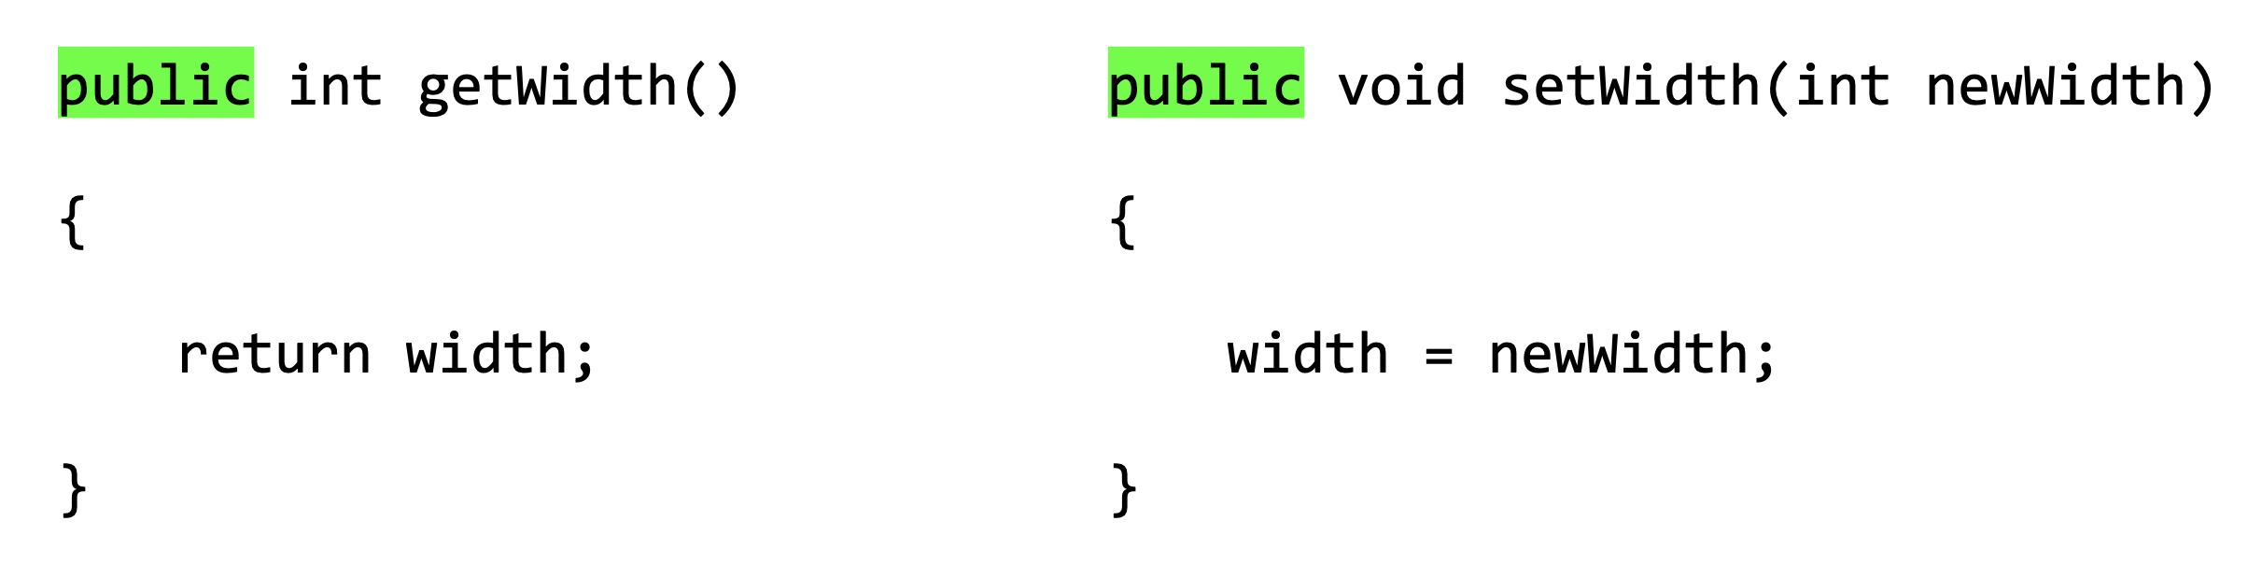
Coding to lean: Activity
Go to your workstation. Read BSTs below.
be sure to:
Log in to CodeHS. Open Dec. 9 CheckingAccount in In-class Examples
Use your work from Tuesday as a blue print:
Declare the appropriate (private) instance variables
build a Constructor
Build getter and setter methods depending on what level of private access is appropriate for a given instance variable
Test your class in the main() method
Getter method:
Setter method:
Notes:
public variables: withdrawal, deposit, balance, date.
private: add interest, private instance variables.
+What should the access for instance variables be? always private.
+Why? If users could access this data directly they could potentially mess up the program. Instead access is managed through getter and setter methods.
+Why should balance NOT have a setter method? because we don’t want the external user to be able to change the balance willy nilly. this should be managed through setter methods for withdrawal and deposit.
IF STUDENTS FINISH EARLY: START WORKING ON HW FOR CodeHS 3.1

Slide 6
e
Reflection: Thinking about thinking
be sure to: Answer each question below in your notebook with a complete sentence. Be prepared to share out.
What was most challenging about building a CheckingAccount class?
How do you determine if information should be accessible, modifiable, both, or neither.
Why is it useful to encapsulate information?
Notes:
it depends on what kind of information you have, if its something the user will want to know or change.
This helps us manage complexity in our programs. people should only have to worry about what they have to worry about!

