Slide 1
Fall 2021 Precalc
Lesson 12.5
Dr. O’Brien
Herbert H. Lehman High School
10 December 2021
Notes:
VOCAB:
nested loop

Slide 2
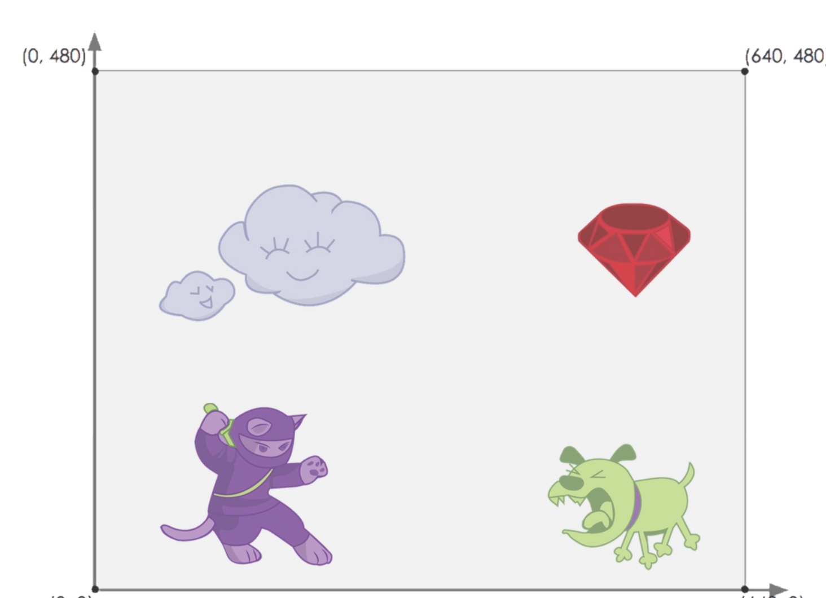
Do now
be sure to: Get out your binder. Make sure you receive your Brainstorm your own game worksheet. Copy the goal and answer do now questions below. Write a complete sentence for each answer:
Examine the worksheet. What images did you select for your game?
How do you think the functions we used in the flag making exercise could be useful for making your game?
Notes:
1 seems more efficient, since you’re only asking one question.
+How can we measure ‘efficiency’? which operation is faster? One will probably take less time
+What might be some problems with situation (1)? if a lot of people share the same birthday as you, it might get confusing.

Slide 3
framing
what: use variables and functions to position images for our video game
why: now we’re actually using our math skills to start making our video games!
where to: defining our own functions. Using computational modeling to solve word problems

Slide 4
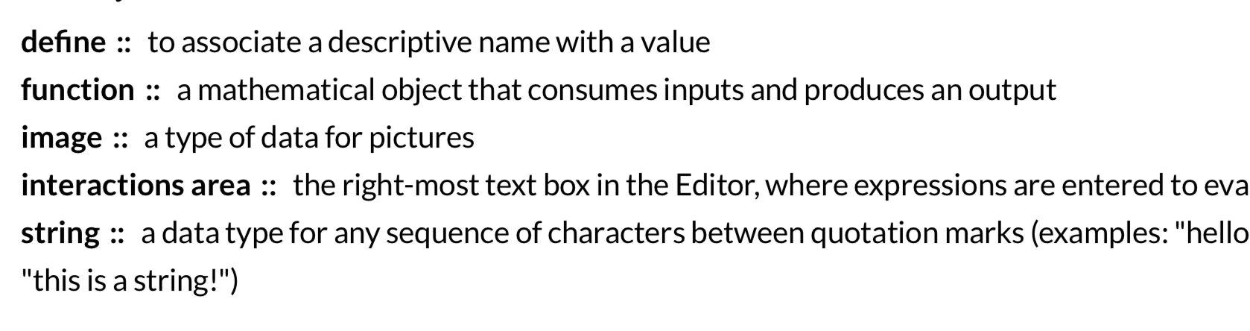
Vocab
be sure to: Keep your notebook open. These definitions should be in your Glossary. If not Copy each definition, in your Pyret Glossary.

Slide 5
Writing to learn: warm up
be sure to: on your computer, open game template file in Google classroom. Then answer the questions below in your notebook. Be prepared to share out.
What familiar things did you see? What were some unfamiliar things? What do you think the unfamiliar things do?
What datatype is GAME-TITLE? BACKGROUND? What does SCREENSHOT return in the Interactions area?
Describe what happens when you press "Run".
What do you think image-url does?
Notes:
What familiar things did you see in the Game Starter File file?
What were some unfamiliar things? Any idea what they might do? Answers vary: new functions, comments, images
What data type is GAME-TITLE? What data type is BACKGROUND? GAME-TITLE is a String, BACKGROUND is an Image
What does SCREENSHOT return in the Interactions area? An image of the BACKGROUND, PLAYER, TARGET, and DANGER all together
Did anyone try pressing "Run"? What happens when you press "Run"? Allow students to discuss what they see and what connections they see with the code
What do you think image-url does? Answers vary: It consumes a String, which is a URL (an image location on the Internet) and produces the Image inside our program

Slide 6
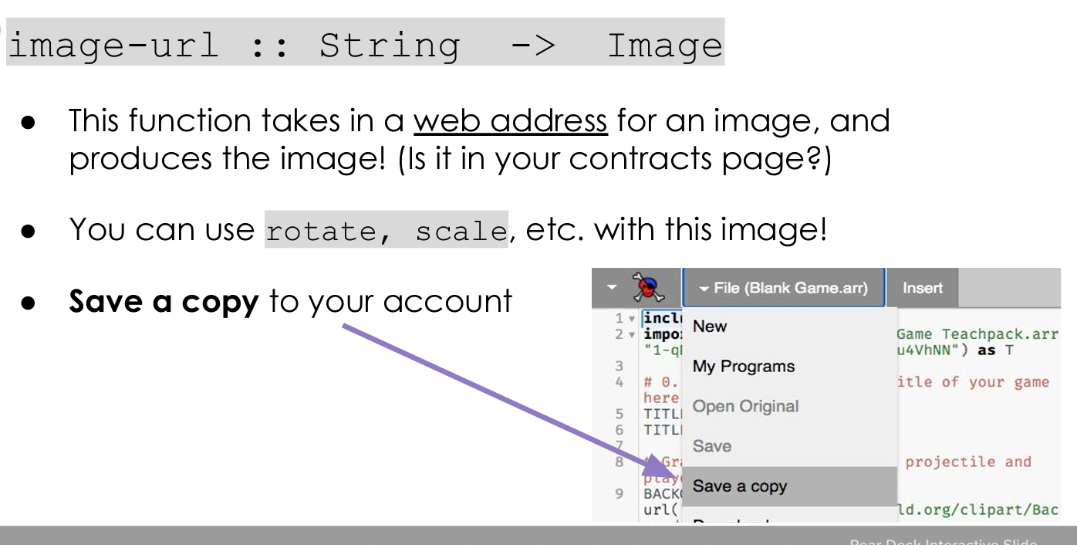
Coding to learn: activity
Be sure to…
Save a copy of the game template.
Find images appropriate for the DANGER, TARGET, PLAYER, and BACKGROUND in your game.
Search using DuckDuckGo search engine
Copy and paste the image address into an image-url() function
How can you test your code to make sure it worked correctly?
What do you do if your image isn’t the right size or orientation?

Slide 7
Reflection: Thinking about thinking
be sure to: Answer each question below with a complete sentence.
What was most fun about this activity? What was most challenging?
How did you have to alter your image to make it look the way you want it to?
Notes:
answers will vary.
using functions for manipulating images, e.g. scale(), overlay, etc.

Slide 8
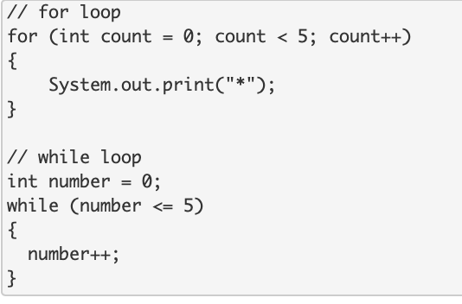
exit ticket
be sure to: Answer each question below with a complete sentence.
text
Notes:
How many times does the for loop iterate? How many times does the while loop iterate? Why are they different?
The for loop will iterate 5 times. The while loop will iterate 6 times. The while loop will iterate one more time because the inequality <= is used instead of <. The while loop will run when the variable = 5 whereas the for loop will not.

