Slide 1
Fall 2021 AP CS A
Lesson 11.3
Dr. O’Brien
Herbert H. Lehman High School
1 December 2021
Notes:
VOCAB:
nested loop

Slide 2
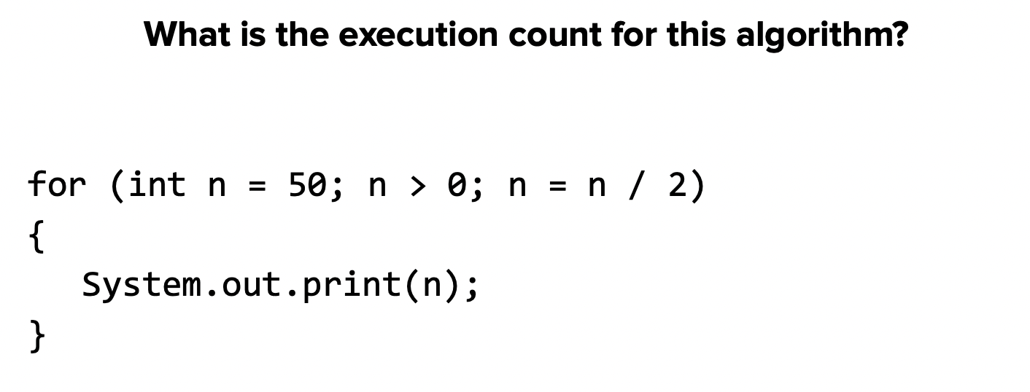
Do now
be sure to: Get out your binder. Copy goal and answer do now questions below. Show all work or write a complete sentence for each answer:
Identify at last 3 operations that would be considered for an execution statement count (review your notes!).
Explain why the program to the right has a program execution count of 6.
How will the execution count change as the maximum value of n increases?
Notes:
input/output, variable assignment, math operations, boolean statements ( aka logical tests)
the following ints are printed: 50 -> 25 -> 12 -> 6 -> 3 -> 1
it’ll tend to get larger. A more precise evaluation will require more formal analysis of the program, which is beyond our abilities right now!

Slide 3
framing
what: HDW use informal run-time comparison to analyze algorithmic efficiency?
why: Efficient algorithms save time and money ($).
where to: Test next week. Then writing classes.

Slide 4
Vocab review
be sure to: Keep your notebook open. These definitions should be in your Glossary. If not copy each definition, in your Java Glossary.
Algorithm
A step-by-step procedure for solving a problem
Statement execution count
The number of times a statement is executed by a program.

Slide 5
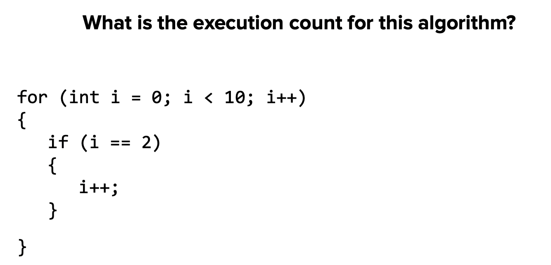
Practice problem #2
be sure to: Take notes and answer questions in your notebook.
Practice problem #1
be sure to: Take notes and answer questions in your notebook.
Notes:
+what operations do we see here that will count for this analysis? we have a logical test, when i == 2, we alter the i, we changes the count (see next slide).

Slide 6
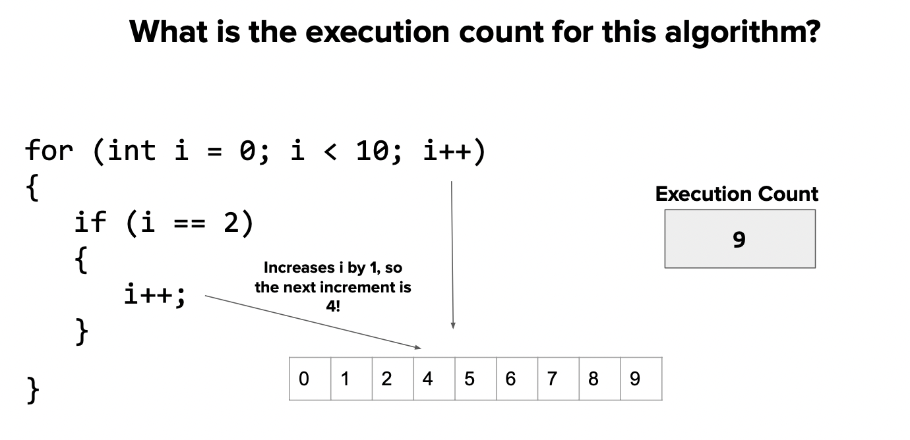
Practice problem #1
be sure to: Take notes and answer questions in your notebook.
Notes:
work out on board, before revealing this slide.

Slide 7
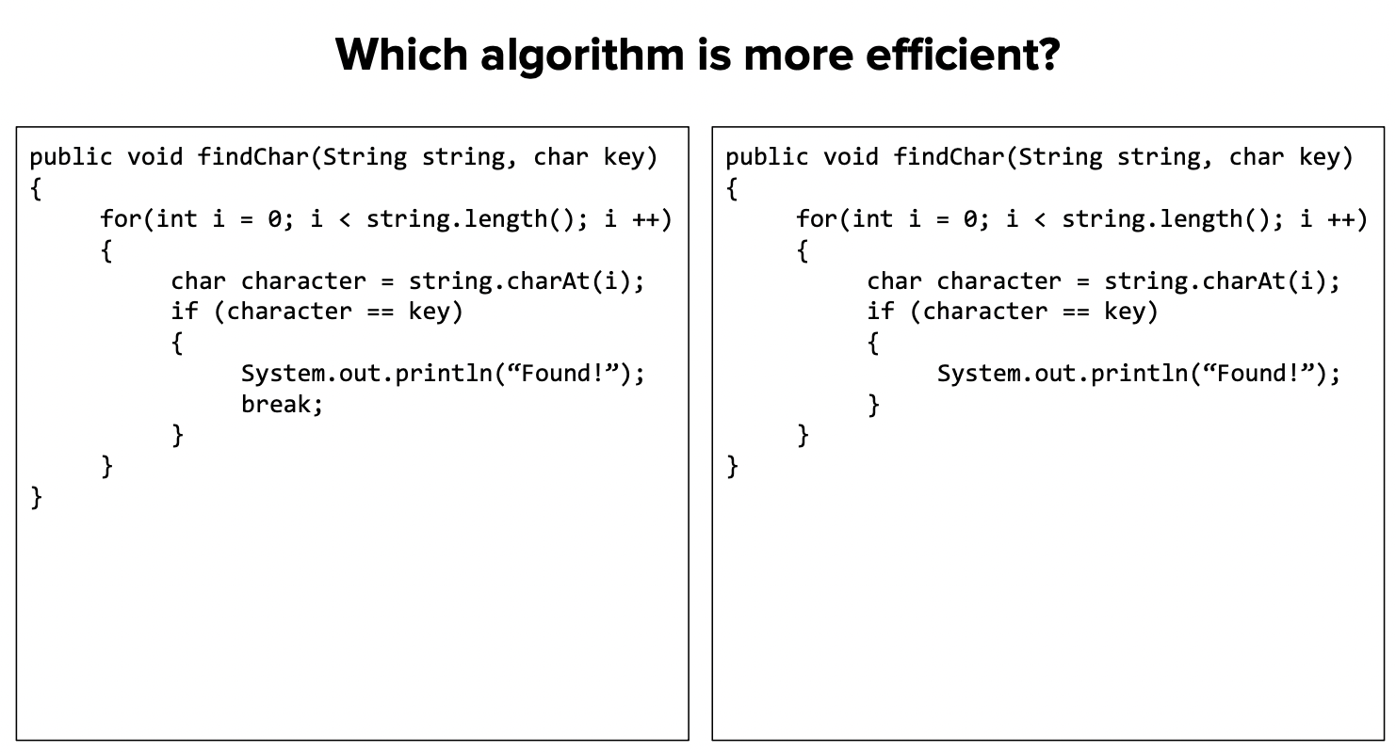
Practice problem #2
be sure to: Take notes and answer questions in your notebook.
Notes:
recall: what kind of algo is this? it’s a traversal algorithm!
how do traversal algo’s work? the go through each character in a string one at a time.
+what’s the difference between these slides? one has a break
+how will this alter the behavior of the program? In the one on the left, it will stop running once the key is found. this means it will be shorter.

Slide 8
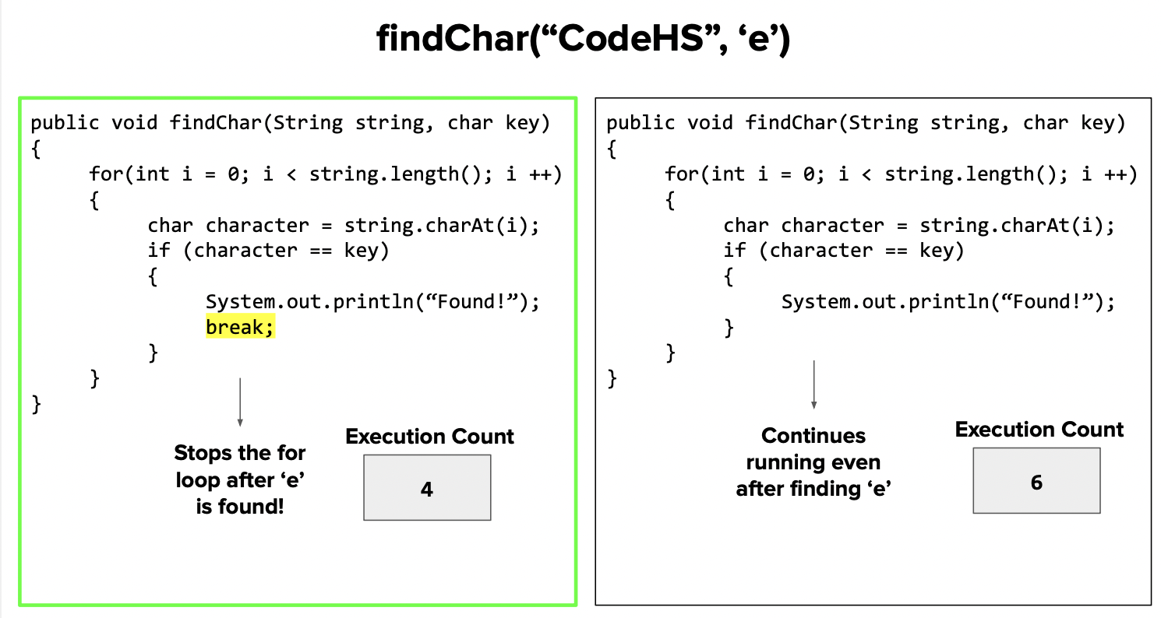
Practice problem #2
be sure to: Take notes and answer questions in your notebook.

Slide 9
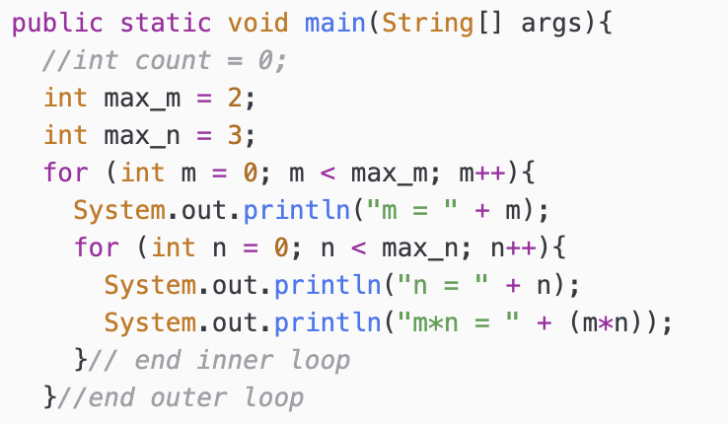
Practice problem #3
be sure to: Take notes and answer questions in your notebook.
Find the execution statement count for the program below:
Notes:
+what operations do we see here that will count for this analysis? we have two variable assignments and two print statements (input/output).
+how could we trace through this program? on board:
m | n | m*n
0. 0. 0
0. 1. 0
0. 2. 0
1 0. 0
1 1. 1
2. 2
DONE.
what’s the relationship between the count and max_m and max_n? max_m * max_n = 6.
Why does this make sense? because the inner loop is run for each iteration of the outer loop
+how will this program change as max_m and max_n increase. the execution count is always max_m * max_n

Slide 10
Coding to learn
be sure to: Log in to Workstation. Work on CodeHS exercises below. Make sure to write out a plan before you start coding!
Algorithm
A step-by-step procedure for solving a problem
CodeHS lesson 4.5
Statement execution count
The number of times a statement is executed by a program.
Notes:
BE SURE TO WRITE OUT A PLAN
+How could you use .indexOf() to solve the password checker assignment? You could make a string containing all lower case letters. and all digits 0-9. then you could check if a given character is in them because if not you’ll return -1.
+
+How is fixing grammar similar to the ‘remove’ method we discussed in the mini-lesson? It’s similar in that we want to make a new string with the corrected form of the input string.

Slide 11
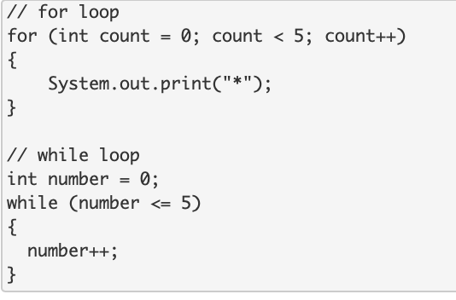
exit ticket
be sure to: Answer each question below with a complete sentence.
How many times does this code iterate?
What are some differences between the for loop and the while loop in terms of execution count?
Notes:
How many times does the for loop iterate? How many times does the while loop iterate? Why are they different?
The for loop will iterate 5 times. The while loop will iterate 6 times. The while loop will iterate one more time because the inequality <= is used instead of <. The while loop will run when the variable = 5 whereas the for loop will not.

