Slide 1
Fall 2021 Java
Lesson 7.1
Dr. O’Brien
Herbert H. Lehman High School
November 1, 2021

Slide 2
do now
be sure to: Get out your binder. Copy goal and answer do now questions below. Show all work or write a complete sentence for each answer:
What’s the difference between reference equality and logical equality? Describe in a sentence.
Why do you think it’s important to keep this distinction in mind when problem solving?
Aliases: Two object variables that reference the same object
Reference equality: Equality operator (==) compares the references (objects in memory) of two objects
Logical equality: The .equals() method compares the data of two oebjects, instead of the value of references
Notes:
refernece equality refers to the location in memory, so distinct items with the same data will be considered unequal. Logical equality compares the attributes of the objects and uses the equals() method.
Because you can run into big problems when you’re comparing objects in the conditions of control structures!

Slide 3
framing
what: HDW use boolean object comparison to solve computational problems
why: Comparing objects can be trick. This activity gives us a change to practice using our skills developed on Friday.
where to: Loops and iteration

Slide 4
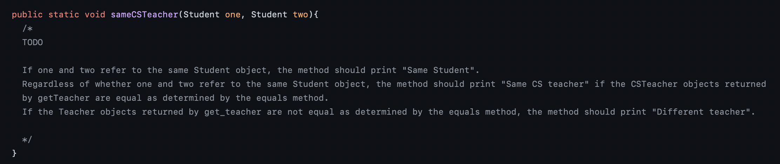
Today’s activity (on Google Classroom)
Go to workstation. Log in to Google classroom.
Open today’s activity.

Slide 5
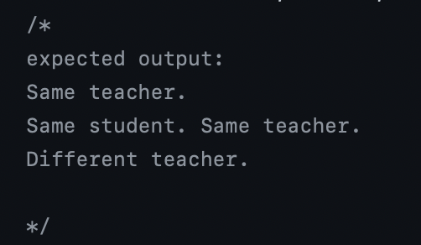
Be sure to…
Work in groups of 2.
Implement sameCSTeacher() so it outputs the appropriate text.
Test your code by running the unit tests
Comment your code so another user can understand what it will do.
Hint: Review your notes from Friday!
Notes:
See solution code on github.
+How do I get started? Read through TODO, then examine the CSTeacher and Student classes.
+How will an if-else control structure be useful here? making decisions about whether students are identical, whether they have the same teacher
+How can I access a student’s teacher? getTeacher() method
+How is the distinction between reference and logical equality important? in this problem we care about logical equality
+why? because we care about whether the objects contain the same data, not the same location in memory

Slide 6
reflection questions
What do you find most tricky about comparing objects in Java?
What’s one thing you understand better than you did before?
What is one questions you still have
Notes:
+answers will vary, students might find it hard to remember to use r1.equals(r2)
+answers will vary.

