Slide 1
Fall 2021 Precalc
Lesson 13.2
Dr. O’Brien
Herbert H. Lehman High School
14 December 2021
Notes:
VOCAB:
nested loop

Slide 2
Do now
be sure to: Get out your binder. Make sure you receive your Brainstorm your own game worksheet. Copy the goal and answer do now questions below. Write a complete sentence for each answer:
Watch the video to your right.
How high does the rocket get? How long does it take to get there?
Make a prediction: the height of the rocket it can be described as a function of time. What sort of function do you think this is? HINT: look at your library of parent functions.
Notes:
The rocket reaches a height of 400 m in 20 s.
The height of the rocket continuously increases at the same rate and the decreases also at the Sam rate. We might expect the function to look like a quadratic. Model on board, then reveal on next slide

Slide 3
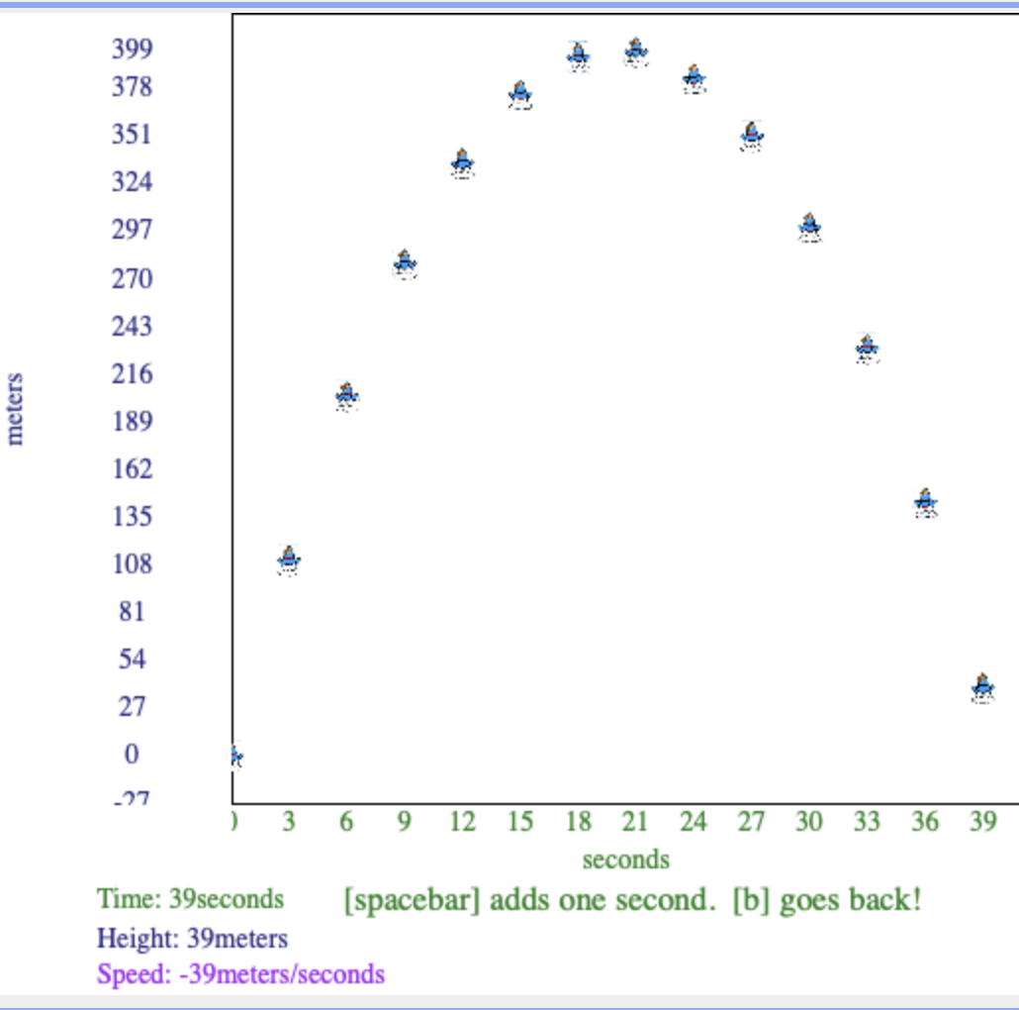
Do now
be sure to: Get out your binder. Make sure you receive your Brainstorm your own game worksheet. Copy the goal and answer do now questions below. Write a complete sentence for each answer:
Notes:
+what’s the family of this function. What’s its x and y intercept?

Slide 4
framing
what: use functions in Pyret for computational modeling
why: in the real world (science, medicine, engineering) math and computer science is frequently used to analyze and make predictions about real world phenomena
where to: using functions in Pyret to model movement in our video game

Slide 5
Vocab
be sure to: Keep your notebook open. Copy the definition for comp. modeling in your notebook. The other definitions should be in your notes. If not copy them!
REVIEW:
Computational modeling
Using computer programs to analyze and make predictions about real world systems (especially in science, medicine, and engineering)
function
a mathematical object that takes in an input and produces a unique output
function definition
Code that names a function, defines its arguments, and states the expression to compute when code is used

Slide 6

Writing to learn: warm up
be sure to: Answer the questions below in your notebook. Be prepared to share out.
A NASA rocket takes off from Cape Canaveral, Florida. It’s traveling at 11 m/s.
How could you determine the distance traveled by the rocket in 5 seconds? How about in 2 minutes?
Write a function $h(t)$ that will return the height of the rocket at a time $t$
Sketch a graph for this function.
What family does this function belong to (see library of parent functions)
Describe the domain and range for this function.
Notes:
Multiple 11 by 5. Multiple 120 by 5.
h(t) = 11 t
This is a linear function
the domain is all real numbers greater than or equal to 0, as is the range.

Slide 7
Coding to learn: warm up
be sure to:
Open Rocket Height Starter File in Google Classroom. Save a copy.
Modify the function h(t) so it works correctly. Observe the the path of the rocket and the graph.
How can you make the rocket move faster or slower? Experiment in Pyret. Then use precise mathematical language to describe how you’re changing the function in your notebook. Be prepared to share out.
Notes:
Fun h(t): 7 * t end
Change the value of the coefficient?
What would it mean for the coffeicient to be negative? The rocket is going down into the ground instead of up!

Slide 8
Coding to learn: activity
Be sure to:
Work with your partner to answer the questions below in your notebook. Be prepared to share out at the end of class!
Examine the table to the right
Specify the function $h(t)$ along with its properties (family, x-/y-intercepts, domain and range).
Model your function $h(t)$ in Pyret. Describe how the behavior of the rocket is different from before.
You want your rocket to reach its maximum hight after exactly 15 seconds and then land.
Sketch a graph of this situation by hand. Identify the family of this function, its other properties, and how it is transformed from its parent. Use this information to find the function.
Model your function in Pyret. Explain whether it behaves as expected. If it doesn’t, figure out what you did wrong and try again!
Make the rocket reach a height of exactly 400 m and then land. Sketch the graph, and write the function in your notebook. Then model it in Pyret to test if the function works as expected, explain why or why not in your notes.
t | h(t)
0 | 0
2 | 8
5 | 50
10 | 200
Notes:
Where do I start? Try sketching a graph in your notes using these values. Which parent function does this graph resemble? Quadratic. What are the other properties of this graph?
What does your graph look like? A quadratic that has been transformed
Preplanned qs:
+How could the vertex form of your equation be useful here? you can write your function as f(x) = -(x - a)^2 + 1000.
+How could you use the x/y intercept to solve for a? 0 = -(0 - a)^2 + 1000 -> a^2 = 1000, a = sqrt(100) approx: 31.6
NOTE: - values in Pyret are represented by (0- x) not -x,
Answers:
h(t) = 2t^2
h(t) = -(t - 15)^2 + 225
h(t)= -(t - 20)^2 + 400
If students finish early: make observations about the speed of your rocket at different moments in time What do you notice about the relationship between the rockers height and its speed. Try this for a variety of specifications of rocket height (quadratic, linear,etx.)

Slide 9
Reflection: Thinking about thinking
be sure to: Answer each question below with a complete sentence.
How did you use computational modeling in class today?
In what situations could it useful to be able to combine math with computational modeling? Use your imagination!
Notes:
answers will vary.
using functions for manipulating images, e.g. scale(), overlay, etc.

