Slide 1
Fall 2021 AP CS A
Lesson 14.2
Dr. O’Brien
Herbert H. Lehman High School
21 December 2021

Slide 2
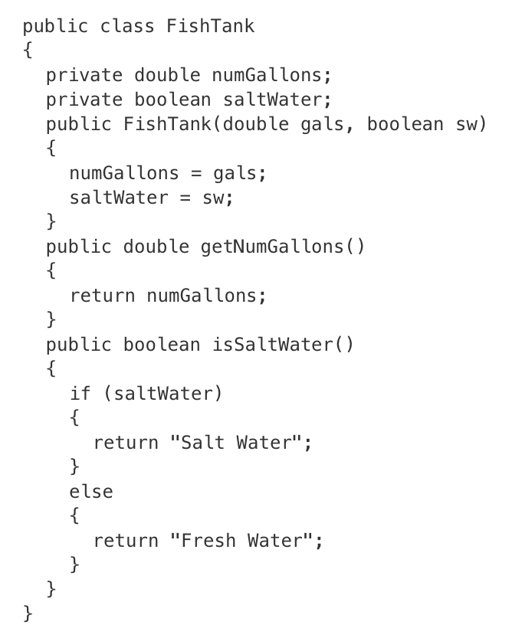
Do now
Which of the following best explains the reason why this class will not compile?
The variable numGallons is not declared in the getNumGallons method.
The variable saltWater is not declared in the isSaltWater method.
The isSaltWater method does not return the value of an instance variable.
The value returned by the getNumGallons method is not compatible with the return type of the method.
The value returned by the isSaltWater method is not compatible with the return type of the method.
Notes:
1)
2)
3)

Slide 3
framing
what: use accessor methods to solve real world computational problems
why: We want to develop facility with writing accessor methods, so we can efficiently write more complex classes.
where to: Fun with mutator methods

Slide 4
Vocab (review)
be sure to: Keep your notebook open. Copy the definitions in your notebook, if they are not there already.
toString()
A special method written within a class that returns a String representation of an object
getter method
Allows us to access specific instance variables in an object. Aka accessor methods.
setter method
Allows us to change specific instance variables in an object. Aka mutator methods

Slide 5
Writing to learn: Warm up
be sure to:
Answer in your notebook. Be prepared to share out.
Will the return the same outputs? Explain why or why not.
How could you write a toString() method for Student that outputs “The student’s name is Jill.”
Student student = new Student(“Jill”);
String studentName = student.getName();
studentName = “Karel”;
System.out.println(studentName);
System.out.println(student.getName());
Notes:
The first will print Karel and the second will print Jill. Line 3 of this code segment reassigns the value of studentName to "Karel. While studentName stored a reference to the name variable of student, changing the value of studentName does not change the value of name, as studentName was simply a reference to the same String object .
public String toString()
{
return “The student’s name is “ + student.getName();
}

Slide 6
Coding to lean: Independent work
be sure to:
Go to your workstation.
Work on following problems in CodeHS:
5.4.5: Add some Getter methods
5.3.6: Full Dragon Class
5.3.7 Different Dragon Class
5.3.8 A Chef’s best Meal
If you have a question, ask!
complete any remaining assignment for homework!

Slide 7
Exit ticket
be sure to: Get out a sheet of loose leaf paper. Write your name and the date on the top. Answer each question below with a complete sentence. Be prepared to turn in!
Answer the questions below.
Why are instance variables in a class kept private?
What are getter (aka accessor) and setter (aka mutator) methods used for?
What is the toString() method used for?
Notes:
They are kept private so that they cannot be altered or accessed outside of the class accept by special, programmer defined methods.
These are the programmer defined methods for accessing (getter) and changing (setter) data in a class. This allows the programmer to control whether and how the data in an object can be accessed and changed.
toString is a special method that always returns a string. It’s what accessed by the Java print methods.

