Slide 1
Fall 2021 AP CS A
Lesson 12.2
Dr. O’Brien
Herbert H. Lehman High School
7 December 2021
Notes:
VOCAB:
nested loop

Slide 2
Do now
be sure to: Get out your binder. Copy goal and answer do now questions below. Show all work or write a complete sentence for each answer:
In general (so not necessarily Java!), how would you describe the difference between public and private?
Thinking of Java, what are some examples of public vs. private?
How would you describe the differences between public and private in Java?
Notes:
private is for specific people, typically the owner or occupier, public is for anybody.
private instance variables, public classes.
Private means that something can only be accessed within the class where it is defined. Public means it can be accessed by an external class.

Slide 3
framing
what:
why:
where to:

Slide 4
Vocab
be sure to: Keep your notebook open. These definitions should be in your Glossary. If not Copy each definition, in your Java Glossary.
private access
Controls how users interact with methods and data in an object. Is used to manage complexity.
Encapsulation
The process of hiding implementation details in a program.

Slide 5
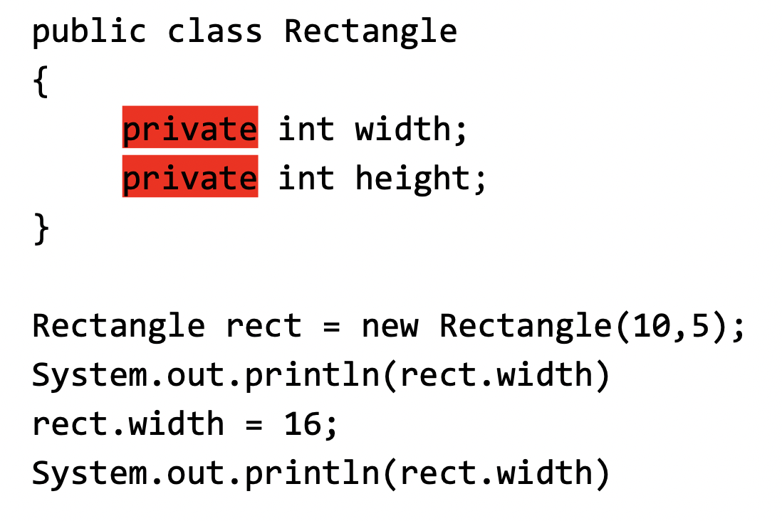
Writing to learn: warm up
be sure to: Answer each question in your notebook. Be prepared to share out!
Describe what this code is intended to do.
Do you think this code will work? Explain why or why not in a sentence.
Why is it a good idea to make instance variables private?
Notes:
-code is intended to define a rectangle with a specific width and height. Then print the width of the rectangle.
-no width is supposed to be accessed from outside of the class so this won’t work.
- this is information that’s only relevant for inside of the rectangle class.

Slide 6
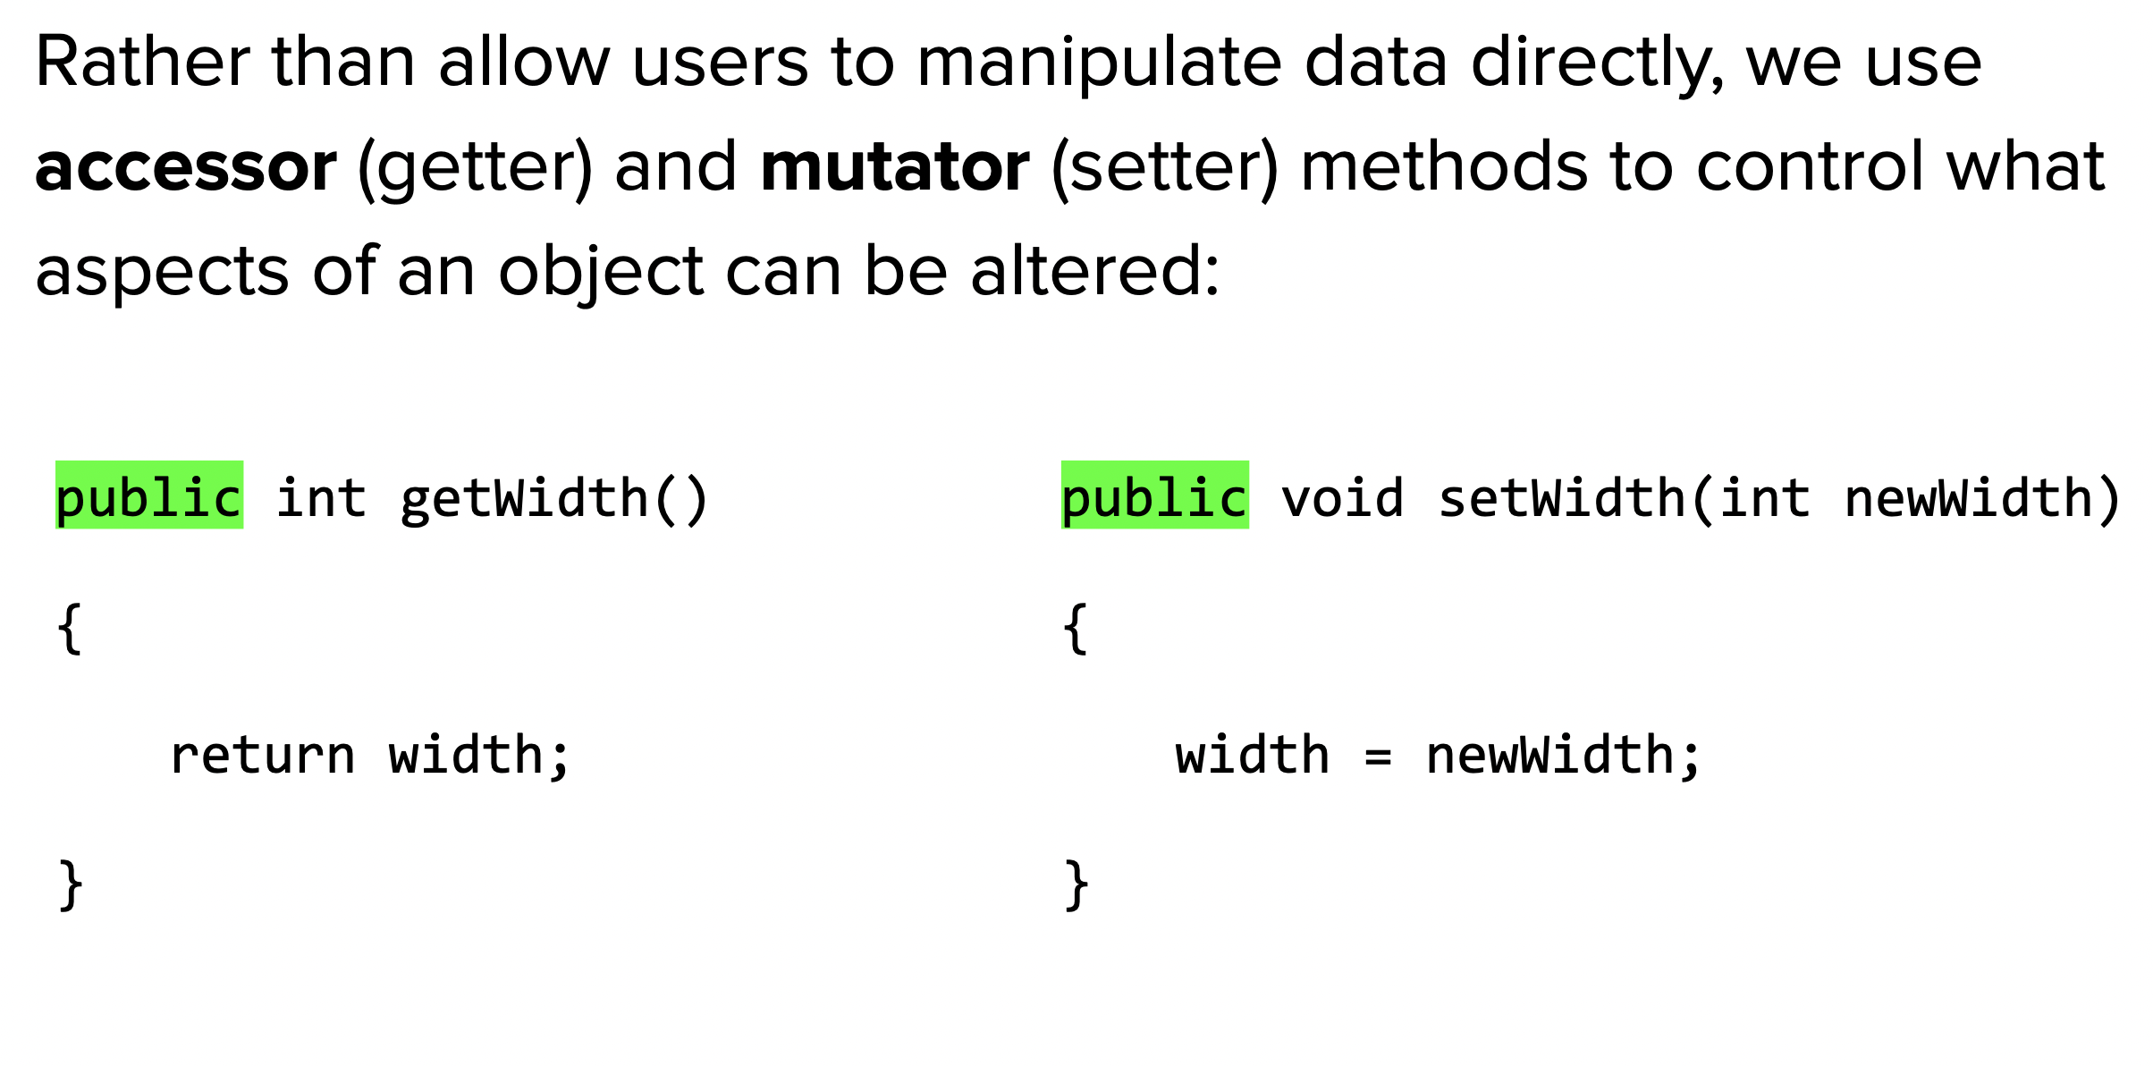
Mini-lesson
be sure to: Take notes and answer questions in your notebook.

Slide 7
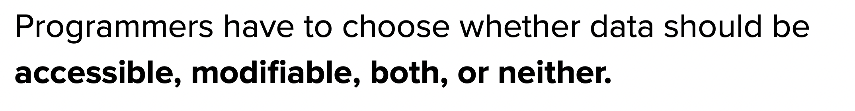
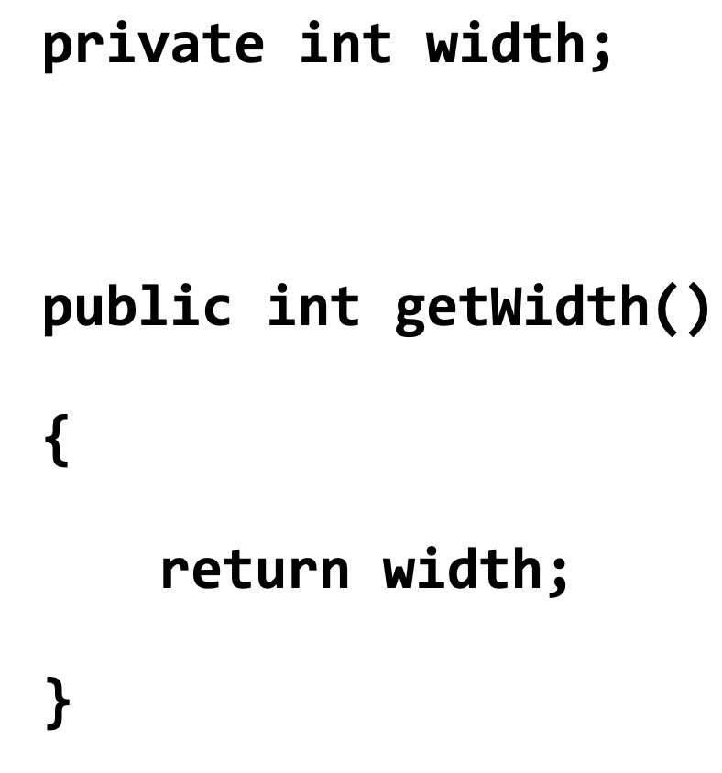
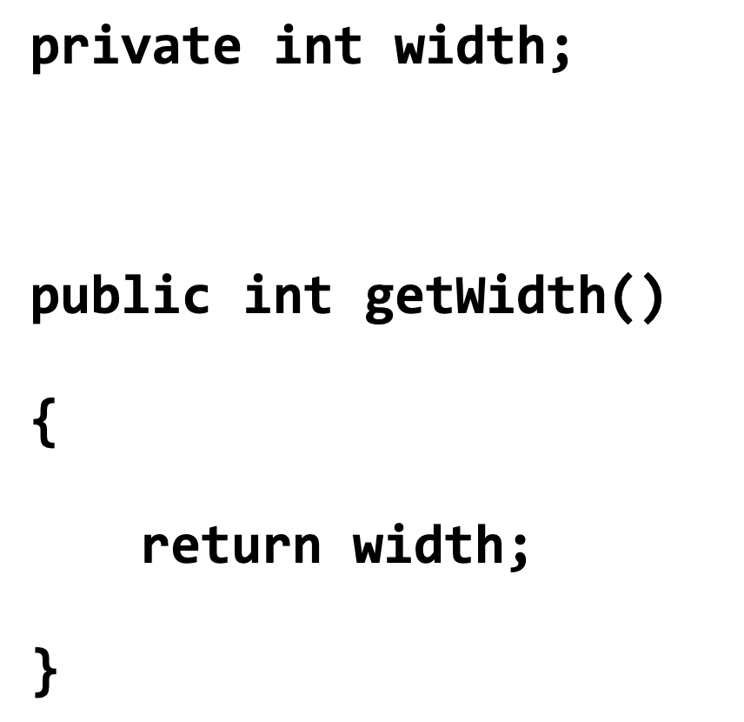
Mini-lesson
be sure to: Take notes and answer questions in your notebook.

Slide 8
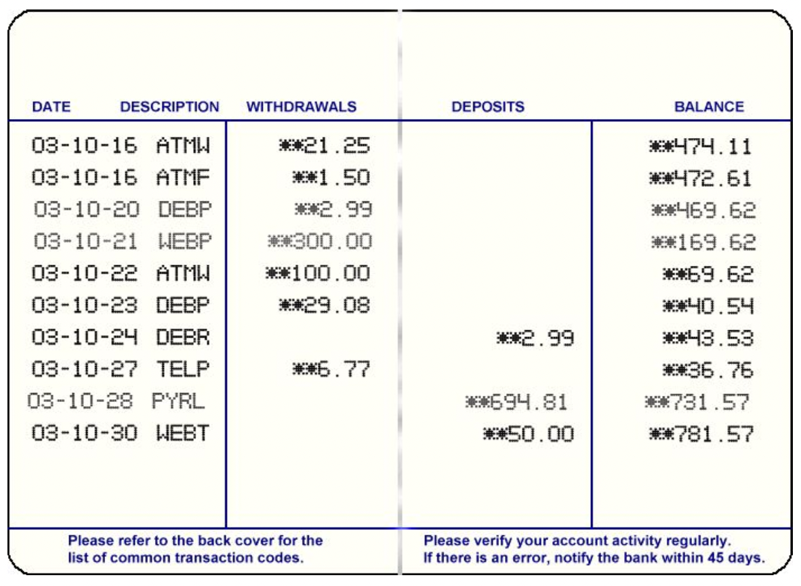
Activity
Keep your notebook out. Work with a partner to identify the data and methods needed to build a SavingsAccount class.
be sure to:
Work with a partner.
Identify the crucial data and methods that you need to store.
For each piece of information, decide whether it should be accessible, modifiable, both, or neither.
Once you finish, begin implementing with your partner in CodeHS sandbox.
Notes:
public variables: withdrawl, deposit, balance, date.
private: add interest, private instance variables.

Slide 9
e
Reflection: Thinking about thinking
be sure to: Answer each question below with a complete sentence.
How do you determine if information should be accessible, modifiable, both, or neither.
Why is it useful to encapsulate information?
Notes:
it depends on what kind of information you have, if its something the user will want to know or change.
This helps us manage complexity in our programs. people should only have to worry about what they have to worry about!

