Slide 1
Fall 2021 AP CS A
Lesson 10.2
Dr. O’Brien
Herbert H. Lehman High School
November 23, 2021
Notes:
VOCAB:
nested loop

Slide 2
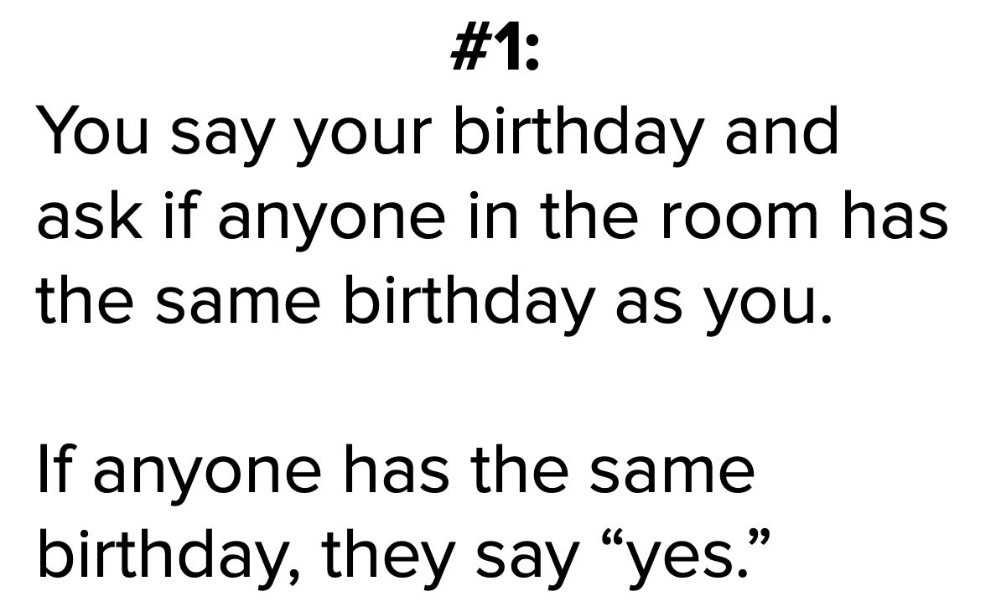
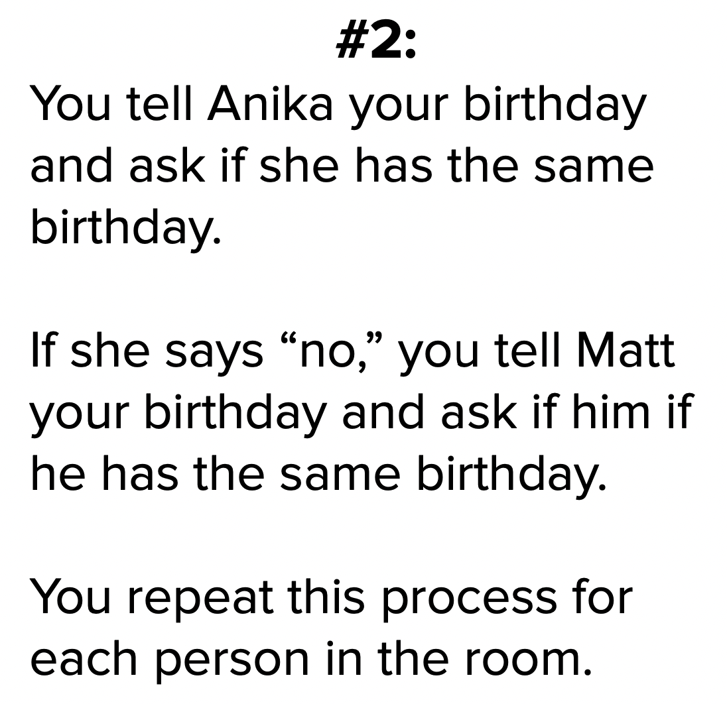

Do now
be sure to: Get out your binder. Copy goal and answer do now questions below. Show all work or write a complete sentence for each answer:
Below are two algorithms for finding someone with the same Birthday as you. Which one do you think is more efficient? Explain why.
Notes:
DRAW TABLE BEFORE CLASS.
The first row increments by 1, the second row by 2, and so on. The first column increments by 1, and so on.
The “brute force solution” involves making a separate for loop for each row, changing the initial state of the counter, the increment and so on. But we can also observe that this table is equivalent to… (1 2 3 4 5) X 1 (1 2 3 4 5) X 2 (1 2 3 4 5) X 3 (1 2 3 4 5) X 4 (1 2 3 4 5) X 5 Believe it or not, this actually suggests a much simpler way to solve our problem.

Slide 3
framing
what: HDW use informal run-time comparison to analyze algorithmic efficiency?
why: Efficient algorithms save time and money ($).
where to: Test next week. Then writing classes.

Slide 4
Vocab
be sure to: Keep your notebook open. Copy each definition, in your Java Glossary.
Algorithm
A step-by-step procedure for solving a problem
Statement execution count
The number of times a statement is executed by a program.
Notes:
+Why do you think it’s called nesting? because one is placed inside of the other?

Slide 5
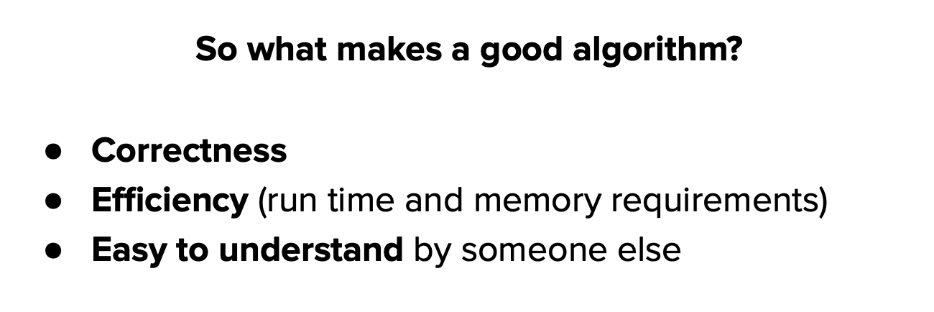
Mini-lesson
be sure to: Take notes and answer questions in your notebook.
Algorithm
A step-by-step procedure for solving a problem

Slide 6
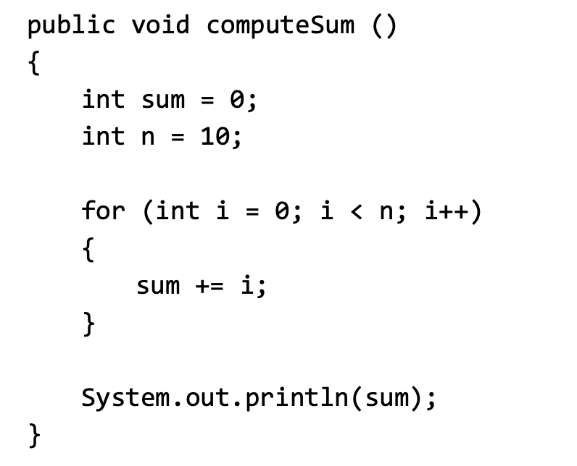
Mini-lesson
be sure to: Take notes and answer questions in your notebook.
Algorithm
A step-by-step procedure for solving a problem
Notes:
execution count: 1 + 1 + n + 1 = 3 + n; = 13

Slide 7
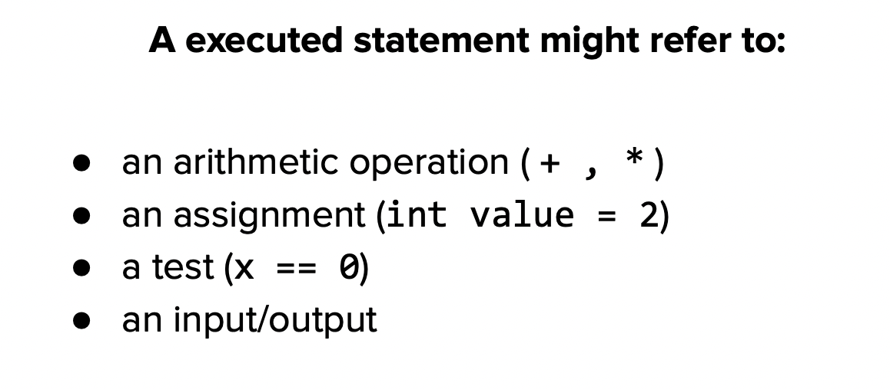
Mini-lesson
be sure to: Take notes and answer questions in your notebook.
Statement execution count
The number of times a statement is executed by a program.
Notes:
Make a table of numbers with five columns where the numbers in each row are a multiple of the top row.
Make a string and add 1 + 2. + 3 +4 +5. A loop could be useful with this.
Multiple each number by 2.
for each number i in 1-5:
for each number j in 1-5:
add i*j to column

Slide 8
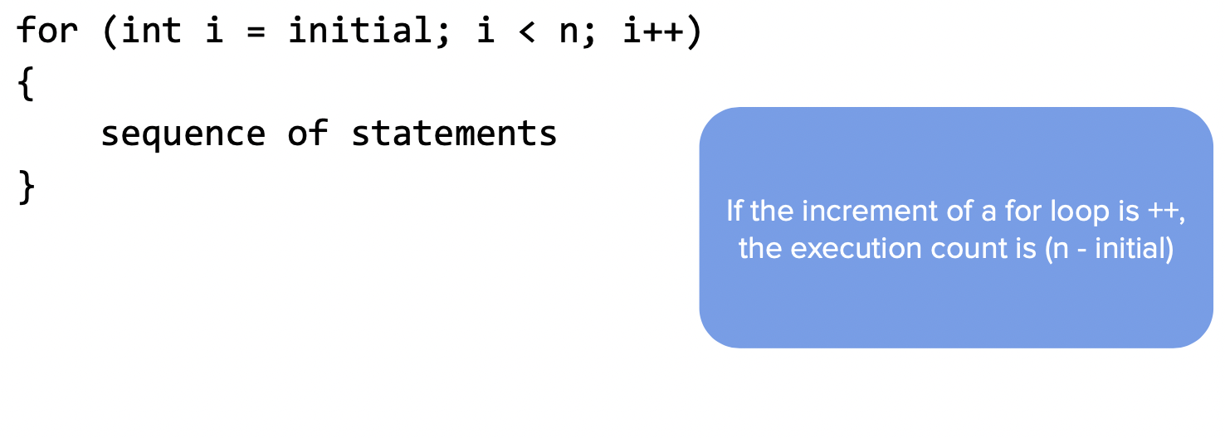
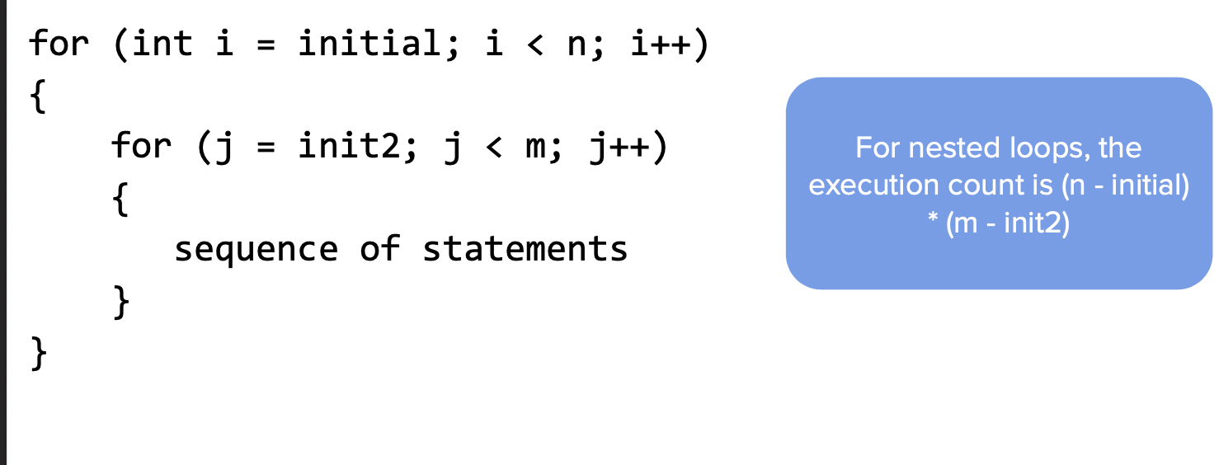
Mini-lesson
be sure to: Take notes and answer questions in your notebook.
Notes:
copy notes in bubble

Slide 9
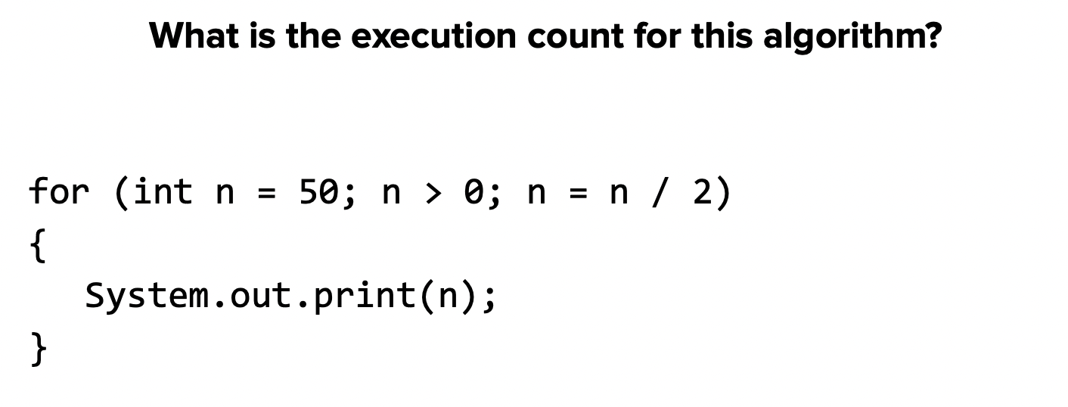
Practice problem #1
be sure to: Take notes and answer questions in your notebook.
Notes:
50 25 12 6 3 1 = 6

Slide 10
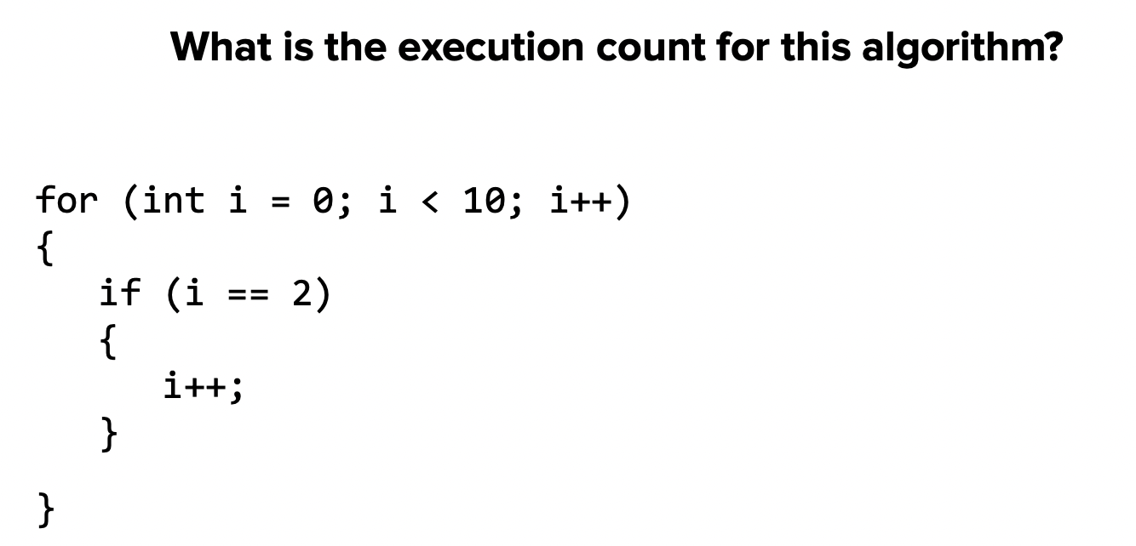
Practice problem #2
be sure to: Take notes and answer questions in your notebook.
Practice problem #2
be sure to: Take notes and answer questions in your notebook.

Slide 11
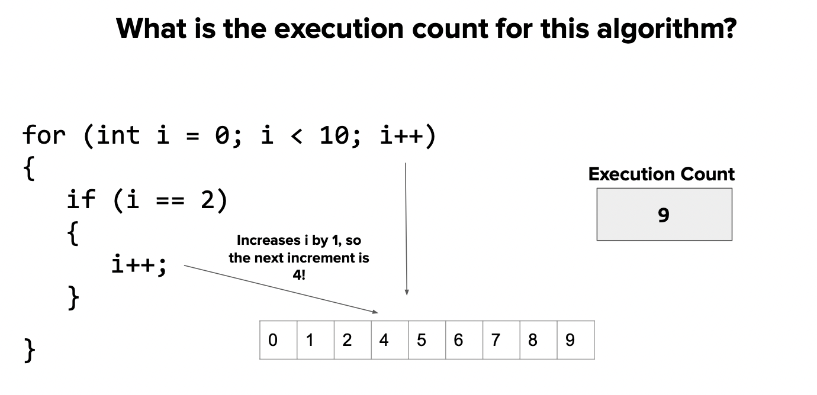
Practice problem #2
be sure to: Take notes and answer questions in your notebook.

Slide 12
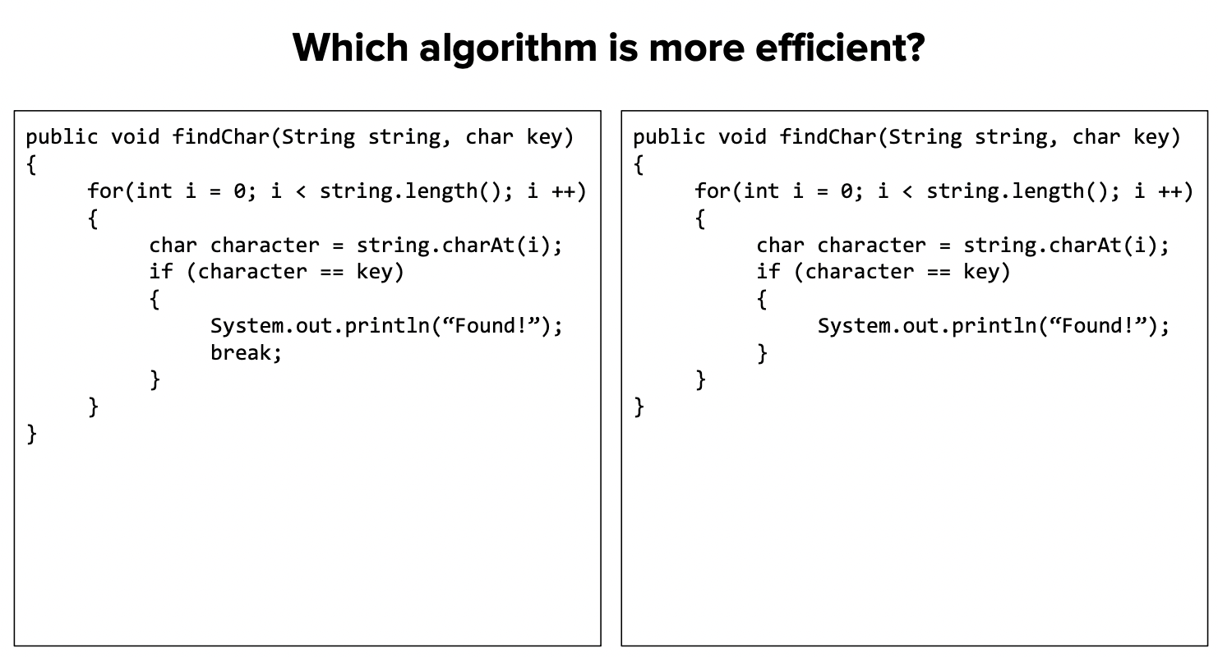
Practice problem #3
be sure to: Take notes and answer questions in your notebook.

Slide 13
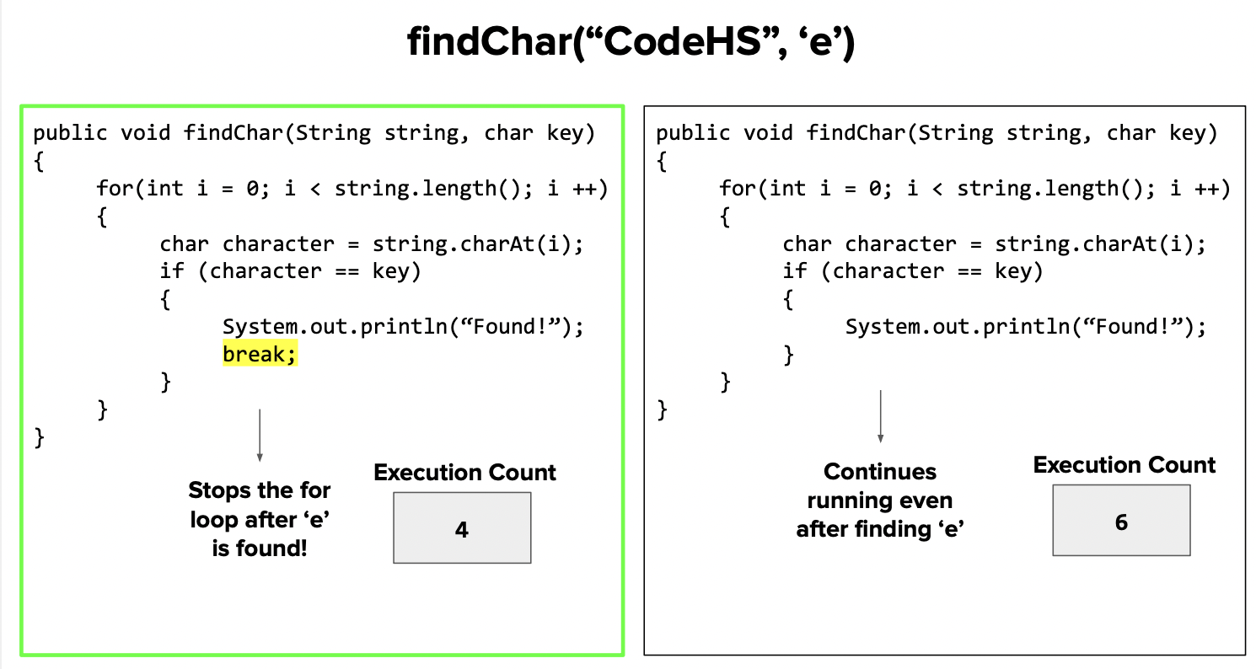
Practice problem #3
be sure to: Take notes and answer questions in your notebook.

Slide 14
Coding to learn
be sure to: Log in to Workstation. Work on CodeHS exercises below. Make sure to write out a plan before you start coding!
Algorithm
A step-by-step procedure for solving a problem
CodeHS lesson 4.5
Statement execution count
The number of times a statement is executed by a program.
Notes:
BE SURE TO WRITE OUT A PLAN
+How could you use .indexOf() to solve the password checker assignment? You could make a string containing all lower case letters. and all digits 0-9. then you could check if a given character is in them because if not you’ll return -1.
+
+How is fixing grammar similar to the ‘remove’ method we discussed in the mini-lesson? It’s similar in that we want to make a new string with the corrected form of the input string.

Slide 15
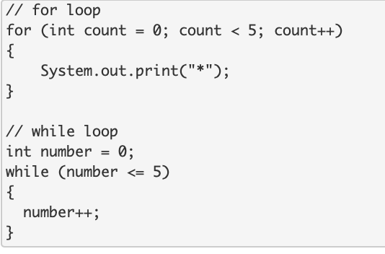
exit ticket
be sure to: Answer each question below with a complete sentence.
Ho many times does this code iterate?
What are some differences between the for loop and the while loop in terms of iteration?
Notes:
How many times does the for loop iterate? How many times does the while loop iterate? Why are they different?
The for loop will iterate 5 times. The while loop will iterate 6 times. The while loop will iterate one more time because the inequality <= is used instead of <. The while loop will run when the variable = 5 whereas the for loop will not.

