Slide 1
Fall 2021 Python
Lesson 7.4
Dr. O’Brien
Herbert Lehman High School
Nov. 4, 2021

Slide 2
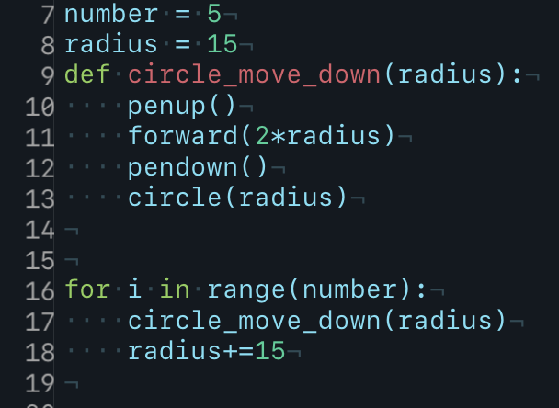
Do now
be sure to: find seat near the board. Get out your binder and answer the do now questions below. Show all work or answer each question with a complete sentence.
Copy the definition in your Python Glossary.
What variables do you notice in the program? How are they used?
Which variable seems to be a parameter? How is it being used?
parameters: Pieces of information you can give to functions when you define them.
Notes:
A.
B. radius. it’s used inside of the circle commmand. it’s updated with each iteration of a for loop to ovule in size. Number is used in the range for the formloop.
C. Radius is passed as a parameter. Where it is used as the argument for circle() and forward()

Slide 3
framing
what: use variables and user input to customize our programs
why: Variables and user input let us make our programs more sophisticated.
where to: While loops!

Slide 4
Work day
be sure to: find your assigned seat. Log in to CodeHS. Begin work!
Find your assigned seat (ask Dr. O’Brien)
Read through the MP1 requirements below.
Make sure your Python glossary is updated.
Begin work! Raise your hand quietly if you have any questions
Vocabulary
Variable: A symbol or container that holds a value
color(“red’): Command that changes the color of tracey’s pen.
parameters: Pieces of information you can give to functions when you define them.
Weekly goal: Complete up through
the end of CodeHS Unit 2!!!
Notes:
Make sure students are working quietly. See problem guides for specific Python activities.
Frequently asked questions:
+I don’t know what to do!?! Make sure to carefully read the instructions. Take notes when watching the video.
+What are you trying to make tracy do?
+how can I figure out why my code doesn’t work? Try getting out a piece of paper, and following your commands yourself. What do you draw. Where do things go wrong?
+What do I do if I forget a command? See the docs section of CodeHS.

Slide 5
Cell phone distro
be sure to: Carefully read the directions below
a. Students will receive their phones at the end of 9th period and 10th period.
b. Students without a phone may leave class immediately. All other students should remain seated. Once a student collects their phone, they should exit the classroom.
c. Students must show their ID, program, or a notebook with their name on it to receive their phone.

Slide 6
wrapping up!
be sure to: read the directions below!
Make sure there isn’t any litter near your workstation.
If you borrowed headphones, sign them back in.
Make sure you are logged out of your computer!
Remain in your seat until the bell rings.

