Slide 1
Fall 2021 Precalc
Lesson 13.1
Dr. O’Brien
Herbert H. Lehman High School
13 December 2021
Notes:
VOCAB:
nested loop

Slide 2

Do now
be sure to: Get out your binder. Make sure you receive your Brainstorm your own game worksheet. Copy the goal and answer do now questions below. Write a complete sentence for each answer:
Let’s say we want to make the image below in Pyret.
What functions would we need to use (check your contracts handout).
Make a prediction: How many lines of code would we need to run?
Notes:
1 seems more efficient, since you’re only asking one question.
+How can we measure ‘efficiency’? which operation is faster? One will probably take less time
+What might be some problems with situation (1)? if a lot of people share the same birthday as you, it might get confusing.

Slide 3
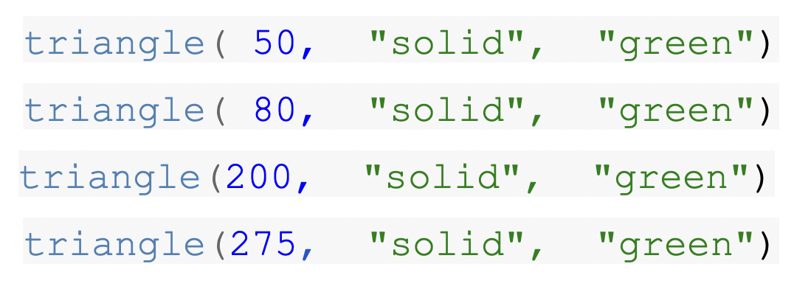
Do now
be sure to: Get out your binder. Make sure you receive your Brainstorm your own game worksheet. Copy the goal and answer do now questions below. Write a complete sentence for each answer:
Making this would get find of tedious because because we’d be using the triangle function over and over again.
There has to be a better way…
Notes:
1 seems more efficient, since you’re only asking one question.
+How can we measure ‘efficiency’? which operation is faster? One will probably take less time
+What might be some problems with situation (1)? if a lot of people share the same birthday as you, it might get confusing.

Slide 4
framing
what: define our own functions in Pyret
why: Making our own functions will be useful to getting our images to move around on the screen in our game. But it will also deepen our understanding of mathematical functions.
where to: using functions in Pyret to solve mathematical word problems

Slide 5
Vocab
be sure to: Keep your notebook open. These definitions should be in your Glossary. If not Copy each definition, in your Pyret Glossary.
function
a mathematical object that takes in an input and produces a unique output
example
Shows the use of a function on specific inputs and the computation the function should perform on those inputs
function definition
Code that names a function, defines its arguments, and states the expression to compute when code is used

Slide 6
Coding to learn: warm up
be sure to: Answer the questions below in your notebook. Be prepared to share out.
$$f(1)=4$$
$$f(2)=5$$
$$f(3)=6$$
$$f(5)=8$$
Define a function $f(x)$ so that it will output the appropriate values given the inputs to the right
Define a function $g(x)$ so that it will give the appropriate outputs given the inputs to the right
How could you write a contract specifying the domain and range for $f(x)$ and $g(x)$?
$$g(1)=3×1=3$$
$$g(2)=3×4=12$$
$$g(3)=3×9=27$$
$$g(5)=3×25=75$$
Notes:
f(x) = x + 3
g(x) = 3x^2
the contract will be Number -> Number; in other words the domain maps any real number to another real number.
Model how to write functions in pyret (next page)

Slide 7
Coding to learn: warm up
be sure to: Write the definitions below in your notebook.
$$f(1)=4$$
$$f(2)=5$$
$$f(3)=6$$
$$f(5)=8$$
Regular math: $f(x)=x+3$
Pyret: fun f(x): x + 3 end
$$g(1)=3×1=3$$
$$g(2)=3×4=12$$
$$g(3)=3×9=27$$
$$g(5)=3×25=75$$
Regular math: $g(x)=3x^{2}$
Pyret: fun g(x): 3 * num-sqr(x) end
Notes:
Model how to write these functions in Google Classroom. Make sure students copy definitions below in notes:
#FUNCTION DEFINITIONS
fun f(x): x + 3 end
fun g(x): 3 * num-sqr(x) end
+How are the function definitions in Pyret different from standard math definitions? They’re written in a funny way, with fun at the beginning and end telling us where the function ends. Also instead of an ‘=‘ we have a ‘:’.

Slide 8
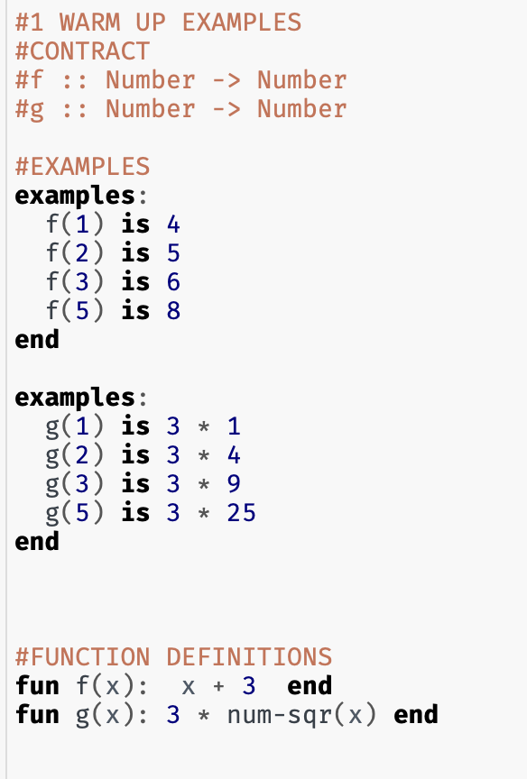
Mini-lesson
be sure to: on your computer, open Monday Examples pyret file in Google classroom. Examine the code with Dr. O’Brien
Notes:
The examples block creates a set of examples which are test on the funcion. If the function returns the correct output for each input, they pass.
Illustrate by changing def. of f(x) to x + 4, then change value of output.

Slide 9
Coding to learn: activity
Examine the examples and function definition for the function gt. Describe how the function works.
How could you write a contract identifying the domain and range for gt?
Write out a function gt2() that produces a triangle with double the size of the input.
Will the domain and range for gt2() be any different from gt()? Explain why or why not in a complete sentence.
Bonus questions:
How could you rewrite gt2() as the composition two functions? Describe the functions and experiment with rewriting the function in Pyret.
Write a function in Pyret for $h(x)=\sqrt{3x^{2}-2}$. Describe the contract for this function.
Be sure to… work with your partner to answer these questions in your notebook. Write code in your Pyret file as needed.
Notes:
+Examine the examples and function definition for the function gt. Describe how the function works. -> the function takes in a number and produces a solid green triangle of that size.
+How could you write a contract identifying the domain and range for gt? gt :: Number -> Image
+Write out a function gt2() that produces a triangle with double the size of the input. gt(x): triangle(2 * x, “solid”, “green”)
Will the domain and range for gt2() be any different from gt()? Explain why or why not in a complete sentence. No, because the function can still take any positve number and produces an image as an output.
Bonus questions:
How could you rewrite gt2() as the composition two functions? Describe the functions and experiment with rewriting the function in Pyret. f(x): 2 * x and gt2(x): gt(f(x))
Write a function in Pyret for . Describe the contract for this function. h(x): num-sqrt((2 * num-sqr(x)) - 2)

Slide 10
Reflection: Thinking about thinking
be sure to: Answer each question below with a complete sentence.
Why is it useful for a programmer to be able to define a function?
Why is it useful to be able to define a function in math?
How do you think functions will make it easier to build our video game?
Notes:
answers will vary.
using functions for manipulating images, e.g. scale(), overlay, etc.

Slide 11

exit ticket
be sure to: Answer each question below with a complete sentence.
Let’s say we want to define a function called bc() that would make a solid blue circle of whatever radius we want.
Write out how to define this function in Pyret.
What would the contract for this function look like?
Notes:
How many times does the for loop iterate? How many times does the while loop iterate? Why are they different?
The for loop will iterate 5 times. The while loop will iterate 6 times. The while loop will iterate one more time because the inequality <= is used instead of <. The while loop will run when the variable = 5 whereas the for loop will not.

