Slide 1
Fall 2021 AP CS A
Lesson 13.1
Dr. O’Brien
Herbert H. Lehman High School
13 December 2021
Notes:
VOCAB:
nested loop

Slide 2
Do now
be sure to: Get out your binder. Copy goal and answer do now questions below. Show all work or write a complete sentence for each answer:
Review your exam. How do you feel like you did on it?
What did you do to prepare for the exam?
How will you change your studying strategy in the future?

Slide 3
Review problem #1
be sure to: Answer the questions below in your notebook. Be prepared to share out!
//CODE:
int count = 10;
for (int i = 1; i<5; i++){
count = count + count;
}
count = count - 5;
Everyone got this answer correct! How could this code have to change for the the answer to be 315?
What will be the value of count as a result of executing this code?
315
160
155
320
Notes:
The value of i would have to be 0. Then there would be an extra iteration, where the count would double again (to 320), before subtracting 5.

Slide 4
Review problem #2
be sure to: Answer the questions below in your notebook. Be prepared to share out!
int sum = 0;
while(sum < 100){
sum += 5;
System.out.println(sum);
}
Why will the initial value printed by this program be 5 instead of 0?
Why will the final value printed by this program be 100?
How could this program be rewritten with a for loop (illustrate with Java code)?
Which statement is true about the code above?
It will print out all multiples of 5, starting with 5 and ending with 100.
It will print out all multiples of 5, starting with 0 and ending with 100.
It will print out all multiples of 5, starting with 5 and ending with 95.
It will print out all multiples of 5, starting with 0 and ending with 95.
Notes:
because the print statement within the body of the while loop follows the statement sum +=5.
Again, the statement sum += 5 precedes the print statement, but in this case follows the test; so in the second to last (penultimate) iteration sum will increase to 95. This is less than 100, so it will enter the final iteration, increment to 100. Then the 100 will print out and the loop will be exited.
for (int sum =5; sum <101; sum+=5){
System.out.println(sum);
}
explain meaning of penultimate: second to last. write on board.

Slide 5
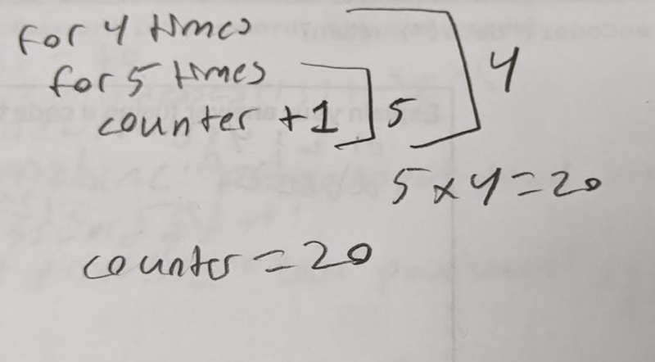
Review problem #3
be sure to: Answer the questions below in your notebook. Be prepared to share out!
int counter = 0;
int a = 4;
int b = 5;
for (int i = 0; i < a; i++){
for (int j = 0; j < b; j++){
counter++;
}
}
System.out.print(counter);
Examine Yosuf’s pseudocode. Why does it make sense?
What is the execution count statement for this program?
What will this program print out?
20
40
18
9
Notes:
It makes sense because each iteration of the outer loop, the inner loop runs 5 times, meaning that 5 is added to count. Since this outer loop runs 4 times, the final value of counter will be 4 * 5 = 20.
Counter is incremented 20 times. In addition there are three variable assignments and one output statement 20 + 3 + 1 = 24.

Slide 6
Review problem #4
be sure to: Answer the questions below in your notebook. Be prepared to share out!
public static String enCoder(String incriptedString){
String alpha = "abcdefghijklmnopqrstuvwxyz";
String output = "";
int num;
String character;
for (int i = 0; i <incriptedString.length();i++ ){
character = incriptedString.substring(i,i+1);
num = alpha.indexOf(character);
output += num;
}
return output;
}
Everyone got this problem correct too!
What does alpha.indexOf() do? Why is it important for this problem?
“34205”
“10012”
“45316”
“46805”
b. What will enCoder(“decaf”) return?

Slide 7
Review problem #5
be sure to: Answer the questions below in your notebook. Be prepared to share out!
Let’s use the how to solve it method to figure this out!
Understand the problem: What is the task you are trying to solve?
Make a strategy: How could we write out a program in pseudocode?
Execute your strategy: translate your pseudocode into Java
Review your work: Let’s try running our code in a Java editor and see if it works!
The method inputPassword has two parameters: password and numGuesses. The method will provide the user with numGuesses chances to input a password. If the user inputs the correct password, the program will stop running. Otherwise, they will guess again until they have exhausted their chances.
For example, a call to inputPassword(“Java rulz”, 4) could result in the following output.
Please input your password: I love Java
Wrong! Please input the correct password: Java Rules
Wrong! Please input the correct password: Java rules
Wrong! Please input the correct password: Java rulz
Your password is correct!

Slide 8
Reflection: Thinking about thinking
be sure to: Answer each question below with a complete sentence.
What’s most challenging about AP-style free response questions?
What can you do for future exams to prepare for this sort of problem?

