Slide 1
Fall 2021 Precalc
Lesson 18.2
Dr. O’Brien
Herbert H. Lehman High School
25 January 2022

Slide 2
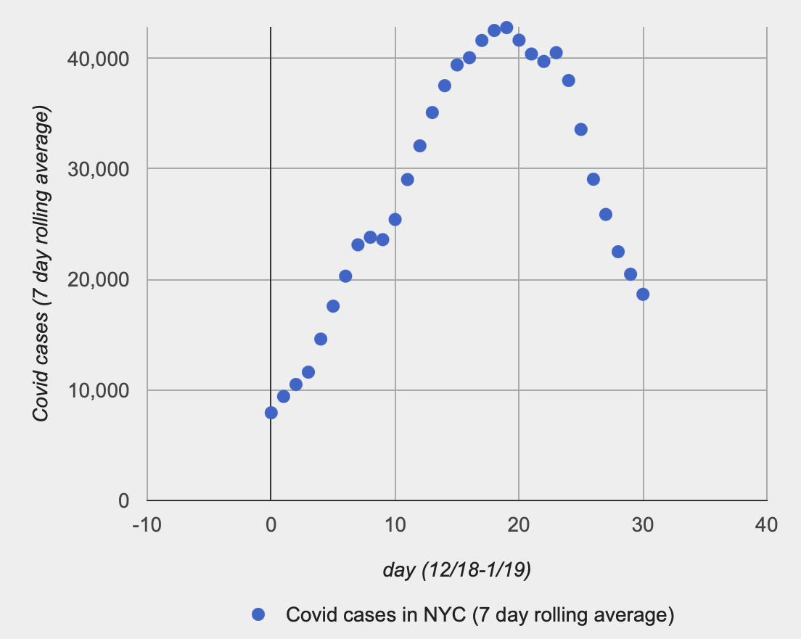
Do Now
Be sure to…Get out your notebook/binder. Read the paragraph below carefully, then answer each question with a complete sentence.
To your right is data representing the number of covid cases reported in NYC between Dec. 18 and Jan. 19.
What do the y- and x-axes represent in this graph?
When does number of covid cases reach it’s peak? How many cases is that, approximately?
What sort of function do you think would best represent this data? Be sure to justify your response in a complete sentence.
Why would we want to find a function that represents this data?
Notes:
x represents days y represents the number of reported Covid cases (7 day average)
+what do you think 7 day rolling average means?
+why do you think the report a 7 day rolling average? There’s a lot of variation on any given day. This smooths it out.
2.day 17 or so. About 45000 cases
3. Students will probably answer a quadratic.
4. So we can predict what Covid going to be like In the future.

Slide 3
B24 rules
Welcome to our new room, B24! Please read the information below:
When you come in, please find a seat at a desk (if one’s available) or one of the six closest desks to the screen. Do not sit in the back of the classroom. We’ll conduct the do now and mini lesson from here.
When I dismiss you for independent work, find a sit at one of the computer workstations.
No food or drink by the computers.
At the end of the period, you’ll be directed to assemble for the exit ticket/debrief. Log out of your computer, and quietly return to a seat near the front.

Slide 4
framing
what: use our knowledge of quadratic functions to fit a model to data
why: (i) This will help review the math needed for parabolic motion in our video game project. (ii) next semester we’ll learn more about curve fitting.
where to: Finish the semester

Slide 5
Vocabulary
curve fitting
Finding the best mathematical function to best fit a series of data points.
parabola (review)
The graph of a quadratic equation

Slide 6
Mini-lesson
curve fitting
Finding the best mathematical function to best fit a series of data points.
Quadratic equation: Vertex form
$$y=a(x-h)^{2}+k$$
where
$(h,k)$ represents the vertex of the parabola and
$a$
parabola (review)
The graph of a quadratic equation
Notes:
Copy the definition for vertex form (should be in notes already)

Slide 7
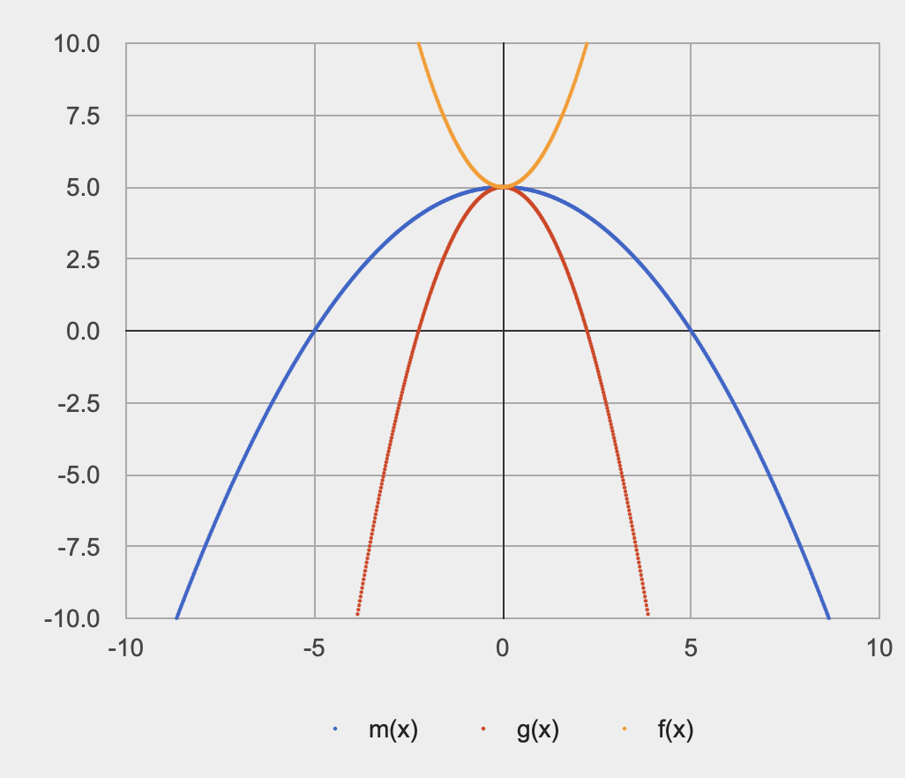
Mini-lesson
Quadratic equation: Vertex form (review)
$$y=a(x-h)^{2}+k$$
where
$(h,k)$ represents the vertex of the parabola
QuickWrite: To the right, graphs for three quadratic functions, f(x), g(x), and m(x).
How are the equations for these three functions similar? What do you think is different?
Notes:
They all share the same vertex. This means that h and k are the same in their equations. They differ in that some are more compressed/stretched than others? This means that a is different.

Slide 8
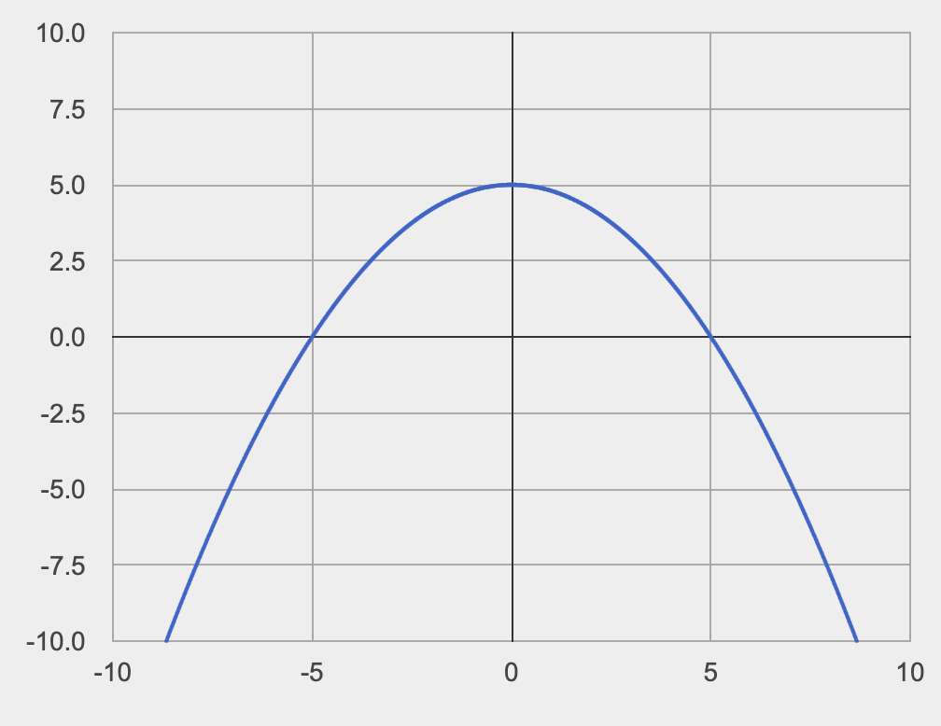
Mini-lesson
Quadratic equation: Vertex form (review)
$$y=a(x-h)^{2}+k$$
where
$(h,k)$ represents the vertex of the parabola
What’s the vertex, x- and y-intercepts for m(x)
How could we use this information to find the equation for m(x)?
$$m(x)=-\frac{1}{5}x^{2}+5$$
Notes:
1.What’s the vertex, x- and y-intercepts for m(x)? Vertex is (0, 5). Y int is5 and x ints are -5 and 5.
2. How could we use this information to find m(x)?
ON BOARD.
+ how can fill in the values of h and k?
Plug in h and k:
m(x) = ax^2 + 5
notice that h is zero, so we can ignore it.
+How could we fill in values for x and m(x)?
We know two points on the parabola, the x-ints. Pick one of them and plug it in.
0 = a(5)^2 + 5 = 25a + 5
+Why are we plugging in x-intercepts? because we know this point is on the graph, so these are both valid values for x and y.
+why does it not matter which x int we pick? Because the y value is the same (0) and 5^2 is the same as (-5)^2.
Solve for a:
a = -1 / 5
Now we can plug in a and represent m(x) as
m(x) = (-1/2)x^2 + 5

Slide 9
Curve fitting activity
Be sure to…
Complete the Covid worksheet:
Draw the parabola that you think best represents the data.
Estimate the vertex and x-intercepts for your graph.
Use the info from (b) and the strategy we discussed earlier to find an equation for your parabola.
On back page, complete the Curve Fitting in Pyret extension activity (code available on Google Classroom).
Quadratic equation: Vertex form
$$y=a(x-h)^{2}+k$$
where
$(h,k)$ represents the vertex of the parabola and
$a$
curve fitting
Finding the best mathematical function to best fit a series of data points.
parabola (review)
The graph of a quadratic equation
Notes:
Pre-planned questions:
+How do I know where to draw the curve? This is about going with your intuition. Draw the best graph you can, that you think fits the data. Later on we’ll talk about something called ‘goodness-of-fit’, about how to measure how well a functions fits data.
+How do I know where the vertex/intercepts are? Again, estimate and do your best.
How do I solve for a? Study the procedure we used for the example earlier (still on the board).
How do I know what my function predicts for a given day? 2 ways you can answer this. One is to plug it in and see what the answer is (write curve-fitter(10) in interactions area on Pyret). The other is by examining the graph.

Slide 10
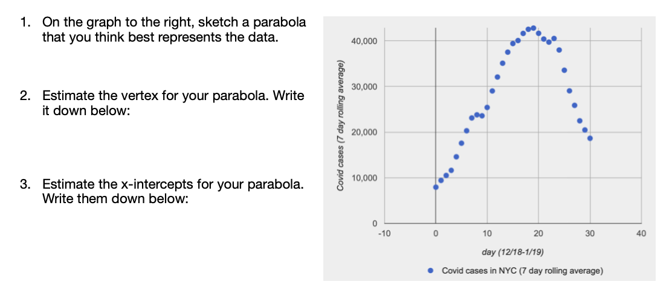
Curve fitting activity
Notes:
answers will vary.
answers will vary. but something around (20, 45000)
Answers will vary. around (5,0) and (40,0)

Slide 11
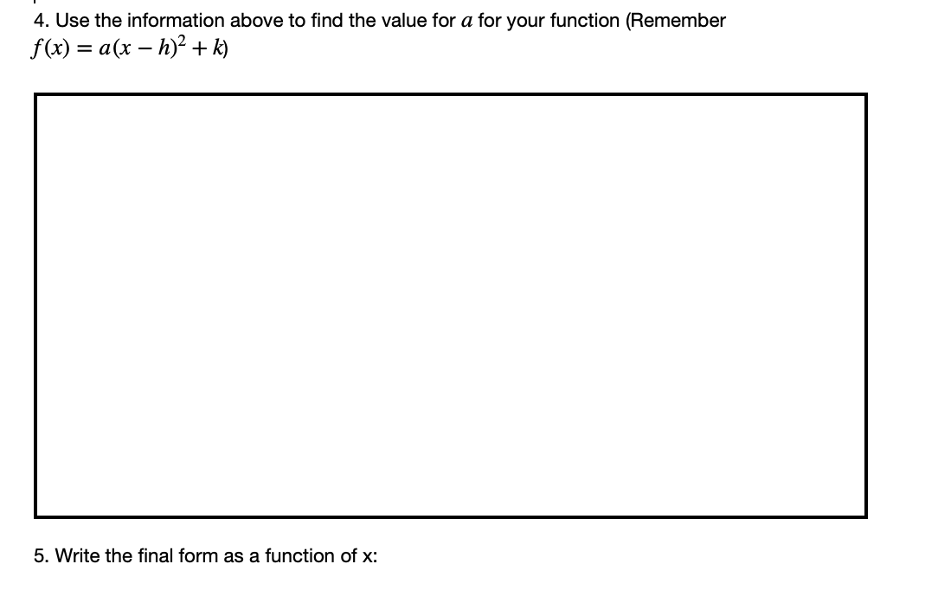
Curve fitting activity
Notes:
Answers will vary, depending on the values the student chose early, but one strategy to solve is presented earlier on slide 8. Likely values for a,h,k:
-100 <= a <= =-200
15 <= h <= 20
40000 <= k <= 45000

Slide 12
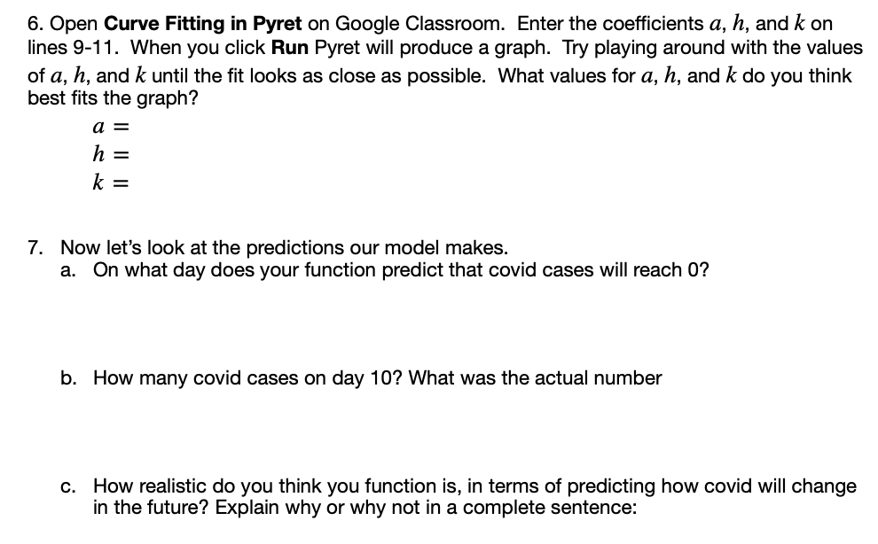
Curve fitting: Extension activity
Notes:
6. Answers will vary, but representative values same as above.
7.
around day 40.
35k-30k
It’s not very realistic because in reality covid probably won’t reach 0 any time soon. also covid case numbers can’t be negative.

Slide 13
Exit ticket
be sure to: Get out a sheet of loose leaf paper. Write your name and the date on the top. Answer each question below with a complete sentence. Be prepared to turn in!
What did you find most challenging about fitting a curve to the data today?
Why is it useful to model data with mathematical functions?
Notes:
+answers will vary, but finding a function that most closely matches the data. This is actually a really hard problem and something we’ll discuss in the future.
+To make predictions and test theories. basically the whole point of using math in science, business, or engineering is a tool for making precise quantitative predictions.

Slide 14
wrapping up!
be sure to: read the directions below!
Make sure there isn’t any litter near your workstation.
If you borrowed headphones, sign them back in.
Make sure you are logged out of your computer!
Remain in your seat until the bell rings.

