Slide 1
Fall 2021 Java
Lesson 6.4
Dr. O’Brien
Lehman High School
October 28, 2021

Slide 2
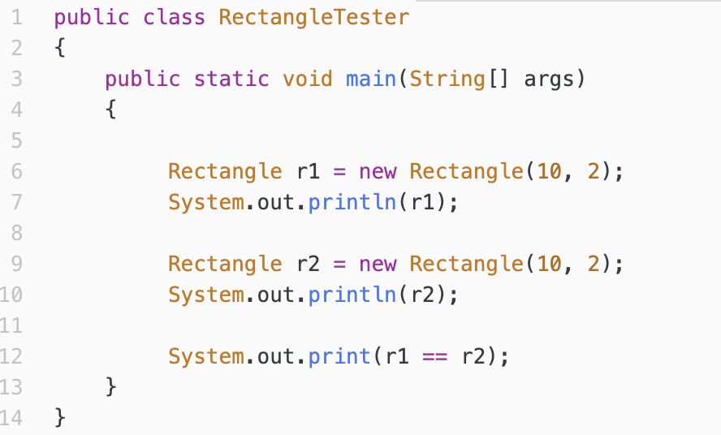
do now
be sure to: Go to computer. Read instructions below.
What will System.out.println(r1) print out if the Rectangle class lacks a toString() method?
What do you think System.out.println(r1==r2) will print out?
Notes:
b 1. firstname, lastname, grade, osis, baseyear,
+how is baseyear different from the other instance variables? it’s not assigned an attribute in the constructor.
2. luis and guilfidan.
3. firstname= “Gulfidan”, grade = “10”, etc.
C. We haven’t seen baseyear, getgrade year or if statements yet.

Slide 3

do now
Notes:
print(r1) and r2 returns locations in memory.

Slide 4
framing
what: HDW compare objects using boolean expressions?
why: Like objects of the String class, instances of classes in general require special care when using boolean expressions.
where to: Loops and iteration
Notes:
b 1. firstname, lastname, grade, osis, baseyear,
+how is baseyear different from the other instance variables? it’s not assigned an attribute in the constructor.
2. luis and guilfidan.
3. firstname= “Gulfidan”, grade = “10”, etc.
C. We haven’t seen baseyear, getgrade year or if statements yet.

Slide 5
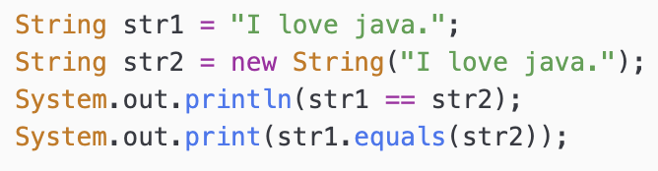
warm up
Make a prediction: What will the code to the right print out?
Why?

Slide 6
memory in Java
Stack memory: Where variables containing primitive values and method calls are stored (think ‘stack frames’)
Heap:
Where Java objects are stored
Notes:
Illustrate on board
str1 and str2 are both stored in a stack frame. str1 points to a literal (technically in the constant pool). str 2 points to a memory addresss (like 6ff3c5b5); , which is a memory location in the heap where the object is stored.
== is looking at whether the variables are pointing to the same thing (they’re not).
equals() looks at whether they point to the same data (they do).

Slide 7
vocabulary
Aliases: Two object variables that reference the same object
Reference equality: Equality operator (==) compares the references (objects in memory) of two objects
Logical equality: The .equals() method compares the data of two oebjects, instead of the value of references
Notes:
copy in notes

Slide 8
other classes
Notes:
Model on board.
r1 = 0x100
r2 = 0x101
r1 and r2 introduce new objects, with distinct locations in memory.
+Why does referece equality return false? (we have distinct memory addresses).
+How could we ensure logical equality? write r1.equals(r2);

Slide 9
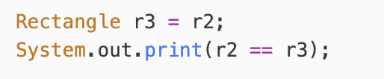
What will this print out?
r3 and r2 are aliases
Notes:
true, because r2 and r2 both point to the same location in memory.

Slide 10
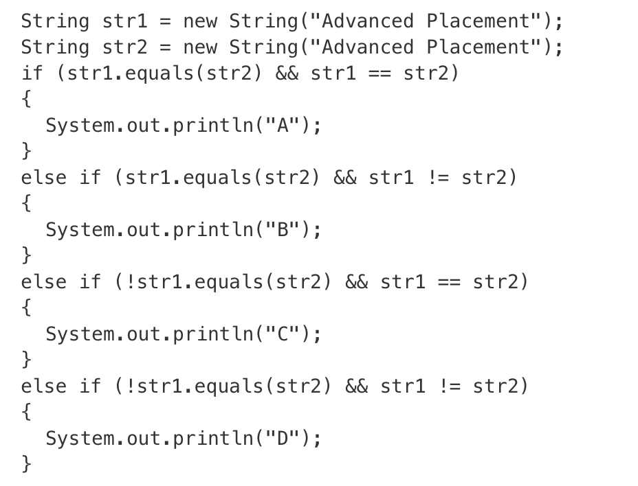
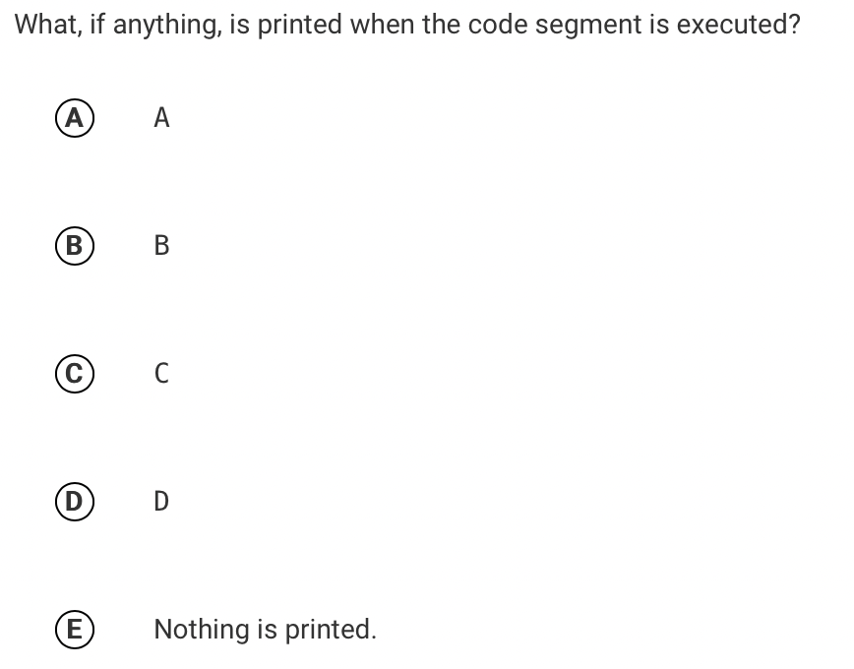
pick and answer, then write a sentence justifying your answer:

Slide 11
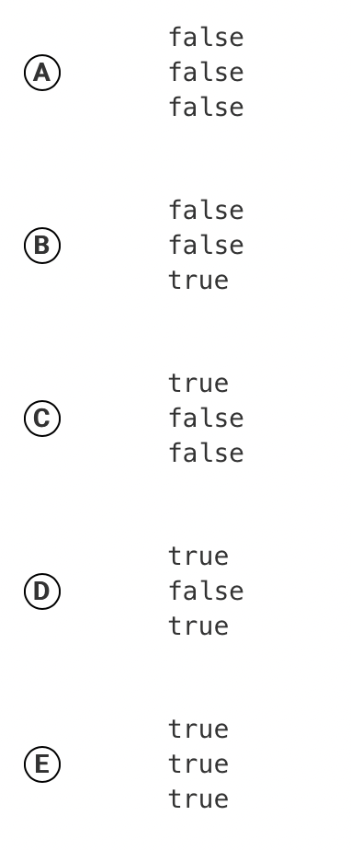
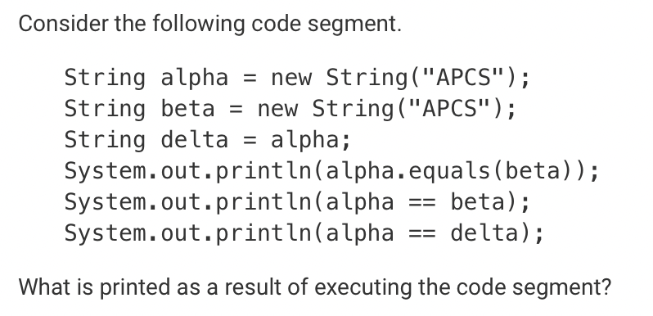
pick and answer, then write a sentence justifying your answer:

Slide 12
reflection questions
What’s the difference between reference equality and logical equality? Describe in a sentence.
Why do you think it’s important to understand this distinction?
Notes:
+logical equality compares data, reference equality compares what the variable is pointing to, which in the case of objects is a location in heap memory, not the data.
+This is important because it affects how booleans behave. If we want to compare data, we need to use the .equals() method;

