Slide 1
Fall 2021 Precalc
Lesson 3.2
Dr. O’Brien
Herbert H. Lehman High School
15 February 2022

Slide 2
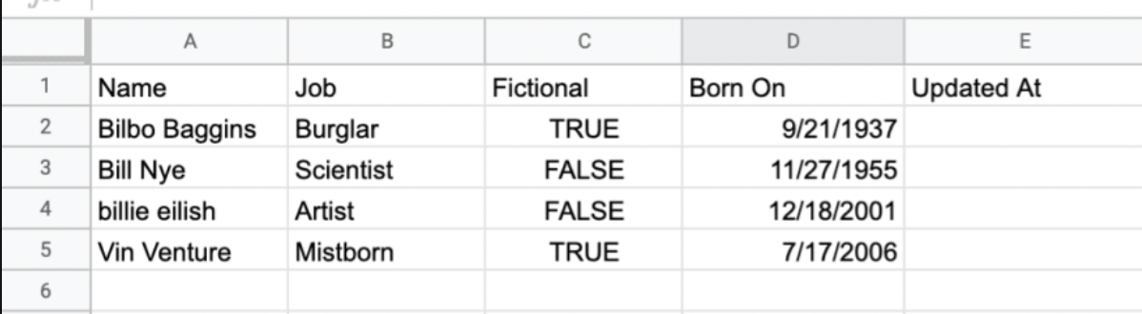
Do Now
Be sure to…Get out your notebook/binder. Answer the questions below. Write a complete sentence for each question!
How many columns are in the spreadsheet to the right? How many rows?
Why do you think it’s useful to represent data in spreadsheets?
Notes:
5 columns and 5 rows.
We can access data by row and column. Easier to represent and access data.

Slide 3
B24 rules
Welcome to our new room, B24! Please read the information below:
When you come in, please find a seat at a desk (if one’s available) or one of the six closest desks to the screen. Do not sit in the back of the classroom. We’ll conduct the do now and mini lesson from here.
When I dismiss you for independent work, find a sit at one of the computer workstations.
No food or drink by the computers.
At the end of the period, you’ll be directed to assemble for the exit ticket/debrief. Log out of your computer, and quietly return to a seat near the front.

Slide 4
framing
what: perform Gaussian elimination on matrices
why: Matrices are a useful way to solve systems of equations
where to: Review for Thursday quiz!

Slide 5
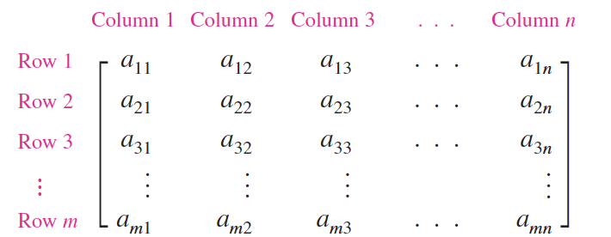
Matrices
An $m×n$ matrix is an array with $m$ rows and $n$ columns:
where each entry $a_{i,j}$ is a real number.

Slide 6
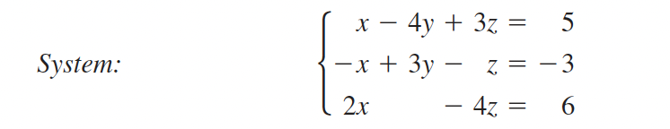
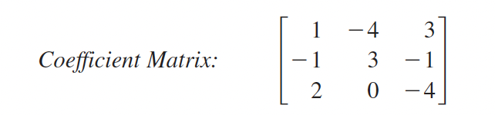
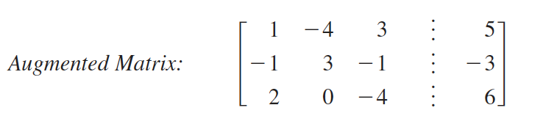
Matrix vocabulary
Coefficient matrix
Matrix containing the coefficients from the left hand side of the system of equations
Augmented matrix
Matrix containing the coefficients from the left hand side of the system of equations and also the numbers on the right hand side

Slide 7
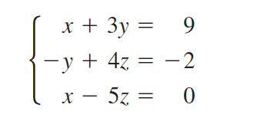
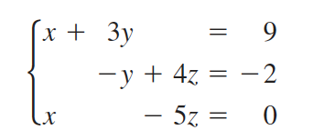
Augmented matrix
Write the augmented matrix for each system of equations:
a.
b.

Slide 8
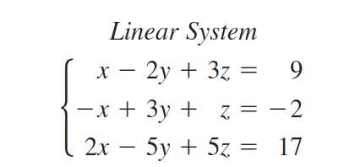
Gaussian elimination on an augmented matrix
Convert the system below to augmented matrix form. Then perform Gaussian elimination.
Notes:
See pg. 507 textbook.

Slide 9
Independent work
1. Solve the nonsquare system below:
2x - 3y + z = -2
-4x + 9y = 7
2. (a) convert the linear system below to an augmented matrix.
(b) Identify the dimensions of this matrix
(c) Convert the matrix to row echelon form:
x + 2y + 3z = 4
-x - 2y + z = 5
2x + 8y + z = -2
Notes:
1.
pivot: 2, elimination coefficient: -4, multiplier: 2
4x - 6y + 2z = -4
-4x + 9y. = 7
————————
3y. +2z = 3
y + 2/3 z = 1
y = 1 - 2/3z
4x - 6(1 - 2/3z) +2z = -4
4x. -6 + 4z + 2z = -4
4x +6z. = 2
2x + 3z = 1
x = 0.5 - 1.5z
z = a, where a is any real.
2. This system will appear to end up with a zero pivot in the second row, if students don’t perform a row exchange (see ipad for detailed solution).
3.

Slide 10
wrapping up!
be sure to: read the directions below!
Make sure there isn’t any litter near your workstation.
If you borrowed headphones, sign them back in.
Make sure you are logged out of your computer!
Remain in your seat until the bell rings.

