Slide 1
Fall 2021 Precalc
Lesson 3.2
Dr. O’Brien
Herbert H. Lehman High School
16 February 2022

Slide 2
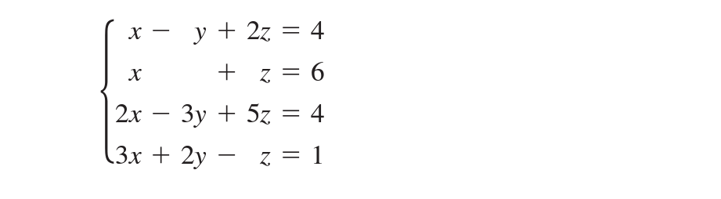
Do Now
Be sure to…Get out your notebook/binder. Answer the questions below. Write a complete sentence for each question!
Convert this linear system to augmented matrix form
Why do you think it’s useful to represent linear systems in matrix form?
Notes:
2. because teh variables equal signs, and so on don’t really matter when we’re doing gaussian elimination.

Slide 3
B24 rules
Welcome to our new room, B24! Please read the information below:
When you come in, please find a seat at a desk (if one’s available) or one of the six closest desks to the screen. Do not sit in the back of the classroom. We’ll conduct the do now and mini lesson from here.
When I dismiss you for independent work, find a sit at one of the computer workstations.
No food or drink by the computers.
At the end of the period, you’ll be directed to assemble for the exit ticket/debrief. Log out of your computer, and quietly return to a seat near the front.

Slide 4
framing
what: use Gauss-Jordan elimination to convert matrices to reduced row echelon form?
why: Gauss Jordan elimination is an easy way to solve for a linear system
where to: Review for Thursday quiz!

Slide 5
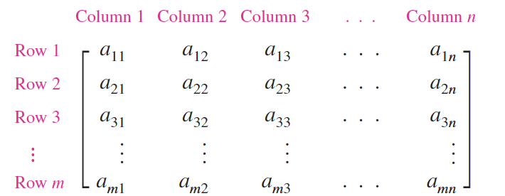
Matrices
An $m×n$ matrix is an array with $m$ rows and $n$ columns:
where each entry $a_{i,j}$ is a real number.

Slide 6
Matrix vocabulary
Reduced row echelon form
A matrix in row echelon form where all pivots are 1 and all values above and below the pivots are 0.
Gauss-Jordan elimination
Extension of Gaussian elimination that converts a matrix to reduced row echelon form.

Slide 7
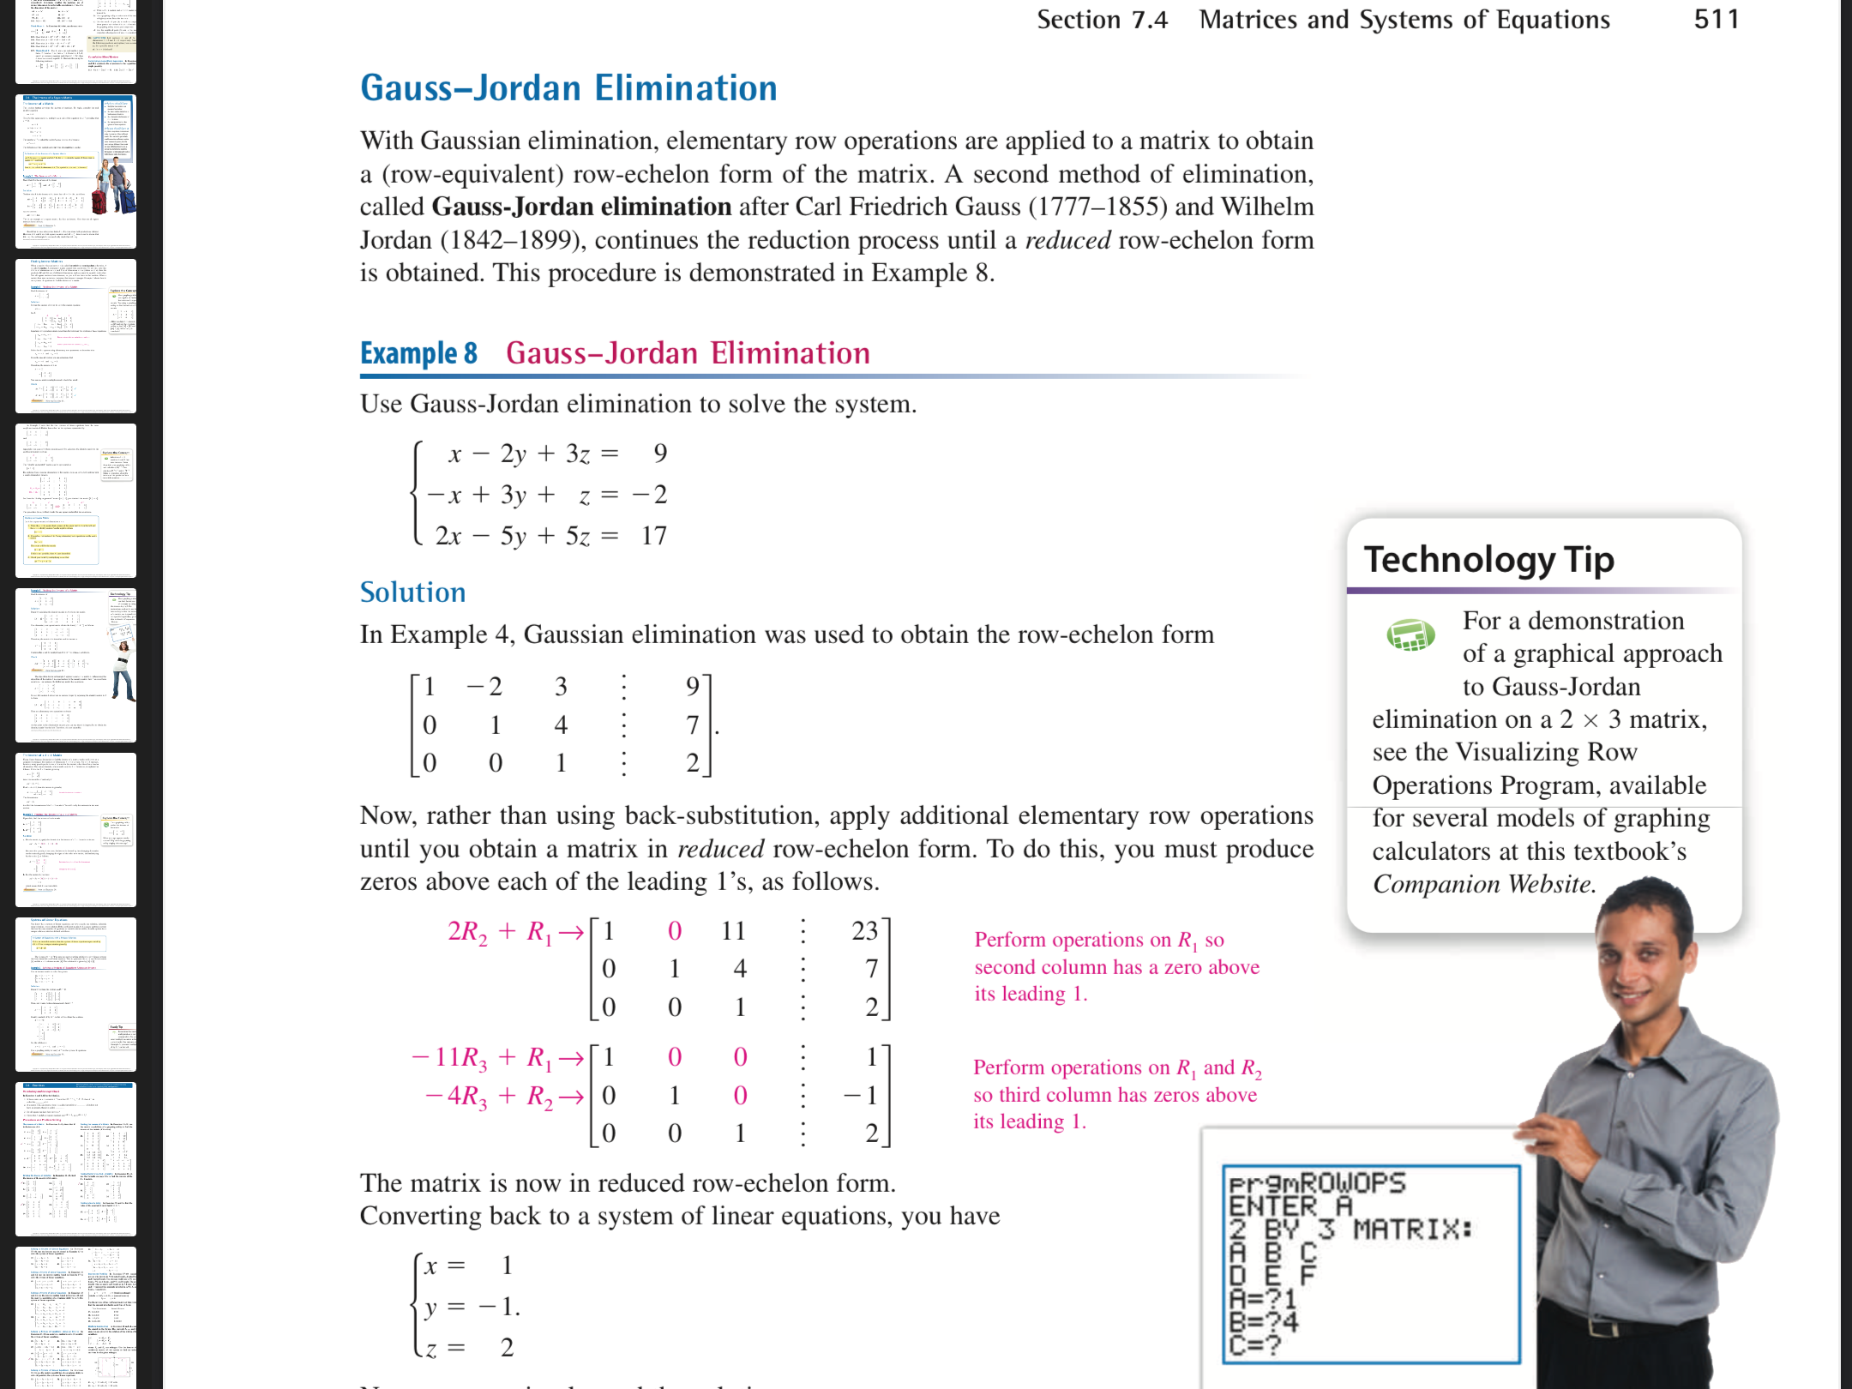
Gauss-Jordan Elimination
Yesterday we converted this system to row echelon form.
Reduced row echelon form
A matrix in row echelon form where all pivots are 1 and all values above and below the pivots are 0.
$$→$$
Gauss-Jordan elimination
Extension of Gaussian elimination that converts a matrix to reduced row echelon form.
Today we’ll convert it to reduced row echelon form with Gauss-Jordan elimination!
Notes:
See pg. 511 of textbook for solution

Slide 8
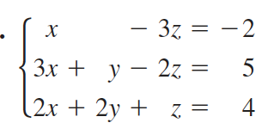
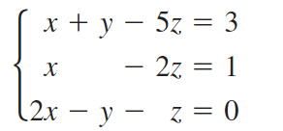
Independent work
1. Solve the nonsquare system below:
2x - 3y + z = -2
-4x + 9y = 7
2. (i) convert the linear system below to an augmented matrix.
(ii) Identify the dimensions of this matrix
(iii) Convert the matrix to row echelon form:
(iv) Use back-substitution or Gauss Jordan elimination to solve.
a.
b.
Notes:
1.
pivot: 2, elimination coefficient: -4, multiplier: 2
4x - 6y + 2z = -4
-4x + 9y. = 7
————————
3y. +2z = 3
y + 2/3 z = 1
y = 1 - 2/3z
4x - 6(1 - 2/3z) +2z = -4
4x. -6 + 4z + 2z = -4
4x +6z. = 2
2x + 3z = 1
x = 0.5 - 1.5z
z = a, where a is any real.
2. see ipad notes for solution.

Slide 9
wrapping up!
be sure to: read the directions below!
Make sure there isn’t any litter near your workstation.
If you borrowed headphones, sign them back in.
Make sure you are logged out of your computer!
Remain in your seat until the bell rings.

