Slide 1
Fall 2021 AP CS A
Lesson 16.5
Dr. O’Brien
Herbert H. Lehman High School
14 January 2022

Slide 2
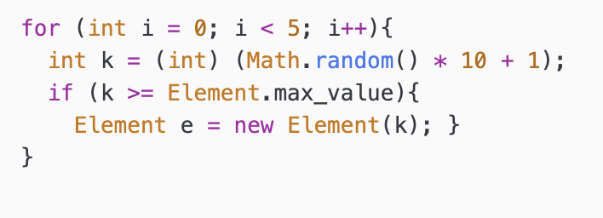
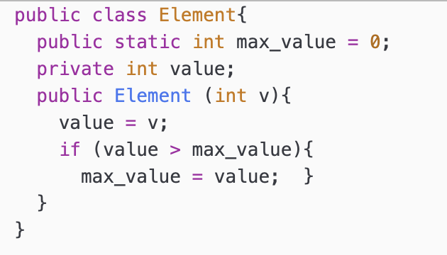
Do now
be sure to: Get out your binder. Copy goal and answer do now questions below. Then (i) select an answer for the problem below, and (ii) justify your answer in a complete sentence:
The following code segment appears in a class other than Element.
Which of the following best describes the behavior of the code segment?
Exactly 5 Element objects are created.
Exactly 10 Element objects are created.
Between 0 and 5 Element objects are created, and Element.max_value is increased only for the first object created.
Between 1 and 5 Element objects are created, and Element.max_value is increased for every object created.
Between 1 and 5 Element objects are created, and Element.max_value is increased for at least one object created.

Slide 3
framing
what: define behaviors of a class w/ static methods
why: Static methods allow us to define behaviors that are specific to an entire class, instead of one object.
where to: Scope and access in classes

Slide 4
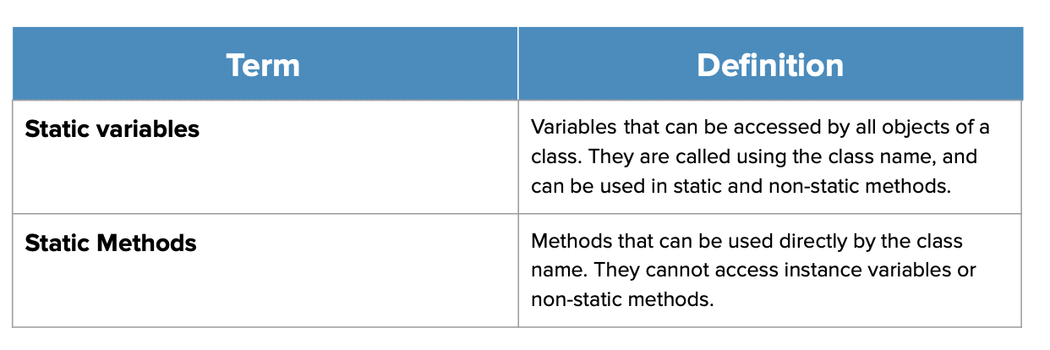
Vocab (recap)
be sure to: Keep your notebook open. These should be in your notes already! If not, copy the definition in your notebook.

Slide 5
Coding to lean: Independent work
Remain your workstation. Read BSTs below.
be sure to:
Work on following problems in CodeHS:
5.375: Randomizer Class
5.7.6: Rock, Paper, Scissors
5.3.7 How many players in the game?
If you have a question, ask!
complete any remaining assignment for homework!
Vocab:
Notes:
See solution references at: https://codehs.com/lms/assignment/55325744/lesson_plan?section_id=256470
Pre-planned Qs for 5.7.5:
+how does the nextInt(min, max) method work? The formula for creating a random number is (Math.random() * range) + min. In order to get the correct numbers for this, students should find the range by subtracting the min range from the max. Then, use the min as the minimum value in the Math.Random formula to create the correct range.
Pre-planned Qs for 5.7.6:
+How can I tell who won? Students will have to create the getWinner method with a series of scenarios for who should win. Essentially, this method should test what the computer put compared to the user. Students should use .equals to compare the responses to determine which player has won.
Pre-planned Qs for 5.7.7:
+Where should I be using the instance variable? +When a new team is created, totalTeams should increase by one. Both variables will be needed to complete the comparison in tournamentReady.
+How do I implement tournamentReady? The tournament is ready to proceed if the total number of teams signed up is at least minTeams. Compare the two static variables and return the result of the comparison.

Slide 6
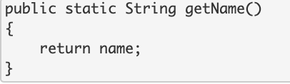
Reflection & wrapping up
be sure to:
Get out your notebook. Answer the questions below with a complete sentence for each:
What makes static methods and variables different from other sorts of constructs?
What will happen if the method below is run? Why?
Be prepared to share out!
Notes:
a. answer: Static variables belong to a class, and all objects of the class share a single static variable.
b. An error will be thrown because a static method cannot access instance variables.

