Slide 1
Fall 2021 Precalc
Lesson 1.2
Dr. O’Brien
Herbert H. Lehman High School
3 February 2022

Slide 2
Do Now
Be sure to…Get out your notebook/binder. Read the paragraph below carefully, then answer the the system of equations below. Show all work and check your results!
$$x+2y=1$$
$$5x-4y=-23$$
Notes:
y = 0.5 - 0.5x
5x - 4(0.5 - 0.5x) = -23
5x -2 + 2x = -23
3x = 25
x = 25/3

Slide 3
B24 rules
Welcome to our new room, B24! Please read the information below:
When you come in, please find a seat at a desk (if one’s available) or one of the six closest desks to the screen. Do not sit in the back of the classroom. We’ll conduct the do now and mini lesson from here.
When I dismiss you for independent work, find a sit at one of the computer workstations.
No food or drink by the computers.
At the end of the period, you’ll be directed to assemble for the exit ticket/debrief. Log out of your computer, and quietly return to a seat near the front.

Slide 4
framing
what: use substitution to solve real world problems.
why: Systems of equations are useful in situations where variables must satisfy two or more conditions. E.g. cost and revenue per units sold.
where to: Using elimination to solve any system of equations

Slide 5
Vocabulary (review)
System of equations
A set of two or more equations that share the same variables.
solution
An ordered pair $(x,y)$ that solves each equation in a system.
Solving a system of equations: finding all the solutions for a system of equations

Slide 6
Warm-up
No-solution case
$-x+y=4$ (1)
$x^{2}+y=3$ (2)
Follow along in your notes, but try to stay one step ahead.
Notes:
DO WORK BELOW IN BOARD. // INDICATES COMMENT (RIGHT SIDE OF BOARD):
solve for y in (1):
y = 4 - x
substitute y into (2):
//write (2)
x - y = 2.
//subsitute 4-x
x - (4 -x) = 2
//distribute -
x - 4 + x = 2
//combine like terms and solve
2x - 4 = 2
2x = 6
x = 3
//**back-substitute** 3 into (1)
//write revised (1)
y = 4 - x
//y = 4 - 3
y = 1
solution: (3,1).
+How do we check this solution?
plug solution into each eq.
x + y = 4
3 + 1 = 4
3 - 1 = 2

Slide 7
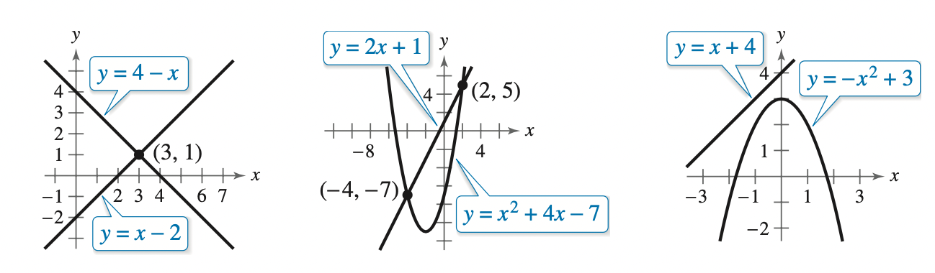
Warm up: 3 possibilities
Notes:
DO WORK BELOW IN BOARD. // INDICATES COMMENT (RIGHT SIDE OF BOARD):
two-solution case.
//solve (2) for y
y = 2x + 1
//write (1), substitute, and distribute -
x^2 + 4x - y = 7
x^2 + 4x - (2x+ 1) = 7
x^2 + 4x -2x - 1 = 7
//combine like terms and solve
x^2 +2x - 1 = 7
x^2 + 2x -8 = 0
(x+4)(x-2) = 0
x = -4,2
//back substitute both values into (2)
y = 2(-4) + 1 = -7
solution 1: (-4,-7)
y = 2(2) + 1 = 5
solution 2: (2,5)
Check.
NO SOLUTIONS
y = 4 -x // solve (1) for y
x^2 +4 - x = 3
x^2 - x + 1 = 0
//quadratic form.
x = ((-1) +/- sqrt( 1 - 4(1)(1)) ) / (2)
This gets us a negative sqrt, so no real solutions

Slide 8
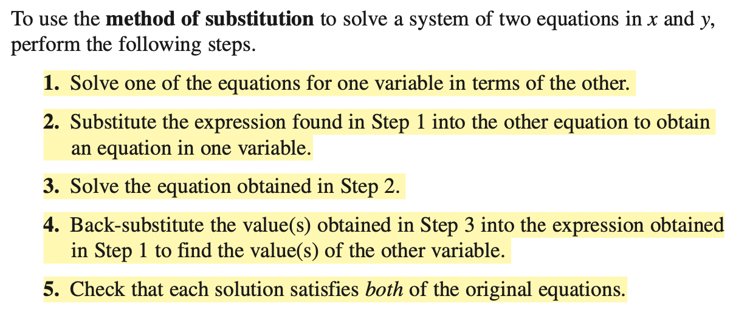
Mini-lesson: review
Be sure to…copy in your notes
Notes:
DO WORK BELOW IN BOARD. // INDICATES COMMENT (RIGHT SIDE OF BOARD):
two-solution case.
//solve (2) for y
y = 2x + 1
//write (1), substitute, and distribute -
x^2 + 4x - y = 7
x^2 + 4x - (2x+ 1) = 7
x^2 + 4x -2x - 1 = 7
//combine like terms and solve
x^2 +2x - 1 = 7
x^2 + 2x -8 = 0
(x+4)(x-2) = 0
x = -4,2
//back substitute both values into (2)
y = 2(-4) + 1 = -7
solution 1: (-4,-7)
y = 2(2) + 1 = 5
solution 2: (2,5)
Check.
NO SOLUTIONS
y = 4 -x // solve (1) for y
x^2 +4 - x = 3
x^2 - x + 1 = 0
//quadratic form.
x = ((-1) +/- sqrt( 1 - 4(1)(1)) ) / (2)
This gets us a negative sqrt, so no real solutions

Slide 9
Real world examples
Be sure to…Follow along in your notes, but try to stay one step ahead.
How do we find the dimensions of a rectangular track of land with a perimeter of 40 miles and an area of 96 square miles?
Notes:
x = length
y = width
2x + 2y = 40
xy = 96
y = 20 - x
x(20 -x) = 96
20x - x^2 -96 = 0

Slide 10
Independent work: Work on each problem. Show all work. Be prepared to share out
Practice Problem 1
A small business invests $10,000 to produce a new kind of super hot tortilla chip. Each package costs $0.65 to produce and is sold for $1.20. How much has to be sold for the company to break even?
Write two functions $R(x)$ and $C(x)$ to represent revenue and cost.
What does $x$ represent in these functions?
Use substitution to determine how many chips need to be sold for the company to break even.
Practice Problem 2
You are deciding how to invest a total of $20,000 in two funds paying 5.5% and 7.5% simple interest. You want to earn a total of $1300 in interest annually.
Write a system of equations to represent this problem. Let $x$ and $y$ represent the amounts invested at 5.5% and 7.5% respectively.
How much of the $20,000 should you invest at 5.5% to earn $1300 in interest per year? Explain you reasoning.
Notes:
see next two pages for preplanened qs and solutions

Slide 11
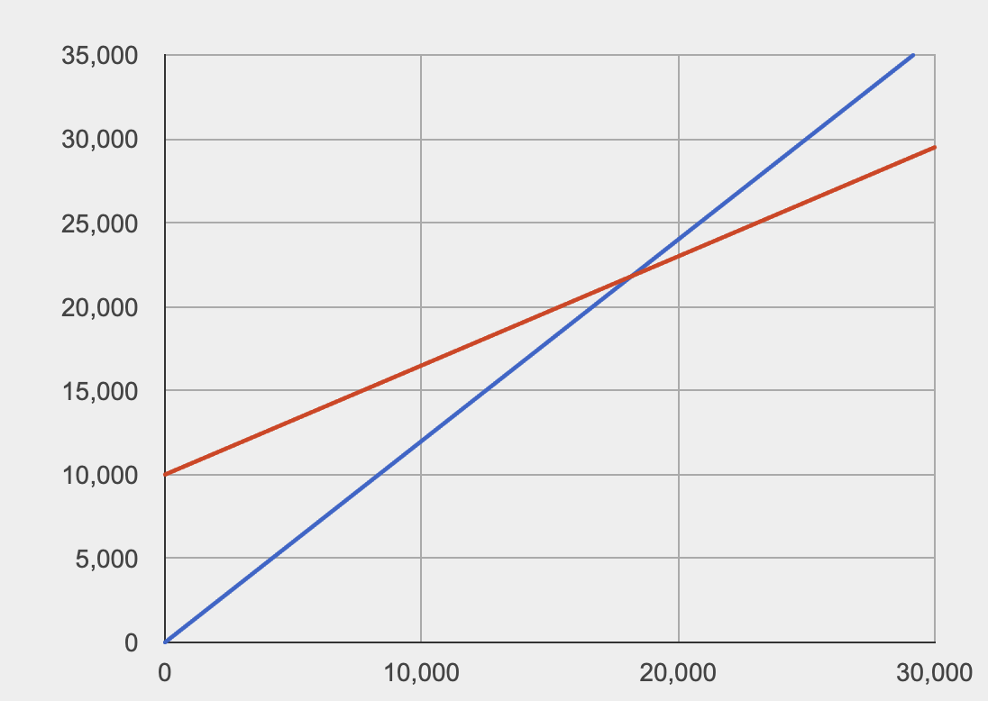
Practice problem #1
Be sure to…Follow along in your notes, but try to stay one step ahead.
A small business invests $10,000 to produce a new kind of super hot tortilla chip. Each package costs $0.65 to produce and is sold for $1.20. How much has to be sold for the company to break even?
Write two functions $R(x)$ and $C(x)$ to represent revenue and cost.
What does $x$ represent in these functions?
Use substitution to determine how many chips need to be sold for the company to break even.
Notes:
R(x) = 0.65x + 10000
C(x) = 1.2x
We want to know hwen C(x) = R(x) in other words
C(x) = 0.65x + 10000
C(x) = 1.2x
subsitution:
1.2x = 0.65x + 10000
0.55x = 10000
x = 10000/0.55 = 18181.8181818
About 1818 bags of chips need to be sold for the company to break even.

Slide 12
Practice problem #2
You are deciding how to invest a total of $20,000 in two funds paying 5.5% and 7.5% simple interest. You want to earn a total of $1300 in interest annually.
Write a system of equations to represent this problem. Let $x$ and $y$ represent the amounts invested at 5.5% and 7.5% respectively.
How much of the $20,000 should you invest at 5.5% to earn $1300 in interest per year? Explain you reasoning.
Notes:
x = amount invested in fund 1
y = amount invested in fund 2
x + y = 12000 (eq. 1)
0.09*x + 0.11*y = 1180
+HDW apply substitution to solve this system?
could go in either direction
y = 12000 - x
0.09x + 0.11(12000 - x) = 1180
0.09x + 1320 - 0.11x = 1180
-0.02x = -140
x = 7000
y = 12000 - 7000 = 5000
solution: (7000, 5000)

Slide 13
wrapping up!
be sure to: read the directions below!
Make sure there isn’t any litter near your workstation.
If you borrowed headphones, sign them back in.
Make sure you are logged out of your computer!
Remain in your seat until the bell rings.

