Slide 1
Fall 2021 Python
Lesson 6.2
Dr. O’Brien
Herbert Lehman High School
Oct. 26, 2021

Slide 2
Do now
be sure to: find seat near the board. Get out your binder and answer the do now questions below. Show all work or answer each question with a complete sentence.
How close are you to completing your work for this marking period?
What are two things you can do to help your classmates do well this marking period?
MP1 requirements:
Complete all CodeHS Lessons, Unit 2
Complete Assessment #1
Complete Turtle Art project (Assessment #2)
Notes:
A. Answers vary. Many students need to finish assessment 2.
B. Work quietly. Don’t distract your neighbor. Stay in your seat coach if asked.

Slide 3
Reminders:
Coaches should...
Answer student questions.
Provide hints.
Coaches shouldn’t...
Talk to one student for for than a few minutes.
Touch other students keyboards. Ever.
Just tell students exactly what to do.
MP1 requirements:
Complete all CodeHS Lessons, Unit 2
Complete Assessment #1
Complete Turtle Art project (Assessment #2)
Notes:
Mp1 ends this week! Some of you really need to focus.

Slide 4
The rest of the day
be sure to: find your assigned seat. Log in to CodeHS. Begin work!
Group A
Find your assigned seat (ask Dr. O’Brien)
Read through the MP1 requirements below.
Begin work! Raise your hand quietly if you have any questions
Group B
Take seat at front desk.
Keep out notebook and pen.
People in group B: Jatlmir G.
Alexis L.
Melvin M.
Kevin R.
Naz T.
MP1 requirements:
Complete all CodeHS Lessons, Unit 2
Complete Assessment #1
Complete Turtle Art project (Assessment #2)
Notes:
Make sure students are working quietly. See problem guides for specific Python activities.
Frequently asked questions:
+I don’t know what to do!?! Make sure to carefully read the instructions. Take notes when watching the video.
+What are you trying to make tracy do?
+how can I figure out why my code doesn’t work? Try getting out a piece of paper, and following your commands yourself. What do you draw. Where do things go wrong?
+What do I do if I forget a command? See the docs section of CodeHS.

Slide 5
The rest of the day
be sure to: find your assigned seat. Log in to CodeHS. Begin work!
Group A
Find your assigned seat (ask Dr. O’Brien)
Read through the MP1 requirements below.
Begin work! Raise your hand quietly if you have any questions
Group B
Take seat at front desk.
Keep out notebook and pen.
People in group B: Emanie C
Emmanuel I
Elijah L
Brenda Q
MP1 requirements:
Complete all CodeHS Lessons, Unit 2
Complete Assessment #1
Complete Turtle Art project (Assessment #2)
Notes:
Make sure students are working quietly. See problem guides for specific Python activities.
Frequently asked questions:
+I don’t know what to do!?! Make sure to carefully read the instructions. Take notes when watching the video.
+What are you trying to make tracy do?
+how can I figure out why my code doesn’t work? Try getting out a piece of paper, and following your commands yourself. What do you draw. Where do things go wrong?
+What do I do if I forget a command? See the docs section of CodeHS.

Slide 6
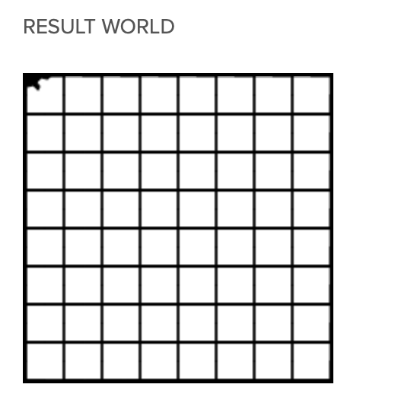
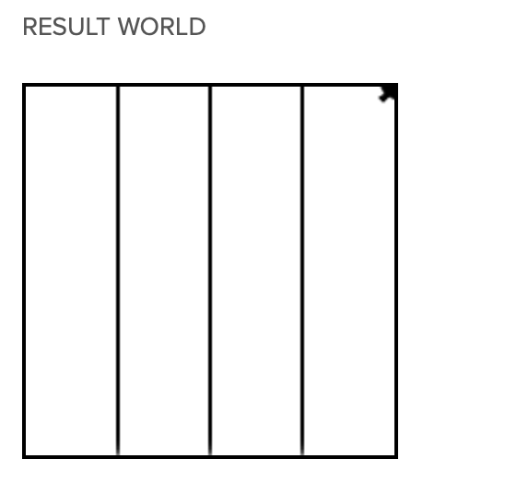
Assessment #1: hospital
What similarities do you notice between these two result worlds?
How can you use your code from 2.4 to finish the assessment?
Lesson 2.4: four columns
Assessment #1
Notes:
+How does the 2.4 problem resemble the Assessment #1 problem? They both involve making columns, repeating the same action.
+hdw use the code from 2.4? You can reuse your code you just need to make the columns smaller and add horizontal columns
+ how do you draw columns? (illustrate on board).

Slide 7

Warm up (answer in notebook)
Examine the picture to the right:
Do you think a computer was used to create this image? Explain why or why not.
In what ways might computers be useful to create art? Explain in at least one complete sentence.
Notes:
+for students are starting the art project (this and subsequent slides):
+In what ways might computers be detrimental to creating art?
+What sorts of computational structures are needed to create an image like the one
This is something called ‘algorithmic art’.

Slide 8



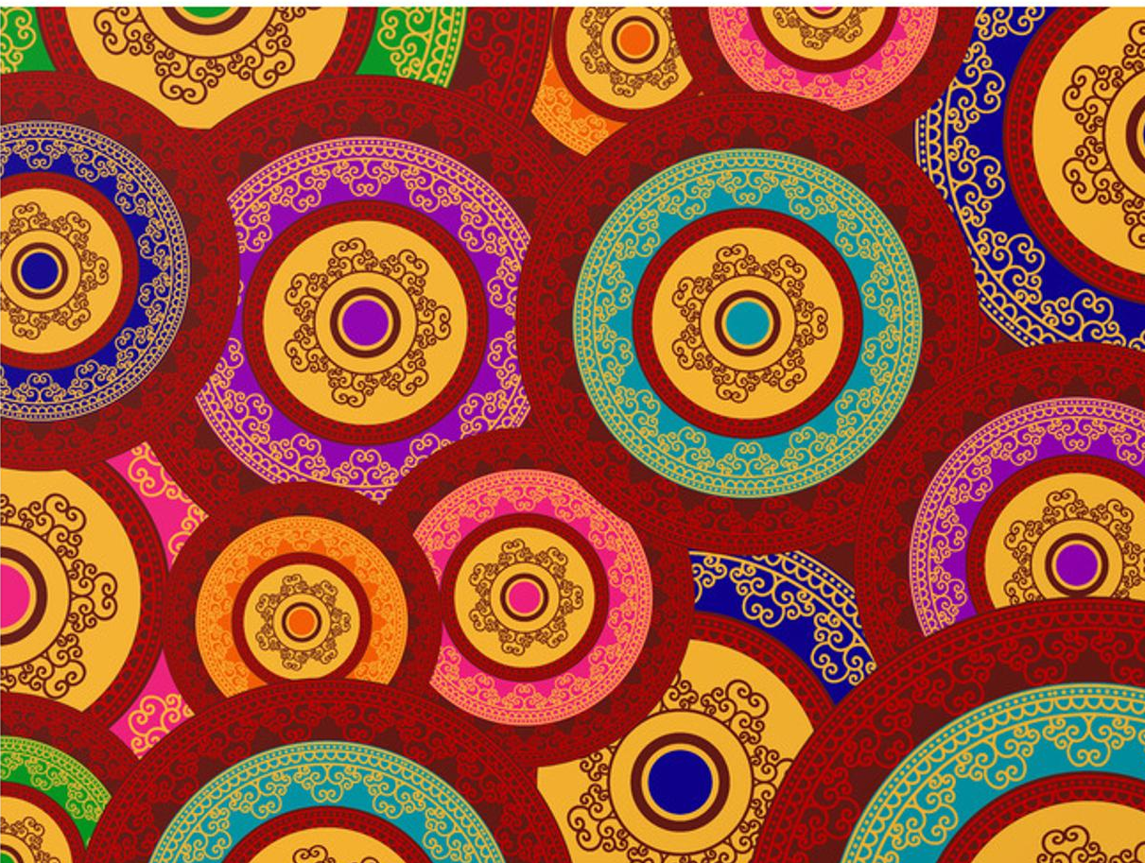
Making art with Turtle Graphics
Part 1: Find/Create an image
You need an image to reproduce using Turtle Graphics.
For any image, be sure to include some sort of pattern that can be reproduced using Python & Turtle Graphics (Check w/ Dr. O'Brien if you're not sure).
Notes:
Examples are on the right.
You’ll need to use color, functions, and loops in your project.

Slide 9
Making art with Turtle Graphics
Part 1: Find/Create an image
two options:
1. Create your own image, take a picture and post it in your google doc.
2. Find an image online. If you find the image online, write a paragraph explaining why you think it's appropriate, along with what you like about it. Paste image and description into your Google Doc.
Complete part 1 by the end of period !!!!

Slide 10
Making art with Turtle Graphics
Part 2: recreate image using turtle graphics
Your image should include all of the techniques we've learned in class
You need the following:
a. Use loops
b. use of functions
c. use of artistic effects (of course!)

