Slide 1
Fall 2021 Precalc
Lesson 6.3
Dr. O’Brien
Herbert H. Lehman High School
16 March 2022
Notes:
VOCAB
identity matrix

Slide 2
Do now…Get out your notebook/binder. Write down the date and goal. Be Sure to copy the cheat sheet below and carefully answer the Warm up question on the left board,both in your notebook.
Cheat sheet
Convert linear system to $AX=B$.
Make Augmented matrix $[A|I]$.
Using Gauss Jordan elimination: $[A|I]→[I|A^{-1}]$
Use $X=A^{-1}I$ to find the missing variables.
A: Coefficient matrix
$A^{-1}$: Inverse of A
X: Variable matrix
B: Solutions matrix
Notes:
answers will vary. students might notice that A almost looks like an identity matrix, except that the top left pivot is 2 instead of 1
This will be identical to B except taht the elements of the first row will be X2

Slide 3
framing
what: Using matrix inverses to solve systems of linear equations
why: Using Gauss-Jordan elimination to find matrix inverses makes it easy to solve large system of linear equation problems
where to: Using matrix multiplication to perform Gaussian elimination

Slide 4
B24 rules
Welcome to our new room, B24! Please read the information below:
When you come in, please find a seat at a desk (if one’s available) or one of the six closest desks to the screen. Do not sit in the back of the classroom. We’ll conduct the do now and mini lesson from here.
When I dismiss you for independent work, find a sit at one of the computer workstations.
No food or drink by the computers.
At the end of the period, you’ll be directed to assemble for the exit ticket/debrief. Log out of your computer, and quietly return to a seat near the front.

Slide 5
Independent work…
Be Sure to Complete problems on both boards. Use cheat sheet (copy in notes if you haven’t done so yet. Check in w/ Dr. O’Brien to make sure you get the right answer. Work on Pset #4 when you’re done.
Cheat sheet
Convert linear system to $AX=B$.
Make Augmented matrix $[A|I]$.
Using Gauss Jordan elimination: $[A|I]→[I|A^{-1}]$
Use $X=A^{-1}I$ to find the missing variables.
A: Coefficient matrix
$A^{-1}$: Inverse of A
X: Variable matrix
B: Solutions matrix
Notes:
answers will vary. students might notice that A almost looks like an identity matrix, except that the top left pivot is 2 instead of 1
This will be identical to B except taht the elements of the first row will be X2

Slide 6
Today’s activity: practice problems
Today we’ll be working on Pset #4.
If you choose to work in a group with Dr. O’Brien
Be sure to:
Sit at a desk.
Ask questions!
If you feel confident enough to do the pset on your own…
Be sure to:
Move to a seat near a computer.
Follow directions carefully. For each problem show all work or answer in a complete sentence.
Feel free to work with a partner!

Slide 7
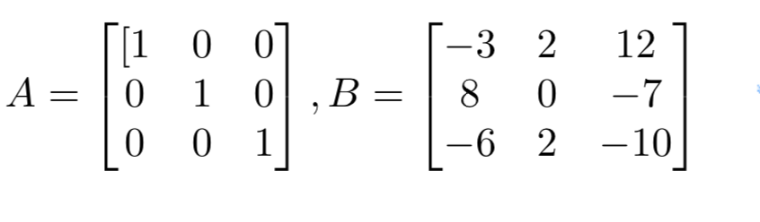
Problem (1d)
Identity matrix
An $n×n$ matrix with 1s on its main diagonal and zeros everywhere else. Denoted by $I$. Multiplying any compatible matrix $A$ by $I$ results in the original matrix A.
Notes:
Why Can these matrices be multiplied? Because A has 3 columns and B 3 rows.
What do you notice about the product of A and B? It’s identical to B.
Do you think the order of operations matter here (ie does AB=BA?) no the output will be B no ,after what.

Slide 8
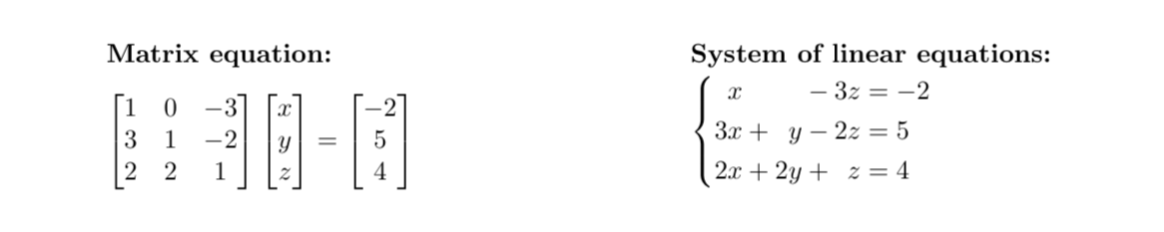
Problem (2b)
Why is the matrix equation below equivalent to the system of linear equations?
Notes:
Coefficient matrix A times variable matrix x equals the left hand side of the equation. Matrices are only equal if each element of one matrix is equal to the corresponding element of the other.

Slide 9
Reflection
Reflection:
be sure to: Answer each question below with a complete sentence. Be prepared to share out!
How is matrix multiplication similar to matrix addition? How is it different?
Why do you think matrix multiplication is defined the way it is?

Slide 10
wrapping up!
be sure to: read the directions below!
Make sure there isn’t any litter near your workstation.
If you borrowed headphones, sign them back in.
Make sure you are logged out of your computer!
Remain in your seat until the bell rings.

