Slide 1
Fall 2021 AP CS A
Lesson 3.4
Dr. O’Brien
Herbert H. Lehman High School
16 February 2022

Slide 2
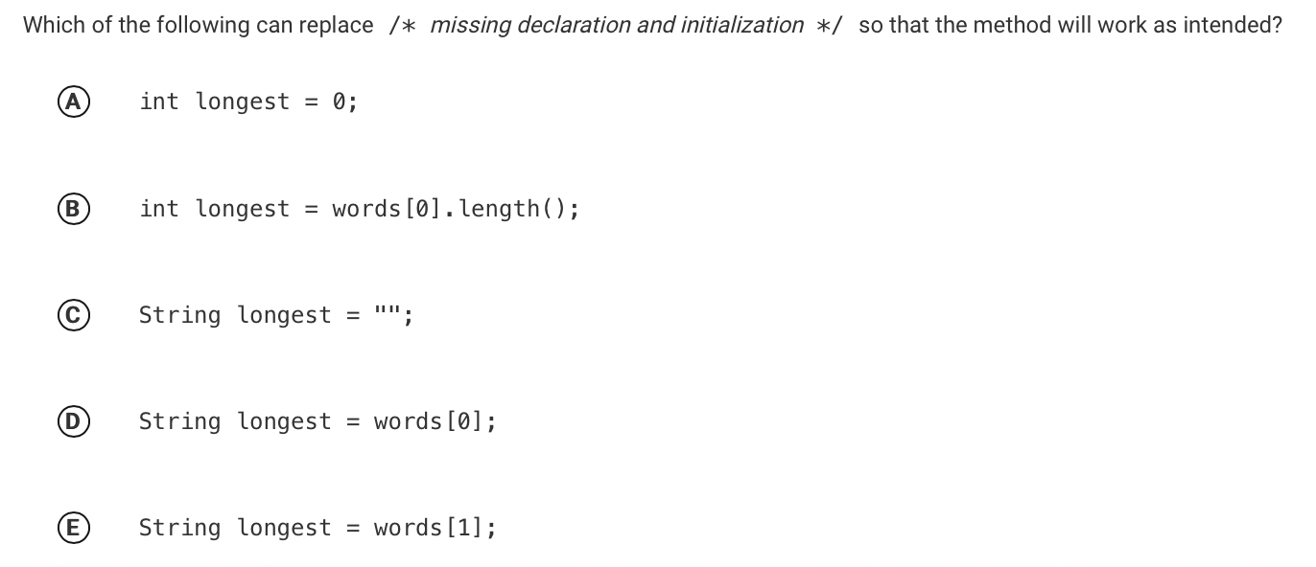
Do now
be sure to: Get out your binder. Copy goal and answer do now questions below. Show all work or write a complete sentence for each answer:
Consider the following incomplete method, which is intended to return the longest string in the string array words. Assume that the array contains at least one element.
public static String longestWord(String[] words)
{
/* missing declaration and initialization */
for (int k = 1; k < words.length; k++)
{
if (words[k].length() > longest.length())
{
longest = words[k];
}
}
return longest;
}
Which of the following can replace /* missing declaration and initialization */ so that the method will work as intended?

Slide 3
Activity
be sure to: Take notes and answer questions in your notebook.
Work with a partner:
Work on the review pset. If you disagree on an answer, try to come to a consensus. If you have a question, feel free to ask me.
Be prepared to share out your answers! We’ll go over the problems at the end of class.
Notes:
Review pset should have been assigned the day before as homework

Slide 4
How to review
To review for the test, please:
Go through your notes.
Look over your review pset

