Slide 1
Fall 2021 Java
Lesson 8.3
Dr. O’Brien
Herbert H. Lehman High School
November 10, 2021
Notes:
VOCAB:
for loop, boolean expression, variable initialization, increment

Slide 2
Coding to learn: CodeHS activity
be sure to: Go to your workstation. Log in to codeHS. Carefully read the instructions below, then complete the assignments on CodeHS
While loop
Repeats a set of statements until a condition is met.
Today we’ll be working on while loop and for loop problems on CodeHS
Make sure the vocab to the write is copied in your Java Glossary.
Work on the lessons listed to the right
Make sure you also complete the Reflection activity at the end of 4.2.
For loop
Repeats a set of statements a specific number of times.
Exercise 4.1.6: Making Taffy
Exercise 4.2.6: Print the Odds
Exercise 4.2.10: Multiplication table
Notes:
See CodeHS problem guides for full solutions.
Possible questions:
+Why do I need to initialize the temperature variable outside of the while loop (ex. 4.1.6)? Because it’s part of the condition for the while loop, so it needs to be initialized before you enter the while loop for the first time.
+How do I only print odd numbers? Think about how you can manipulate the increment in your loop?
+ How do I print out the counter (lesson 4.2)? Remember that the counter is just a variable, so you can concatenate it with strings.

Slide 3
framing
what: use for loops loops to iterate code in Java
why: Along with the while loop, for loops are basic control structures that are crucial to any programming language. Today we’ll explore them in Java.
where to: Basic algorithms that use loops.

Slide 4
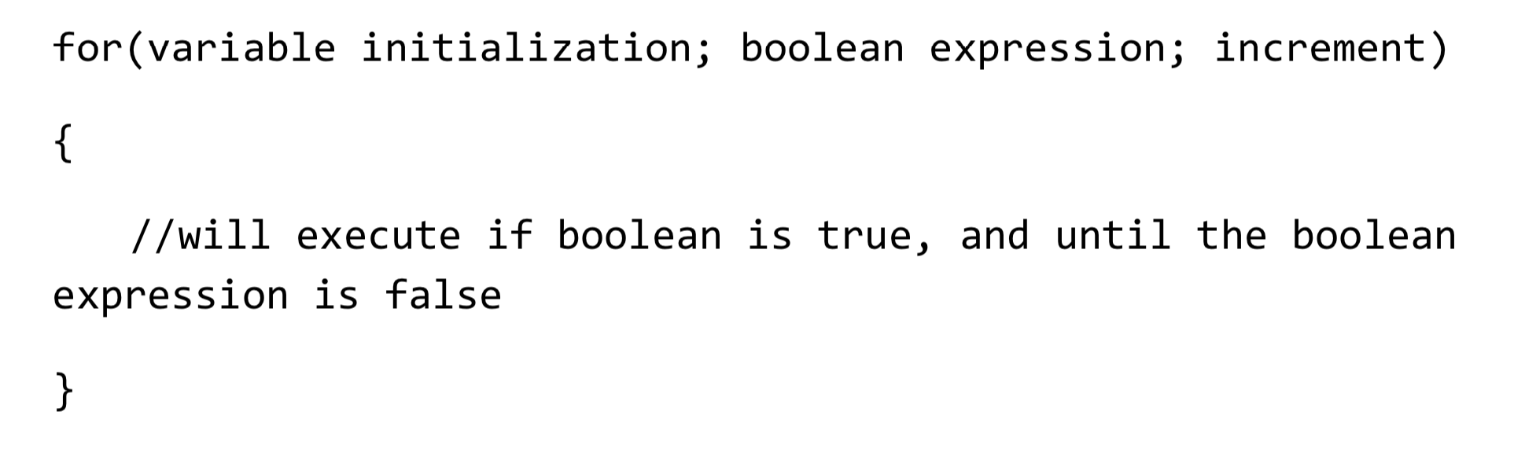
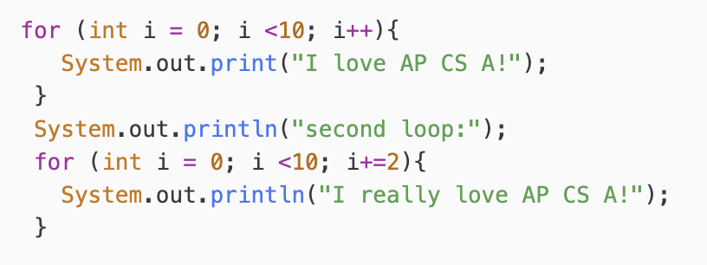
Vocab
be sure to: Keep your notebook open. Copy each definition, including the code sample, in your Java Glossary.
For loop
Variable initialization gives us the starting value for the counter.
Boolean expression sets the upper bound.
Increment sets how the counter changes with each iteration.
Notes:
copy in notes
Important thing to notice, increemnt can decrease as well as increase, or change by whatever increment/decrement we want.

Slide 5
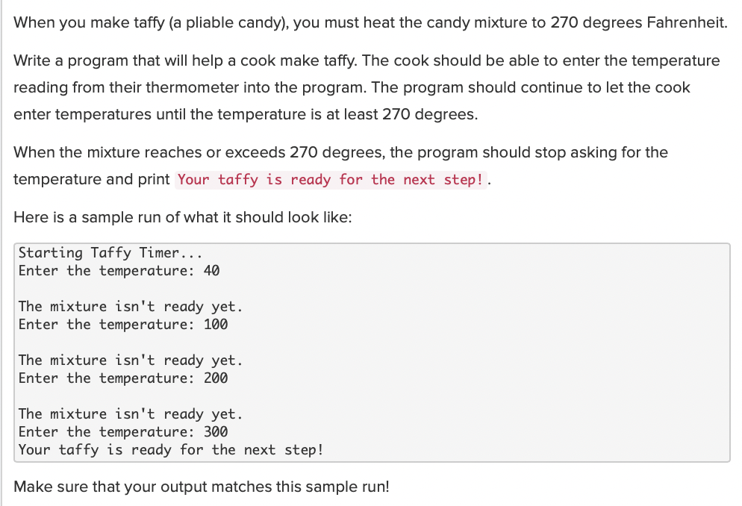
Coding to learn: CodeHS activity
be sure to: Go to your workstation. Log in to codeHS. Carefully read the instructions below, then complete the assignments on CodeHS
4.1.6: Making taffy:
Notes:
See pre-planed questions on slide 2. Problem guide for fuly worked out solution

Slide 6
Coding to learn: CodeHS activity
be sure to: Go to your workstation. Log in to codeHS. Carefully read the instructions below, then complete the assignments on CodeHS
4.2.6: Printing the odds:
Write a program that prints the odd numbers from 1 to 100.
Notes:
See pre-planed questions on slide 2. Problem guide for fuly worked out solution

Slide 7
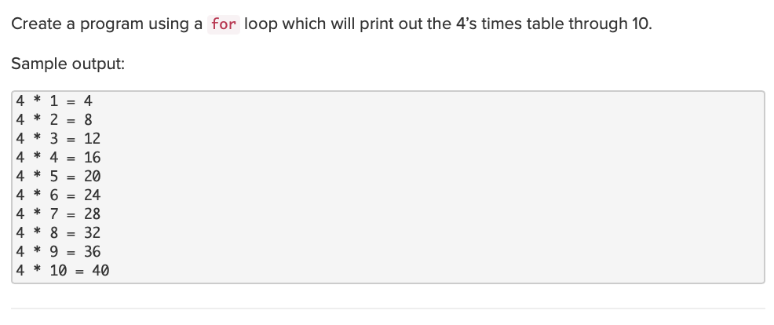
Coding to learn: CodeHS activity
be sure to: Go to your workstation. Log in to codeHS. Carefully read the instructions below, then complete the assignments on CodeHS
4.2.10: Multiplication table:
Notes:
See pre-planed questions on slide 2. Problem guide for fuly worked out solution

Slide 8
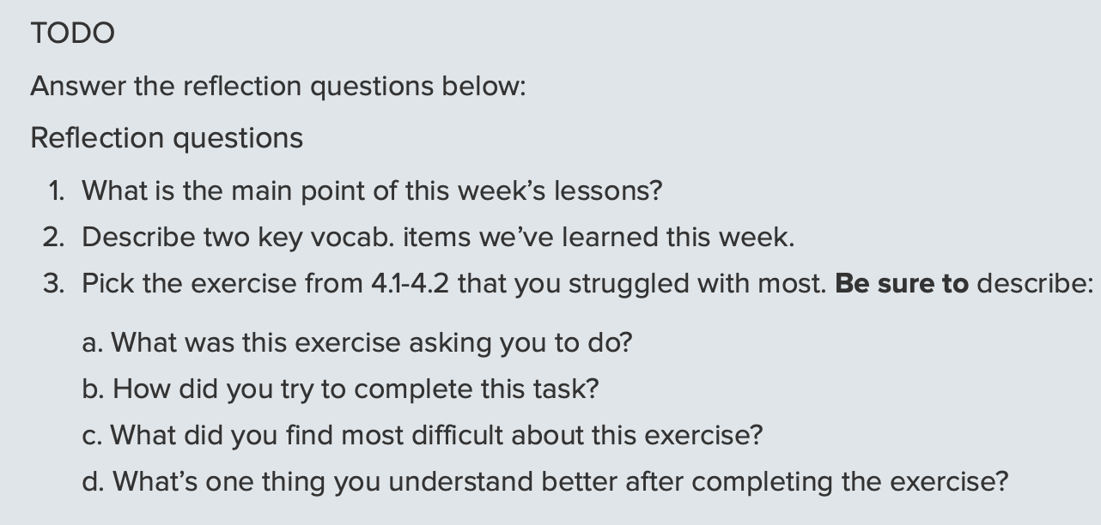
Writing to learn: CodeHS Reflection activity
be sure to: Go to your workstation. Log in to codeHS. Carefully read the instructions below, then complete the assignments on CodeHS
Notes:
answers will vary. Students will share out answers.

Slide 9
Writing to learn: Thinking about thinking
be sure to: Answer each question below with a complete sentence.
How are for loops and while loops different?
If we have while loops, why do we need for loops?
Why do you think the same control structures are used in different programming language, including Python and Java?
Notes:
For loops work better when there is a predetermined number of iterations and while loops work better when there is an undetermined number of iterations.
They reduce the amount of code that needs to be written in a program, and help decrease the amount of redundant code in a program.

